Slide 1
Creating Class Culture & Community
An Introduction to Classroom Management

Slide 2
Agenda
Before the Students Walk In
Objectives
Expectations
Positive Consequences
Entrance Structures
During the Lesson
Excusing Students
Encouraging Empathy
Modeling Empathy
Last Thoughts
Link to audio “narrated” version of this presentation

Slide 3
Objectives
Before anything, set objectives. What is your end goal? Just like any academic standard, set ones for your students. Here are a few of my major ones:
Students will:
Come in quietly and get started on work without teacher intervention
Be active, respectful listeners when their peers and teacher are talking (whole-class and small-group)
Say “thank you” when appropriate (e.g. holding open the door for them)
Notes:
In middle school, my students don’t come in the first few weeks unless they’re allowed. If you have them wait outside and there is room, I would have students wait in lines against the wall the first few weeks. For high school, I let them come in if the door is open and the room is clear of students from previous class, save a few stragglers

Slide 4
Expectations
Expectations are basically the objectives in simple, student-friendly terms, what I advertise on a poster in the class (at least at the beginning of the year)
I’ve had classes:
where I’ve just had one rule: “Show respect”
where I had three
Show respect to peers and teachers
Come to class ready and willing to learn
Take responsibility for your own actions
where I needed to be more specific—e.g. “raise your hand” or “Don’t talk while others are talking”
and where the students came up with the rules together, consequences, and we all signed it
The maximum # of rules I’ve ever had was five, as I believe anything more waters down the other ones

Slide 5
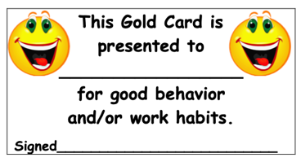
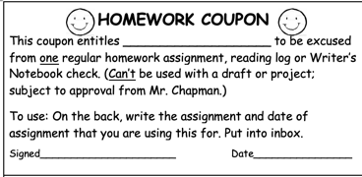
Positive Consequences
Use positive reinforcement when possible (it makes a world of difference):
“Thank you Eugenia for coming in quietly. Thank you Table 1 for cleaning up first.”
Email home for positive behavior or improvement (I literally call or email every home in the first month for a positive reason)
Table Tickets for groups (or individual tickets for students)
“Gold Cards” for going above and beyond or small acts of kindness
Depending on the age level, 3-5 Gold Cards = Homework Coupon
Turn something negative into something positive
If you contact home for a negative reason, always say that you’ll contact them the following week with an update (this gives it a silver lining, and sets them up for a positive email the following week)

Slide 6
Entering the Classroom
The way students enter the classroom sets the tone for your lesson. So ideally:
Students come in quietly when you are ready for them to come in; if they don’t do it right, have them do it again: individually or as a class, at the time or—if it happens a lot—at break;
Don’t make it a big deal: calmly say to the student, “Try it again” (by now, my students usually just need a look for me, or if need be a finger-point to the door)
There is some kind of “Do Now” on the board or standard procedure that students follow whenever they come in;
Students should never come up to you at the beginning of class to ask a question—unless it’s an emergency (whether they can before class is your choice)
Have music playing (e.g.: “meditation”, guitar, soundtracks, classical)
Have an unobtrusive lateness system
e.g. A minute detention for every minute late or a sign-in clipboard
Notes:
In my middle school, my students don’t come in the first few weeks unless they’re allowed. If you have them wait outside and there is room, I would have students wait in lines against the wall the first few weeks. For 8th grade/high school, I let them come in if the door is open and the room is clear of students from previous class, save a few stragglers. Really depends on your students
Don’t make a big deal out of things that aren’t a big deal (in other words, there’s no need to interrupt the whole class to lecture a student on lateness)
Clipboard for latenesses

Slide 7
During the Lesson
100% (90% isn’t good enough)
If there’s a rule/expectation, enforce it 100% in the least obtrusive way possible
Use an on-board timer so students can see exactly how much time they’re wasting…and that they have to take responsibility for it;
Bell: when you ring it, they say “Yes, sir!” or “Yes, ma’am!”
During independent work, use silent communication as much as possible
Don’t waste time arguing with a student in class (“I argue at 3 PM”)
Students have the right to ask for an explanation from you or explain something to you, but the middle of class is not the place
Have students take responsibility for own discipline
Have them write a letter to you convincing you why you don’t need to contact home or have them call their own parents (especially effective for cheating/plagiarism)
Don’t just pick your battles; avoid them!
e.g. Instead of wasting time in the middle of class lecturing a student about not bringing a pencil, maybe you have a can of pencils with your name on it on your desk…or you just give the student a pencil (and follow-up if it happens regularly); instead of getting into an argument about “Whose trash is this?!”, simply ask, “Sam, can you do me a favor and pick that up?”
Notes:
• Keep advisors informed and show your students that the admins will back you up as needed, but know that you are in charge of your own classroom. When there is a consequence for poor behavior, make sure you implement it;
• I give students one free minute; if it goes above 59 seconds, they come in during break for a minute. If it goes above two minutes, it’s two minutes at break.
• “I argue at 3 pm”

Slide 8
Leaving the Classroom
As a favor to yourself and the teacher that has your students after you:
Most important, remind the students that you excuse them, not the bell;
Have students stay in their seats until you excuse them, and push in their chairs on way out;
Again, keep the 100%: if a student is starting to walk out without pushing in their chair, have them come back and do it
Personally, I excuse students by table groups (you could do it by row) so it’s not so chaotic.
If your students leave your class orderly, they’re more likely to be that way in the hallway and especially for their other teachers

Slide 9
Make Empathy Important
Hold open the door and have a student video with your phone camera as they walk in the classroom; then put it on the projector
To set the tone, ask them to write thank you notes on the first day of school to someone
Supplies needed (Letter/A4 paper cut in half)
Ask them to reflect on “How are you going to change the world today?”

Slide 10
Most Important Rule I’ve Learned
You are your students’ model of empathy: as people, treat them as you’d like to be treated:
Don’t be hypocritical about the rules;
e.g. I have my phone on airplane mode, and if I forget and it goes off—which has happened 2-3 times over the years—they get to “take it away” and give it to the dean
Model politeness at all times, regardless of what’s going on in your life; it’s amazing how far words like “please” and “thank you” go when you use them with your students;
Personally, I use the term “ma’am” and “sir” when I don’t know a student’s name, like in the hallway, but I also say it to my students all the time too
Be willing to apologize when you make a mistake or overreact
Show in the way you treat your students that you are in charge and that there is a reason you are in charge—but that you do care about them.
Notes:
Be yourself…but be the best version of yourself

Slide 11
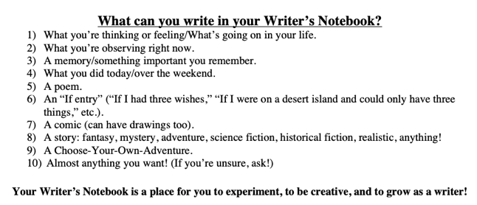
Last Thoughts/Advice
Language
The language you use to describe your kids outside of class seeps into the way you treat them in class
Get to know your students
Don’t yell unless absolutely necessary
Don’t make sending a student outside your normal go-to
Take advantage of your colleagues’ experiences
Behavior Contracts
Anonymous online surveys
Never underestimate regular structure
Set your expectations high
Follow through on your discipline, and “outsource” it only when needed
Continual reflection-in-action
Don’t argue with the data or the feedback: reflect on it

