Slide 1
Creating a Shared Vision
Based on Schools That Deliver by Bill Martin and John Edwards

Slide 2
Agenda
What’s a Shared Vision?
8 Steps to Creating It
After the Fact

Slide 3
Intro Story: Importance of Alignment

Slide 4
Intro Story: Importance of Alignment
Lesson: when we’re aligned as a school, we can be so much more effective for our students

Slide 5
Mission Statement vs Shared Vision
Mission Statement: “statement of overall purpose”
Shared Vision: “clear picture of how our school will deliver on that mission”

Slide 6
Shared Vision as an Alignment Tool
The Shared Vision is used to “get everyone on the same page, speaking with one mind and one voice”
Throughout, people are welcome to disagree with things or discuss them
“However, the Shared Vision clearly states where we are heading and that is not up for discussion.”

Slide 7
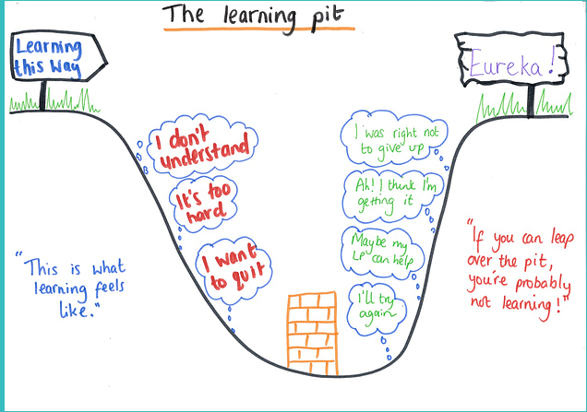
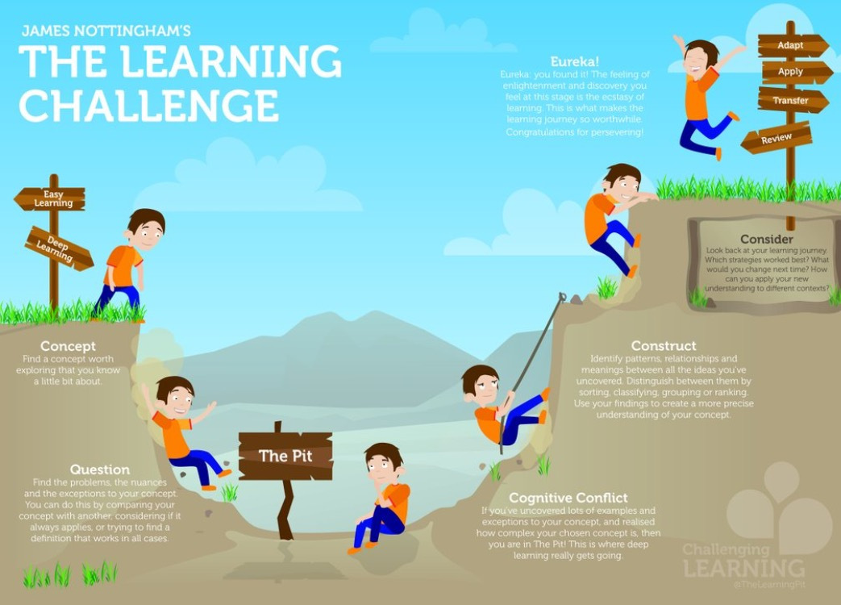
Alignment is Challenging! (The Learning Pit)
v
(more detailed version below this slide)

Slide 8
Schedule: 2-Day Process
Key Words
Personal Practice Knowledge (PPK): what teachers know/believe based on their experiences
Mental Models: our beliefs based on PPK
Classroom management is a curriculum issue
Students must learn to take responsibility for their own learning
Teaching requires deep subject knowledge
Core Values: “are statements of the mental models we are going to live together on our Shared Vision journey”
We value one another’s time
We take personal responsibility for our performance
We respect every voice in our school.
Day 1: Deep Thinking, Reflecting, and Probing
“This draws the mental models and PPK from the Vision Creating Community”
“These form the first drafts of the Shared Vision”
Day 2: Writing the 2nd Draft of Shared Vision
From there, “we can then identify the Core Values and the research themes: the areas that we must address to get where we want to be from where we are now.”
Notes:
Because we’re a bilingual school, we might have to do 4-5 days: half-days in the morning, translation in the afternoon
Day 1 (morning): Coming up with inquiry probes (with translators there)
Day 1 (afternoon): Translators translate questions
Day 2 (morning): Classical Brainstorming (in groups by language, still as diverse as possible) and 10/4 Voting
Day 2 (afternoon): Translators translate ideas into Master List
Day 3 (morning): Voting on Master List (English & Turkish versions available)
Day 3 (afternoon): translators work with writers to create 1st draft of Shared Vision in English & Turkish
Day 4 (morning): Review 1st draft
Day 4 (afternoon): Translators finalize 2nd draft, making sure English & Turkish versions are the same
Day 5: Final draft presented to group

Slide 9
Step 1: Create Vision Creation Team
Some schools invite just teachers, others everybody on staff, others “parent representatives, board members, former students, current students, community or cultural leaders”
Just ensure that the staff feels represented on the team, so when they see the Shared Vision, they feel like they own it, not they’re being “sold it”
Notes:
The chapter kept reiterating: if people don’t feel that their PPK’s are valued, or that their voices are heard…then you won’t have buy-in. A Shared Vision should feel owned

Slide 10
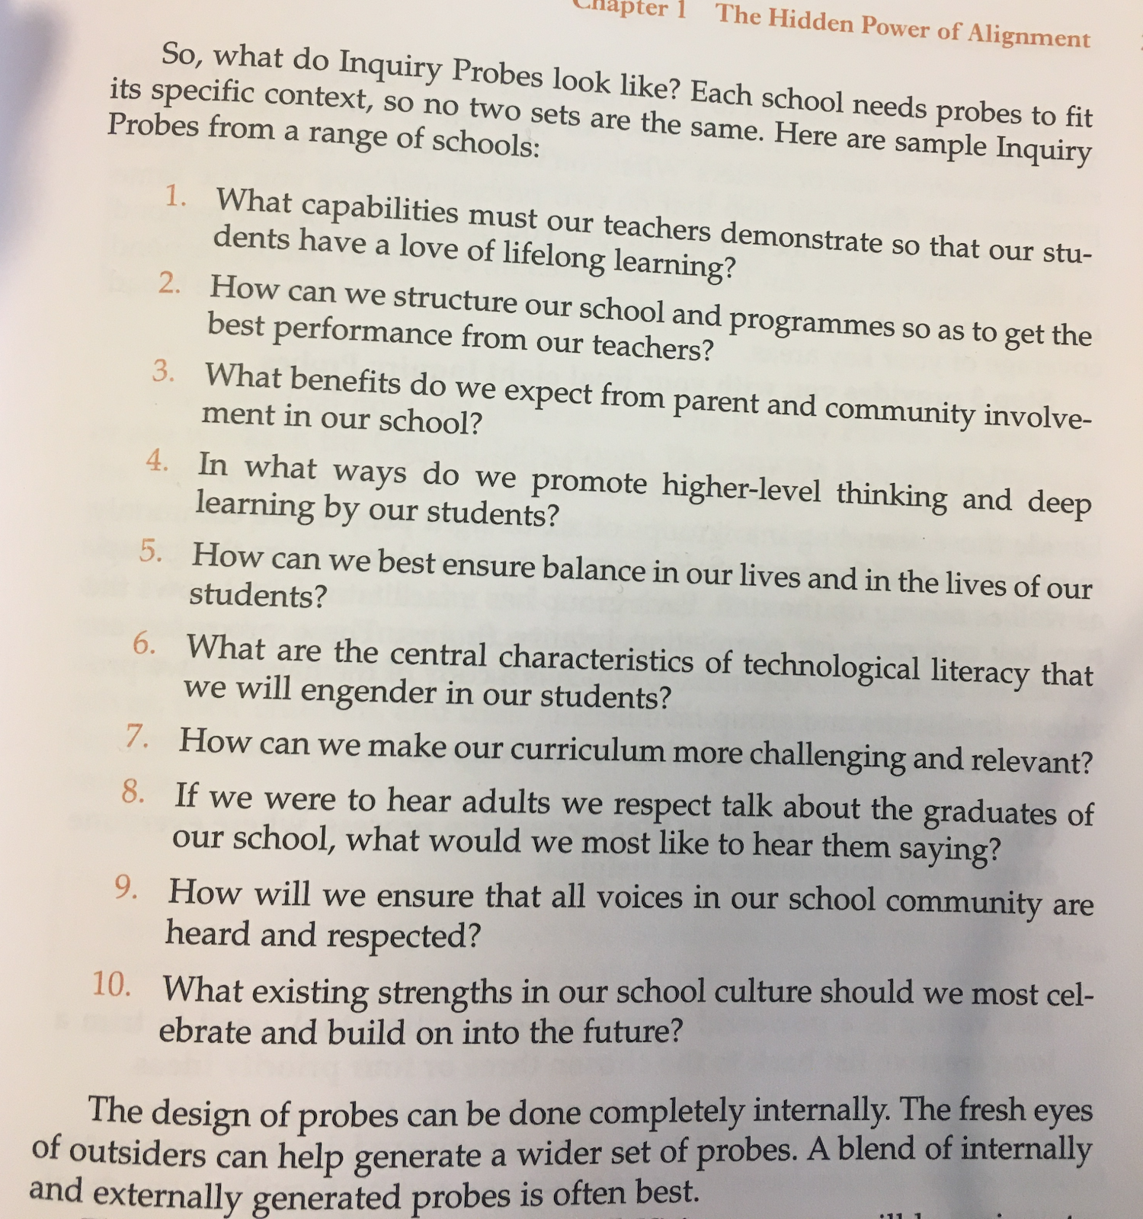
Step 2: Designing the Inquiry Probes
Inquiry probes are key questions that should tackle all the important aspects of the school
The Vision Creating Team should start with about 30 questions before narrowing it down
(Click image for docx version)

Slide 11
Step 3: Choose the Best Inquiry Probes
The final 8 need to be chosen internally. Could be by administration, various heads of departments, or the whole staff
Ensure that “no two probes just give you the same data” (we want completely different sets of data/information from each question)
Test the best 10-12 on a small group of staff-members and/or leaders, and from there narrow it to 8

Slide 12
Step 4: Set Up Groups With Trained Facilitators
Divide people into groups of 6-8
Should be diverse groups (e.g. counselors, support staff, non-teachers spread across groups)
Each group has a facilitator, someone familiar with:
Classic Brainstorming
10/4 Voting
Note: The principal/director doesn’t participate in the Inquiry Probes. They stay in the “Central Tally Room” tallying up the votes.
This is for three reasons:
“Based on trusting the staff and community” (shows trust in their judgment)
“Diplomatic immunity”: the staff can’t complain to the principal, since they didn’t make the decisions here
“Servant Leadership: by giving away apparent power, real power emerges”

Slide 13
Step 4: Set Up Groups With Trained Facilitators
X
I disagree. That’s not a good idea!
Let’s give more tests so we can make sure the students are learning.
Our 1st Inquiry Probe is this: how can we make our curriculum more challenging and relevant?
Classic Brainstorming
The 6-8 people go around clockwise and say an idea for that specific Inquiry Probe (question) while someone records it
People are allowed to pass
It ends once everyone passes in a row
Most Important Part: NO DISCUSSION!
Facilitator
Recorder
Let’s allocate money to professional development so we can go to different conferences and learn about these things.
Pass

Slide 14
Step 4: Set Up Groups With Trained Facilitators
Reminder: there’s Classical Brainstorming and 10/4 voting for *each* of the 8 Inquiry Probes.
So if Inquiry Probe #1 is “What benefits do we expect from parent and community involvement in our school?”
Brainstorm ideas without discussion about IP #1
Do 10/4 voting on all the ideas that came up for IP #1 (if 15 ideas came up, do 10/4 voting to get to 3 ideas)
Since 3 ideas will be chosen (per group) from 8 different Inquiry Probes, there will be a total of 24 ideas in your group at the end of the process

Slide 15
Step 4: Set Up Groups With Trained Facilitators
Inquiry Probe #2: “What benefits do we expect from parent and community involvement in our school?”
10/4 Voting
Each person has 10 votes
There are 3 rounds of voting
During each round, each person can only use 4 of their votes (could be 3-3-4, 2-4-4, etc.);
They can use all 4 of their votes on one idea, or scatter them around
The top 3 ideas at the end of the three rounds are chosen
 | Idea 1 | Idea 2 | Idea 3 | Idea 4 | Idea 5
Round 1
Round 2
Round 3

Slide 16
Step 4: Set Up Groups With Trained Facilitators
Inquiry Probe #2: “What benefits do we expect from parent and community involvement in our school?”
10/4 Voting
Each person has 10 votes
There are 3 rounds of voting
During each round, each person can only use 4 of their votes (could be 3-3-4, 2-4-4, etc.);
They can use all 4 of their votes on one idea, or scatter them around
The top 3 ideas at the end of the three rounds are chosen
 | Idea 1 | Idea 2 | Idea 3 | Idea 4 | Idea 5
Round 1
Round 2
Round 3
10 votes

Slide 17
Step 4: Set Up Groups With Trained Facilitators
10/4 Voting
Each person has 10 votes
There are 3 rounds of voting
During each round, each person can only use 4 of their votes (could be 3-3-4, 2-4-4, etc.);
They can use all 4 of their votes on one idea, or scatter them around
The top 3 ideas at the end of the three rounds are chosen
 | Idea 1 | Idea 2 | Idea 3 | Idea 4 | Idea 5
Round 1 | 1
Round 2
Round 3
9 votes

Slide 18
Step 4: Set Up Groups With Trained Facilitators
10/4 Voting
Each person has 10 votes
There are 3 rounds of voting
During each round, each person can only use 4 of their votes (could be 3-3-4, 2-4-4, etc.);
They can use all 4 of their votes on one idea, or scatter them around
The top 3 ideas at the end of the three rounds are chosen
 | Idea 1 | Idea 2 | Idea 3 | Idea 4 | Idea 5
Round 1 | 1 | 3
Round 2
Round 3
6 votes

Slide 19
Step 4: Set Up Groups With Trained Facilitators
10/4 Voting
Each person has 10 votes
There are 3 rounds of voting
During each round, each person can only use 4 of their votes (could be 3-3-4, 2-4-4, etc.);
They can use all 4 of their votes on one idea, or scatter them around
The top 3 ideas at the end of the three rounds are chosen
 | Idea 1 | Idea 2 | Idea 3 | Idea 4 | Idea 5
Round 1 | 1 | 3
Round 2
Round 3
6 votes

Slide 20
Step 4: Set Up Groups With Trained Facilitators
10/4 Voting
Each person has 10 votes
There are 3 rounds of voting
During each round, each person can only use 4 of their votes (could be 3-3-4, 2-4-4, etc.);
They can use all 4 of their votes on one idea, or scatter them around
The top 3 ideas at the end of the three rounds are chosen
 | Idea 1 | Idea 2 | Idea 3 | Idea 4 | Idea 5
Round 1 | 1 | 3
Round 2 | 1
Round 3
5 votes

Slide 21
Step 4: Set Up Groups With Trained Facilitators
10/4 Voting
Each person has 10 votes
There are 3 rounds of voting
During each round, each person can only use 4 of their votes (could be 3-3-4, 2-4-4, etc.);
They can use all 4 of their votes on one idea, or scatter them around
The top 3 ideas at the end of the three rounds are chosen
 | Idea 1 | Idea 2 | Idea 3 | Idea 4 | Idea 5
Round 1 | 1 | 3
Round 2 | 1 | 1
Round 3
4 votes

Slide 22
Step 4: Set Up Groups With Trained Facilitators
10/4 Voting
Each person has 10 votes
There are 3 rounds of voting
During each round, each person can only use 4 of their votes (could be 3-3-4, 2-4-4, etc.);
They can use all 4 of their votes on one idea, or scatter them around
The top 3 ideas at the end of the three rounds are chosen
 | Idea 1 | Idea 2 | Idea 3 | Idea 4 | Idea 5
Round 1 | 1 | 3
Round 2 | 1 | 1 |  | 1
Round 3
3 votes

Slide 23
Step 4: Set Up Groups With Trained Facilitators
10/4 Voting
Each person has 10 votes
There are 3 rounds of voting
During each round, each person can only use 4 of their votes (could be 3-3-4, 2-4-4, etc.);
They can use all 4 of their votes on one idea, or scatter them around
The top 3 ideas at the end of the three rounds are chosen
 | Idea 1 | Idea 2 | Idea 3 | Idea 4 | Idea 5
Round 1 | 1 | 3
Round 2 | 1 | 1 |  | 1
Round 3
3 votes

Slide 24
Step 4: Set Up Groups With Trained Facilitators
10/4 Voting
Each person has 10 votes
There are 3 rounds of voting
During each round, each person can only use 4 of their votes (could be 3-3-4, 2-4-4, etc.);
They can use all 4 of their votes on one idea, or scatter them around
The top 3 ideas at the end of the three rounds are chosen
 | Idea 1 | Idea 2 | Idea 3 | Idea 4 | Idea 5
Round 1 | 1 | 3
Round 2 | 1 | 1 |  | 1
Round 3 |  | 3
0 votes

Slide 25
Step 4: Set Up Groups With Trained Facilitators
10/4 Voting
Each person has 10 votes
There are 3 rounds of voting
During each round, each person can only use 4 of their votes (could be 3-3-4, 2-4-4, etc.);
They can use all 4 of their votes on one idea, or scatter them around
The top 3 ideas at the end of the three rounds are chosen
 | Idea 1 | Idea 2 | Idea 3 | Idea 4 | Idea 5
Round 1 | 1 | 3
Round 2 | 1 | 1 |  | 1
Round 3 |  | 3
All the votes from everyone are totaled, and the top 3 are chosen.

Slide 26
Step 4: Set Up Groups With Trained Facilitators
10/4 Voting
Each person has 10 votes
There are 3 rounds of voting
During each round, each person can only use 4 of their votes (could be 3-3-4, 2-4-4, etc.);
They can use all 4 of their votes on one idea, or scatter them around
The top 3 ideas at the end of the three rounds are chosen
 | Idea 1 | Idea 2 | Idea 3 | Idea 4 | Idea 5
Round 1 | 5 | 3 | 1 | 12 | 1
Round 2 | 3 | 5 | 2 | 8 | 0
Round 3 | 9 | 3 | 1 | 6 | 1
All the votes from everyone are totaled, and the top 3 are chosen.

Slide 27
Step 4: Set Up Groups With Trained Facilitators
10/4 Voting
Each person has 10 votes
There are 3 rounds of voting
During each round, each person can only use 4 of their votes (could be 3-3-4, 2-4-4, etc.);
They can use all 4 of their votes on one idea, or scatter them around
The top 3 ideas at the end of the three rounds are chosen
 | Idea 1 | Idea 2 | Idea 3 | Idea 4 | Idea 5
Round 1 | 5 | 3 | 1 | 12 | 1
Round 2 | 3 | 5 | 2 | 8 | 0
Round 3 | 9 | 3 | 1 | 6 | 1
Total | 17 | 11 | 4 | 26 | 2
All the votes from everyone are totaled, and the top 3 are chosen.

Slide 28
Step 4: Set Up Groups With Trained Facilitators
10/4 Voting
Each person has 10 votes
There are 3 rounds of voting
During each round, each person can only use 4 of their votes (could be 3-3-4, 2-4-4, etc.);
They can use all 4 of their votes on one idea, or scatter them around
The top 3 ideas at the end of the three rounds are chosen
 | Idea 1 | Idea 2 | Idea 3 | Idea 4 | Idea 5
Round 1 | 5 | 3 | 1 | 12 | 1
Round 2 | 3 | 5 | 2 | 8 | 0
Round 3 | 9 | 3 | 1 | 6 | 1
Total | 17 | 11 |  | 26
All the votes from everyone are totaled, and the top 3 are chosen.

Slide 29
Step 4: Set Up Groups With Trained Facilitators
10/4 Voting
Each person has 10 votes
There are 3 rounds of voting
During each round, each person can only use 4 of their votes (could be 3-3-4, 2-4-4, etc.);
They can use all 4 of their votes on one idea, or scatter them around
The top 3 ideas at the end of the three rounds are chosen
 | Idea 1 | Idea 2 | Idea 3 | Idea 4 | Idea 5
Round 1 | 5 | 3 | 1 | 12 | 1
Round 2 | 3 | 5 | 2 | 8 | 0
Round 3 | 9 | 3 | 1 | 6 | 1
Total | 17 | 11 |  | 26
These 3 ideas will later be put in the Master List to give to the whole Vision Committee.

Slide 30
Step 5: Combine Ideas into a Master List
Make a master list with top ideas from each group, combining ideas that are the same.
For example, if there are 6 groups, and each group voted on their top 3, there will be up to 18 ideas for each Probe/Question
Inquiry Probe 1: 18 different ideas
Inquiry Probe 2: 15 ideas
…Inquiry Probe 8: 18 ideas

Slide 31
Step 6: The Final Vote
The master list is given to each person
Each person has 10 votes for each Inquiry Probe
If there are 48 people, 480 votes divided between 18 ideas for each probe
They can use those votes in any way they want for the top ideas in each Probe

Slide 32
Step 6: The Final Vote
Inquiry Probe #1: “What benefits do we expect from parent and community involvement in our school?”
48 people, 480 votes divided between 18 ideas
Idea #
Votes:
Idea # | 1
Votes:
Idea # | 1 | 2
Votes:
Idea # | 1 | 2 | 3
Votes:
Idea # | 1 | 2 | 3 | 4
Votes:
Idea # | 1 | 2 | 3 | 4 | 5 | 6 | 7 | 8 | 9 | 10
Votes:
Idea # | 1 | 2 | 3 | 4 | 5
Votes:
Idea # | 1 | 2 | 3 | 4 | 5 | 6
Votes:
Idea # | 1 | 2 | 3 | 4 | 5 | 6 | 7
Votes:
Idea # | 1 | 2 | 3 | 4 | 5 | 6 | 7 | 8
Votes:
Idea # | 1 | 2 | 3 | 4 | 5 | 6 | 7 | 8 | 9
Votes:
Idea # | 1 | 2 | 3 | 4 | 5 | 6 | 7 | 8 | 9 | 10 | 11
Votes:
Idea # | 1 | 2 | 3 | 4 | 5 | 6 | 7 | 8 | 9 | 10 | 11 | 12
Votes:
Idea # | 1 | 2 | 3 | 4 | 5 | 6 | 7 | 8 | 9 | 10 | 11 | 12 | 13 | 14
Votes:
Idea # | 1 | 2 | 3 | 4 | 5 | 6 | 7 | 8 | 9 | 10 | 11 | 12 | 13
Votes:
Idea # | 1 | 2 | 3 | 4 | 5 | 6 | 7 | 8 | 9 | 10 | 11 | 12 | 13 | 14 | 15
Votes:
Idea # | 1 | 2 | 3 | 4 | 5 | 6 | 7 | 8 | 9 | 10 | 11 | 12 | 13 | 14 | 15 | 16
Votes:
Idea # | 1 | 2 | 3 | 4 | 5 | 6 | 7 | 8 | 9 | 10 | 11 | 12 | 13 | 14 | 15 | 16 | 17 | 18
Votes:

Slide 33
Step 6: The Final Vote
Inquiry Probe #1: “What benefits do we expect from parent and community involvement in our school?”
48 people, 453 votes divided between 18 ideas
Idea # | 1 | 2 | 3 | 4 | 5 | 6 | 7 | 8 | 9 | 10 | 11 | 12 | 13 | 14 | 15 | 16 | 17 | 18
Votes: | 27

Slide 34
Step 6: The Final Vote
Inquiry Probe #1: “What benefits do we expect from parent and community involvement in our school?”
48 people, 413 votes divided between 18 ideas
Idea # | 1 | 2 | 3 | 4 | 5 | 6 | 7 | 8 | 9 | 10 | 11 | 12 | 13 | 14 | 15 | 16 | 17 | 18
Votes: | 27 | 40

Slide 35
Step 6: The Final Vote
Inquiry Probe #1: “What benefits do we expect from parent and community involvement in our school?”
48 people, 402 votes divided between 18 ideas
Idea # | 1 | 2 | 3 | 4 | 5 | 6 | 7 | 8 | 9 | 10 | 11 | 12 | 13 | 14 | 15 | 16 | 17 | 18
Votes: | 27 | 40 | 11

Slide 36
Step 6: The Final Vote
Inquiry Probe #1: “What benefits do we expect from parent and community involvement in our school?”
48 people, 392 votes divided between 18 ideas
Idea # | 1 | 2 | 3 | 4 | 5 | 6 | 7 | 8 | 9 | 10 | 11 | 12 | 13 | 14 | 15 | 16 | 17 | 18
Votes: | 27 | 40 | 11 | 10

Slide 37
Step 6: The Final Vote
Inquiry Probe #1: “What benefits do we expect from parent and community involvement in our school?”
48 people, 334 votes divided between 18 ideas
Idea # | 1 | 2 | 3 | 4 | 5 | 6 | 7 | 8 | 9 | 10 | 11 | 12 | 13 | 14 | 15 | 16 | 17 | 18
Votes: | 27 | 40 | 11 | 10 | 58

Slide 38
Step 6: The Final Vote
Inquiry Probe #1: “What benefits do we expect from parent and community involvement in our school?”
48 people, 302 votes divided between 18 ideas
Idea # | 1 | 2 | 3 | 4 | 5 | 6 | 7 | 8 | 9 | 10 | 11 | 12 | 13 | 14 | 15 | 16 | 17 | 18
Votes: | 27 | 40 | 11 | 10 | 58 | 32

Slide 39
Step 6: The Final Vote
Inquiry Probe #1: “What benefits do we expect from parent and community involvement in our school?”
48 people, 297 votes divided between 18 ideas
Idea # | 1 | 2 | 3 | 4 | 5 | 6 | 7 | 8 | 9 | 10 | 11 | 12 | 13 | 14 | 15 | 16 | 17 | 18
Votes: | 27 | 40 | 11 | 10 | 58 | 32 | 5

Slide 40
Step 6: The Final Vote
Inquiry Probe #1: “What benefits do we expect from parent and community involvement in our school?”
48 people, 268 votes divided between 18 ideas
Idea # | 1 | 2 | 3 | 4 | 5 | 6 | 7 | 8 | 9 | 10 | 11 | 12 | 13 | 14 | 15 | 16 | 17 | 18
Votes: | 27 | 40 | 11 | 10 | 58 | 32 | 5 | 29

Slide 41
Step 6: The Final Vote
Inquiry Probe #1: “What benefits do we expect from parent and community involvement in our school?”
48 people, 191 votes divided between 18 ideas
Idea # | 1 | 2 | 3 | 4 | 5 | 6 | 7 | 8 | 9 | 10 | 11 | 12 | 13 | 14 | 15 | 16 | 17 | 18
Votes: | 27 | 40 | 11 | 10 | 58 | 32 | 5 | 29 | 77

Slide 42
Step 6: The Final Vote
Inquiry Probe #1: “What benefits do we expect from parent and community involvement in our school?”
48 people, 183 votes divided between 18 ideas
Idea # | 1 | 2 | 3 | 4 | 5 | 6 | 7 | 8 | 9 | 10 | 11 | 12 | 13 | 14 | 15 | 16 | 17 | 18
Votes: | 27 | 40 | 11 | 10 | 58 | 32 | 5 | 29 | 77 | 8

Slide 43
Step 6: The Final Vote
Inquiry Probe #1: “What benefits do we expect from parent and community involvement in our school?”
48 people, 162 votes divided between 18 ideas
Idea # | 1 | 2 | 3 | 4 | 5 | 6 | 7 | 8 | 9 | 10 | 11 | 12 | 13 | 14 | 15 | 16 | 17 | 18
Votes: | 27 | 40 | 11 | 10 | 58 | 32 | 5 | 29 | 77 | 8 | 21

Slide 44
Step 6: The Final Vote
Inquiry Probe #1: “What benefits do we expect from parent and community involvement in our school?”
48 people, 146 votes divided between 18 ideas
Idea # | 1 | 2 | 3 | 4 | 5 | 6 | 7 | 8 | 9 | 10 | 11 | 12 | 13 | 14 | 15 | 16 | 17 | 18
Votes: | 27 | 40 | 11 | 10 | 58 | 32 | 5 | 29 | 77 | 8 | 21 | 16

Slide 45
Step 6: The Final Vote
Inquiry Probe #1: “What benefits do we expect from parent and community involvement in our school?”
48 people, 103 votes divided between 18 ideas
Idea # | 1 | 2 | 3 | 4 | 5 | 6 | 7 | 8 | 9 | 10 | 11 | 12 | 13 | 14 | 15 | 16 | 17 | 18
Votes: | 27 | 40 | 11 | 10 | 58 | 32 | 5 | 29 | 77 | 8 | 21 | 16 | 43

Slide 46
Step 6: The Final Vote
Inquiry Probe #1: “What benefits do we expect from parent and community involvement in our school?”
48 people, 101 votes divided between 18 ideas
Idea # | 1 | 2 | 3 | 4 | 5 | 6 | 7 | 8 | 9 | 10 | 11 | 12 | 13 | 14 | 15 | 16 | 17 | 18
Votes: | 27 | 40 | 11 | 10 | 58 | 32 | 5 | 29 | 77 | 8 | 21 | 16 | 43 | 2

Slide 47
Step 6: The Final Vote
Inquiry Probe #1: “What benefits do we expect from parent and community involvement in our school?”
48 people, 75 votes divided between 18 ideas
Idea # | 1 | 2 | 3 | 4 | 5 | 6 | 7 | 8 | 9 | 10 | 11 | 12 | 13 | 14 | 15 | 16 | 17 | 18
Votes: | 27 | 40 | 11 | 10 | 58 | 32 | 5 | 29 | 77 | 8 | 21 | 16 | 43 | 2 | 26

Slide 48
Step 6: The Final Vote
Inquiry Probe #1: “What benefits do we expect from parent and community involvement in our school?”
48 people, 57 votes divided between 18 ideas
Idea # | 1 | 2 | 3 | 4 | 5 | 6 | 7 | 8 | 9 | 10 | 11 | 12 | 13 | 14 | 15 | 16 | 17 | 18
Votes: | 27 | 40 | 11 | 10 | 58 | 32 | 5 | 29 | 77 | 8 | 21 | 16 | 43 | 2 | 26 | 18

Slide 49
Step 6: The Final Vote
Inquiry Probe #1: “What benefits do we expect from parent and community involvement in our school?”
48 people, 34 votes divided between 18 ideas
Idea # | 1 | 2 | 3 | 4 | 5 | 6 | 7 | 8 | 9 | 10 | 11 | 12 | 13 | 14 | 15 | 16 | 17 | 18
Votes: | 27 | 40 | 11 | 10 | 58 | 32 | 5 | 29 | 77 | 8 | 21 | 16 | 43 | 2 | 26 | 18 | 23

Slide 50
Step 6: The Final Vote
Inquiry Probe #1: “What benefits do we expect from parent and community involvement in our school?”
48 people, 0 votes divided between 18 ideas
Idea # | 1 | 2 | 3 | 4 | 5 | 6 | 7 | 8 | 9 | 10 | 11 | 12 | 13 | 14 | 15 | 16 | 17 | 18
Votes: | 27 | 40 | 11 | 10 | 58 | 32 | 5 | 29 | 77 | 8 | 21 | 16 | 43 | 2 | 26 | 18 | 23 | 34

Slide 51
Step 6: The Final Vote
Inquiry Probe #1: “What benefits do we expect from parent and community involvement in our school?”
Idea # | 1 | 2 | 3 | 4 | 5 | 6 | 7 | 8 | 9 | 10 | 11 | 12 | 13 | 14 | 15 | 16 | 17 | 18
Votes: | 27 | 40 | 11 | 10 | 58 | 32 | 5 | 29 | 77 | 8 | 21 | 16 | 43 | 2 | 26 | 18 | 23 | 34
(The top 4 ideas in each probe are passed on to the Vision Writers)

Slide 52
Step 7: Writing First Drafts of Shared Vision
Identify the top four responses (based on vote) from each of the 8 probes (32 total)
Draft Vision Writers “thread” these together into various paragraphs
Three writers or pairs of writers create drafts of the Shared Vision (“the best ‘wordsmiths’”)
In the end, there are three first drafts (one from each of the writer/writer-pairs)
Drafts are prepared overnight
Shared Vision fits on 1 page

Slide 53
Step 8: Forming the Final Shared Vision
The Creative Vision Team looks over the drafts:
“Highlighting sections (paragraphs, sentences, or words) they particularly like in each of the drafts and sections they do not like”
Can “recommend new wordings, so long as these are to be found” in the data voted on in those groups (no new ideas!)
Sample Paragraph
“Our school is a learning community committing itself to maximizing individual growth for our student population. We expect demonstrated academic achievement for every student in accord with the highest standards that stand up to national scrutiny. A professional, enthusiastic, and energetic team challenges students to become the best they can be intellectually, socially, and behaviorally."

Slide 54
Step 8: Forming the Final Shared Vision
A second draft is created based on the “most highly rated sections”
Usually 2-3 “skilled” writers (same people or new ones)
Usually takes 2-3 hours
Read aloud to the whole group after lunch on Day 2
“We have found that this public affirmation of what the group has achieved together is commonly a deeply moving experience for those in attendance”
Sample Paragraph (cont.)
“A strong work ethic permeates the learning environment. Working hard in a warm, caring atmosphere motivates each community member to become a life-long learner by continually thinking productively at the highest levels.”

Slide 55
Step 8: Forming the Final Shared Vision
Sometimes a 3rd draft needs to be created based on critiques from “The Vision Creating Community”
Rarely more than 3rd draft, and usually then just minor editing
(Example of Finished Shared Vision)
Reminders:
The Shared Vision “is a clear picture of where we are heading. It is not a statement of where we are now.”
These “drafts must stay true to the data generated in the Inquiry Probes process. This is not an opportunity for any one voice to try to introduce new ideas and dominate”

Slide 56
Next Step: A Year of ‘Preparation for Action”
After the Shared Vision, “staff identity key areas for research to shift the school to where it wants to be”
Action themes (3-8 themes, depending on school size; more for larger schools)
21st Century Teaching and Learning Best Practice
Behaving off of our Core Values
Advocating for Students and Staff
Making a Large School Feel Small
Expanding Our Classrooms into the Community
Communication and Feedback
Student Voice
Sample Action Themes from Monroe High School (USA)

Slide 57
Next Step: A Year of ‘Preparation for Action”
Team Creation
Those involved in the vision creation form teams to investigate one of the action themes
Teams are 3-12 people, depending on size of school/number of themes
Usually, people choose to be on the teams for topics they’re most passionate about, but leadership can ask people to switch to ensure diversity of experience & skills

Slide 58
Next Step: A Year of ‘Preparation for Action”
Teams take one year to do their research “and trial ideas in their classes or across the school”
Can visit other schools in-person or “across the internet”
Can “invite visits from innovative teachers and schools they uncover”
In the end, each team creates their recommendations

