Slide 1
Writing Prompt
If you could design a flag to represent you, what would you put on it? What colors/images represent you?
(5 minutes: minimum 50 words

Slide 2
Mood, Messages, Themes, and Symbols
Pushing Your Reading to a High School Level

Slide 3
Objectives
Students will be able to:
understand the meaning of:
Mood
Theme
Messages
Symbolism
identify them in stories
explain their own reasoning

Slide 4
Mood
The mood is what the reader is feeling as they’re reading. What are the emotions that are coming up?
For mood, pay special attention to the imagery/sensory description that the author uses.
It was a dark and stormy night. The rain smashed against the old shingles of the creaky house.
What is the mood?
What description/actions make you say that?
The lights were bright, the food was plentiful, and everyone was dancing.
What is the mood? Why do you say that?
The man screamed at the orphan, “You’re never to come back to the orphanage!” “But where will I go?” the young child cried, tears running down his dirt-splotched face.
What is the mood? Why do you say that?

Slide 5
Mood in The Giver
Using the mood words from your “Cheat Sheet”, what do you think is the mood of this passage from The Giver? What words/phrases show you that?
(There may be more words/phrases that caught your eye)
Notes:
Any

Slide 6
Mood in The Giver
Using the mood words from your “Cheat Sheet”, what do you think is the mood of this passage from The Giver? What words/phrases show you that?
Notes:
Any

Slide 7
Themes
The theme is the topic of a text (whether written or visual); it’s what the story is about
For theme, consider what problems the characters have to face or the decisions they have to make
Note: You’ll discover that half of teachers use the word theme to mean the thematic message; in 8th grade, we’ll simply use the term “message” or “author’s purpose” for that.

Slide 8
Theme
For theme, consider what problems the characters have to face or the decisions they have to make
In Finding Nemo, for example, Marlin has to deal with his overprotective nature, the trauma of the death of his wife & loss of his son, and his fear of trusting others.
So potential themes are:
Trust
Family
Fear vs. Perseverance
Overcoming the past/Letting go
Growing Up

Slide 9
Theme
For theme, consider what problems the characters have to face or the decisions they have to make
In Holes, Stanley has to deal with his family’s poverty, his family’s curse, an unfair prison system, surviving bullies in and outside of prison, and his weight.
So potential themes are:
Self-esteem/self-confidence
Fate vs. Choice
Friendship
Bullying
Racism
Social/Criminal Justice

Slide 10
Themes in The Giver
What are some of themes in The Giver so far? Ask yourself, what are some of the conflicts/issues/doubts that the Jonas faces so far, even just in his mind?
Freedom of Choice
Individual desires (individualism) vs. Social pressure/control (society)
Being different vs. Uniformity/Sameness
(Un)Importance of Emotions
Utopia vs. Dystopia
Genetic Engineering

Slide 11
Adele – Someone Like You
What are the issues (themes) that are brought up in this song?
Heartbreak
Moving on
Loss of innocence
Regret
Avoiding love vs. avoiding pain
I heard that you're settled down
That you found a girl and you're married now.
I heard that your dreams came true.
Guess she gave you things I didn't give to you.
Old friend, why are you so shy?
Ain't like you to hold back or hide from the light.
I hate to turn up out of the blue uninvited
But I couldn't stay away, I couldn't fight it.
I had hoped you'd see my face and that you'd be reminded
That for me it isn't over.
Never mind, I'll find someone like you
I wish nothing but the best for you too
Don't forget me, I beg
I remember you said,
"Sometimes it lasts in love but sometimes it hurts instead,
Sometimes it lasts in love but sometimes it hurts instead"
Notes:
http://www.youtube.com/watch?v=hLQl3WQQoQ0
Do you always have to trust the narrator? When she says, “Never mind, I’ll find someone like you,” do you believe her?

Slide 12
Adele – Someone Like You
And what about the mood?
What makes you say that?
I heard that you're settled down
That you found a girl and you're married now.
I heard that your dreams came true.
Guess she gave you things I didn't give to you.
Old friend, why are you so shy?
Ain't like you to hold back or hide from the light.
I hate to turn up out of the blue uninvited
But I couldn't stay away, I couldn't fight it.
I had hoped you'd see my face and that you'd be reminded
That for me it isn't over.
Never mind, I'll find someone like you
I wish nothing but the best for you too
Don't forget me, I beg
I remember you said,
"Sometimes it lasts in love but sometimes it hurts instead,
Sometimes it lasts in love but sometimes it hurts instead"
Notes:
http://www.youtube.com/watch?v=hLQl3WQQoQ0
Do you always have to trust the narrator? When she says, “Never mind, I’ll find someone like you,” do you believe her?

Slide 13
Symbolism

Slide 14
Symbolism
Almost every text you see in middle & high school will have symbols, but you also see them every day. For example:

Slide 16
Symbolism
To find the meaning of a symbol, consider:
what that object/person has symbolized in history, other “texts” (visual or written), or current society
e.g. a skeleton has symbolized death for thousands of years
what that symbol is used for in the text
Elsa’s gloves in Frozen stop her magic, so they can symbolize hiding oneself
how that symbol has changed the character(s)
Buzz Lightyear changes Woody’s outlook on life in Toy Story, so Buzz could symbolize change & growing

Slide 17
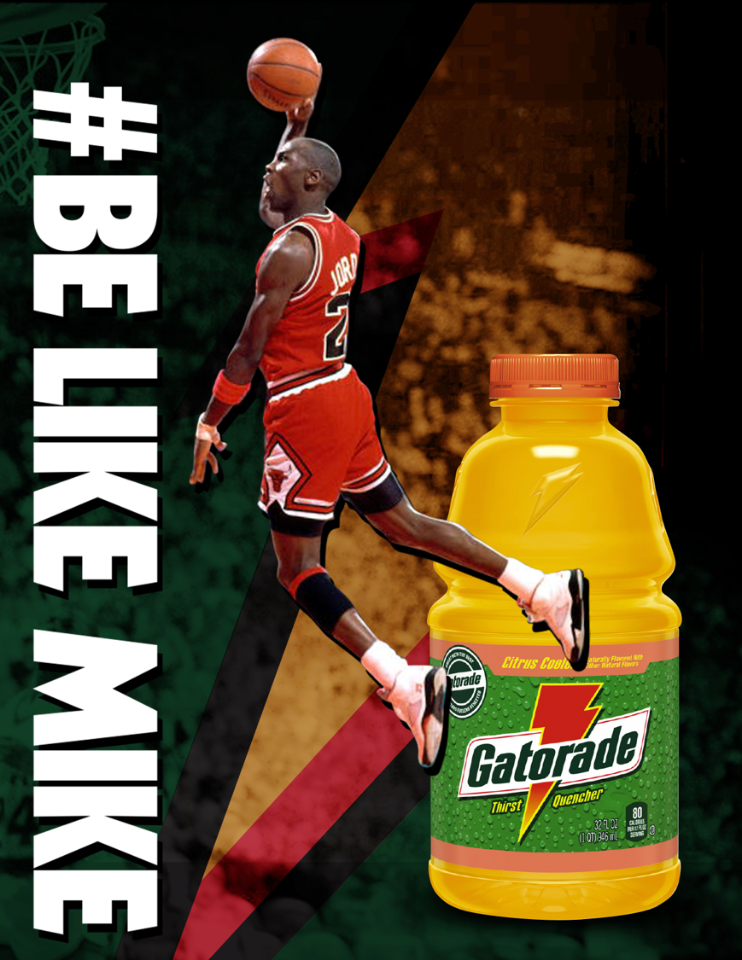
People can be symbols too. Here, what does basketball superstar Michael Jordan symbolize?
Power/Strength
Agility/Speed
Superstardom
Talent
(and more)
(We’ll come back to this ad later)

Slide 18
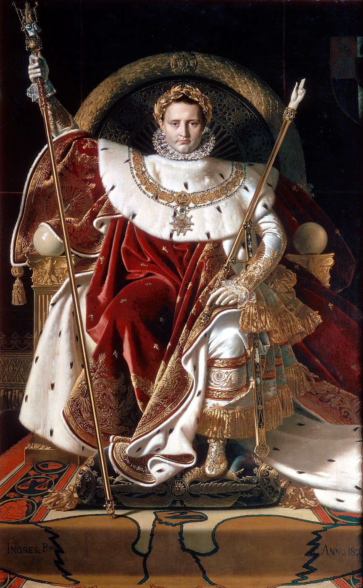
What about this painting of Napoleon? What symbols you can find?

Slide 19
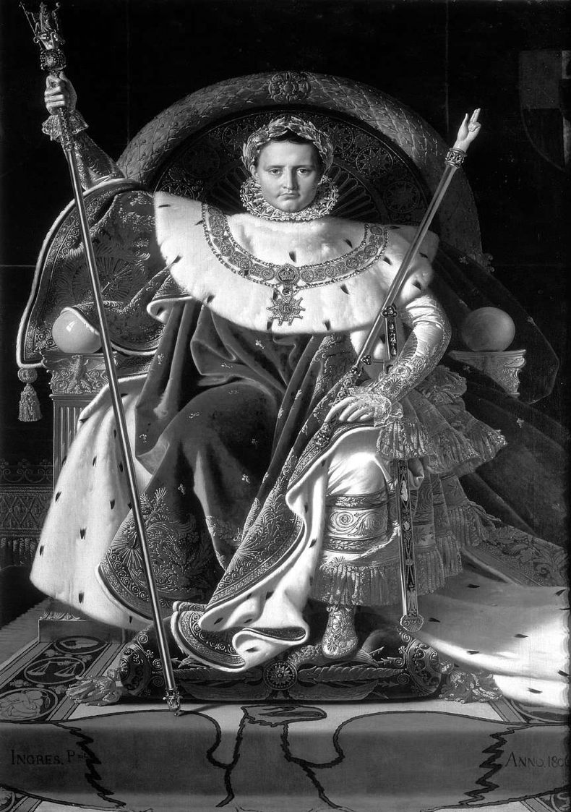
For example, this rod that he’s holding is known as the “hand of God”.
(I think) This symbolizes God’s blessing…(why?)
…because in ancient & medieval paintings, this same image of just a hand represents God making a decision, showing that God has chosen Napoleon.

Slide 20
What might the laurel wreath symbolize? Why do you say that?
Consider:
• where you’ve seen it before in history or stories and/or
• what it was used for in stories
• Victory/triumph (because they were given to the winners of the ancient Greek Olympics)
• Connection to the Greek gods (because Apollo used to wear them)
• Connection to the Roman emperors (since they used to wear them during celebrations)
Note: You can say a symbol represents anything, but it doesn’t matter if you can’t logically explain/prove it in relation to the text. Here, saying it represents a connection to aliens doesn’t make logical sense in the painting .

Slide 21
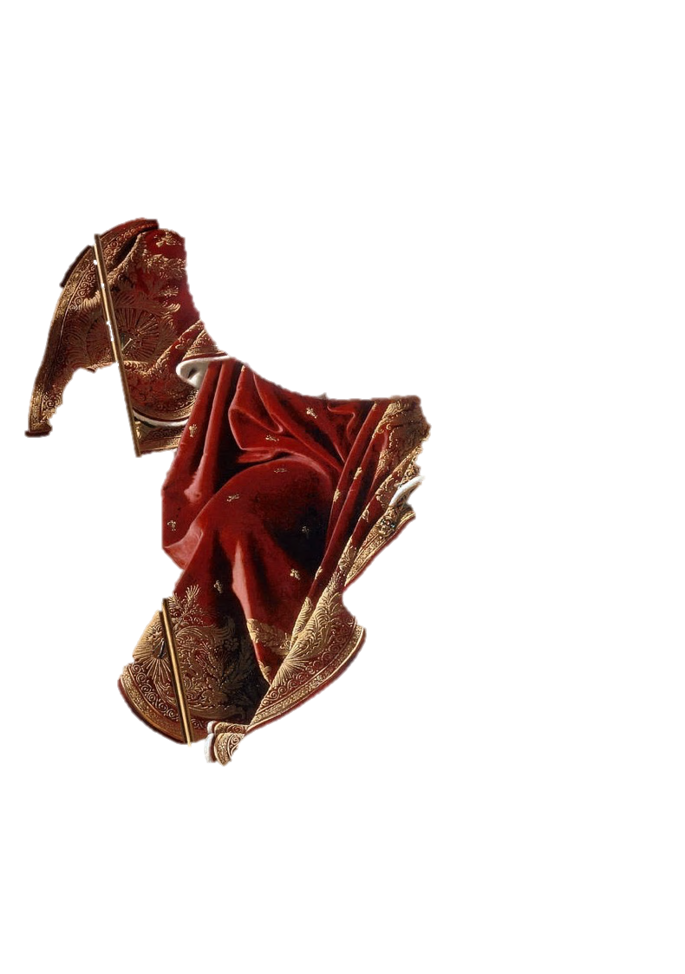
What about the red/purple robes? Why?
• Wealth (because only the rich in ancient Rome could afford this color dye in their togas)
• Connection to royalty/Roman emperors (because the colors were often worn by the emperors of Rome and European monarchs)

Slide 22
What about the eagle? Why?
• Power (because eagles are a powerful, deadly bird)
• Connection to the unstoppable Roman Empire (because the eagle was a symbol of the Roman army, which conquered almost all of Europe)

Slide 23
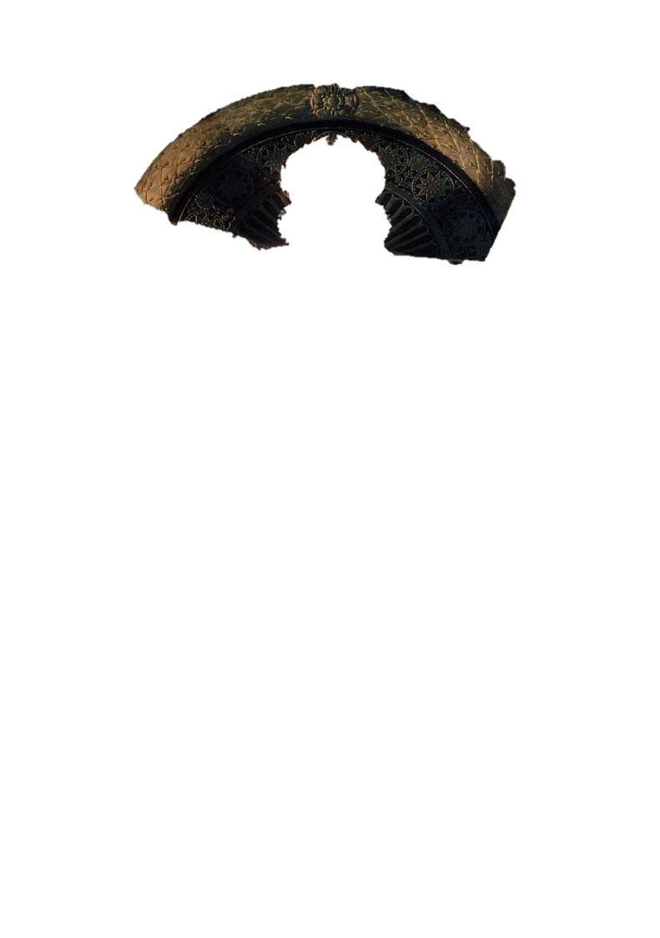
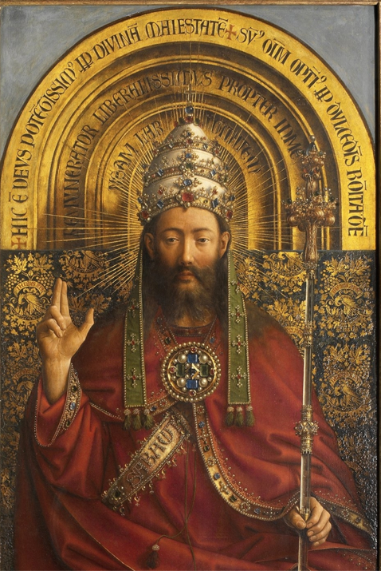
Did anyone notice what the throne behind him looks like?

Slide 24
The halo can symbolize…
• Power (because “the sun” rises and falls over him as if he were in control of it)
• Connection to the gods/God (because images of holy people and ancient gods had halos around them)

Slide 25
Before we move on, a funny side note: Napoleon actually didn’t like this painting at all because he thought the symbols were too arrogant, even for him! In fact, he never took it from the artist!

Slide 26
Symbolism in The Giver
In The Giver, what do you think the sled symbolizes? Why do you think that?
Hint: consider what the sled transports Jonas to or away from, literally and figuratively.

Slide 27
Symbolism in The Giver
In The Giver, what do you think the sled symbolizes? Why do you think that?
It can symbolize:
Jonas’ journey through memories—and foreshadows the future difficulty of them—because this is his 1st memory transmitted through The Giver
Knowledge because from it Jonas learns about colors, weather, hills, and even plain exhilaration
Loss of Innocence/Growing Up because it’s when Jonas starts thinking differently than his community but also realizing some of the negative things about it too

Slide 28
Message
The message is what the author is trying to teach the reader through the text. Almost every story has a message, some more hidden than others. As literature students, your job is to find it.
We can usually find the message from one or more of the following:
Based on the theme, and what the author thinks about that theme
Based on the symbols in the story, and what happens with them
Based on what the characters say
Depending on who we trust & who we don’t
Based on what the main character(s) learn(s)
Note: We’ll get to #3 & 4 on another day.

Slide 29
1) Finding the Message from the Theme
If one of the themes of Beauty & the Beast is external vs. internal beauty, what do you think the movie’s writers believe about it?
Author’s Message: It’s what’s inside that counts (because Gaston is handsome but horrible, and dies in the end…while the Beast is “ugly” outside, but shows his true heart and ends up living happily ever after with Belle.)
Note: You don’t need to agree with the author’s message: it’s not about what you believe; it’s about what you think the author believes

Slide 30
1) Finding the Message from the Theme
If one of the themes of Holes is fate, what do we think Louis Sachar feels about it?
Author’s Message: We can’t change fate, but we can overcome it through hard work and kindness (because Stanley in the end is a millionaire due to his and his father’s persistence, and his friendship with Zero.)

Slide 31
1) Finding the Message from the Theme in The Giver
We’ll work on the message of The Giver once we finish it, but as we read the last half of the book in the next three weeks, ask yourself, “What do you think the author (Lois Lowry) thinks about those themes?”
(e.g. What side do you think she would fall on for the battle between Individuality vs. Social Pressure?)
Freedom of Choice
Individual desires (individualism) vs. Social pressure/control (society)
Being different vs. Social Pressure to be the same
Uniformity/Sameness
(Un)Importance of Emotions
Utopia vs. Dystopia

Slide 32
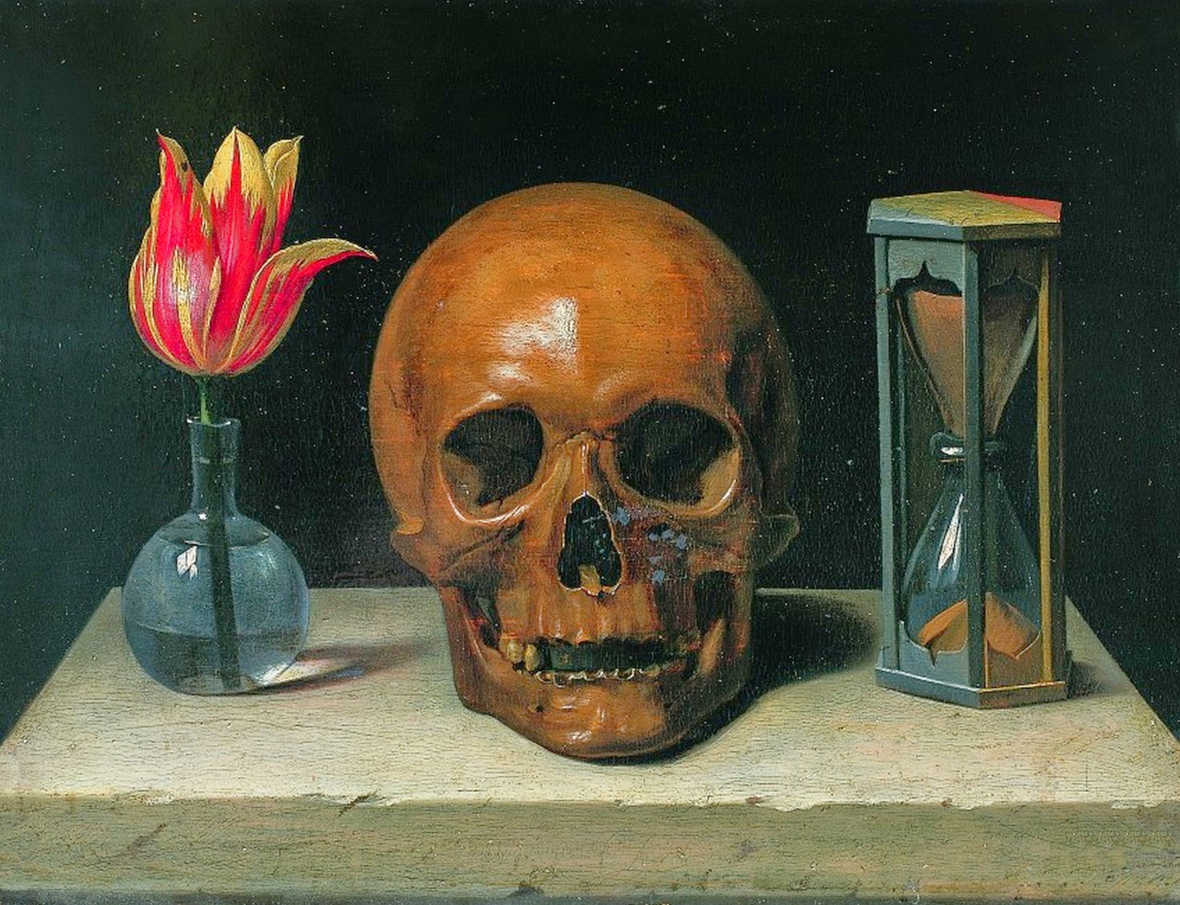
2) Finding the Message from Symbols
We can often discover the message of a text based just on the symbols. Let’s try with paintings first.
Flower
(symbol of beauty and life)
Skull
(symbol of death & decay)
Hourglass
(symbol of time)
Potential Message: Time inevitably leads beauty and life to death.

Slide 33
Now let’s go back to ol’ Napoleon.

Slide 34
So we have all these symbols now. Symbols of:
Power (orb, sword, medal, throne-halo, eagle, robes)
Victory (laurel wreath, medal)
A connection to God/the gods (hand of God, throne-halo, laurel wreath)
A connection to the Roman Empire (eagle, laurel wreath, robes)
Based on the symbols above, what is the artist trying to say about the subject/topic of this painting, Napoleon?
Napoleon is a leader hand-picked by God.
Napoleon is an all-powerful ruler.
Napoleon will bring the glory of Ancient Rome to France.
(among others)

Slide 35
If Michael Jordan represents…
Power/Strength
Agility/Speed
Superstardom
Talent
…what is this ad trying to trick your subconscious into thinking?
If you drink Gatorade, you will…

Slide 36
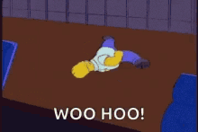
Woohoo!
Yay! You’re on your way to being a high school reader!
Now let’s see what you can do on your own…

