Slide 1
Headlines | Captions | Introductions | Outlining | Potpourri
100 | 100 | 200 | 200 | 200
200 | 200 | 400 | 400 | 400
300 | 300 | 600 | 600 | 900
400 | 400 | 800 | 800 | 1200
500 | 500 | 1000 | 1000 | 1500

Slide 2
Write a Headline for…
When the government said there would be no more exams

Slide 3
Write a Headline for…
A lab explosion at school that created mutant students

Slide 4
Write a Headline for…
When Santa Claus was actually found

Slide 5
Write a Headline for…
When a choir student was chosen to tour with Nikki Minaj

Slide 6
Write a Headline for…
The time that T-Rex bones were discovered under the school

Slide 7
Write a Caption for the Following Picture:
For privacy reasons, I’ve blurred students’ faces

Slide 8
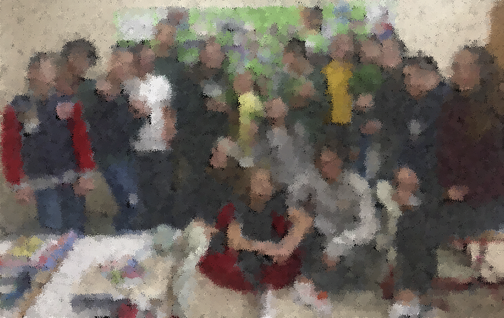
Write a Caption for the Following Picture:
For privacy reasons, I’ve blurred students’ faces

Slide 9
Write a Caption for the Following Picture:
1st Place
Koç Robotics Team

Slide 10
Write a Caption for the Following Picture:

Slide 11
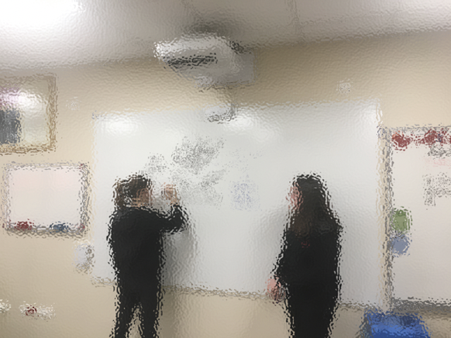
Write a Caption for the Following Picture:
For privacy reasons, I’ve blurred students’ faces
I will not pick on kindergarteners
I will not pick on kindergarteners
I will not pick on kindergarteners
I n

Slide 12
List the 5 W’s for the following:
Turkey bans exams

Slide 13
List the 5 W’s for the following:
Destructive black hole created in science lab

Slide 14
List the 5 W’s for the following:
Koç installs zip-lines between blocks

Slide 15
List the 5 W’s for the following:
Mr. Chapman takes plastic IKEA plants hostage

Slide 16
List the 5 W’s for the following:
Mr. Chapman is revealed to be a giant lizard in a costume

Slide 17
Outline (including two quotes) the following:
Mr. Chapman becoming school dictator

Slide 18
Outline (including two quotes) the following:
Destructive black hole that was created in Koç science lab

Slide 19
Outline (including two quotes) the following:
Turkey’s new law banning exams

Slide 20
Outline (including two quotes) the following:
Koç School installing 100–meter rock wall

Slide 21
Outline (including two quotes) the following:
A unicorn being discovered on campus

Slide 22
Write a quote, including intro/name/grade, from someone involving:
Mr. Chapman accidentally coming to school in Spiderman pajamas

Slide 23
Write a quote, including intro/name/grade, from someone involving:
Koç installing zip-lines between blocks

Slide 24
Write the full last paragraph of:
A unicorn being discovered on campus

Slide 25
Write the full last paragraph of:
Ali attacking Cardi B when she visited campus

Slide 26
Write the full last paragraph of:
Snow Day
two weeks ago

Slide 27
Outline the following (including 2 quotes)
Giant Gorillas attacks Koç!

Slide 28
Write the 5W’s for:
Giant Gorillas Attack Koc!

Slide 29
Write a quote for:
Dragon attacks Koç!

Slide 30
Write a “How/Why it happened” paragraph for:
Giant Gorillas Attack Koc!

Slide 31
Write the last paragraph for:
Giant Gorillas Attack Koc!

