Slide 1
Learning By Discovery
An Introduction to P.B.L.

Slide 2
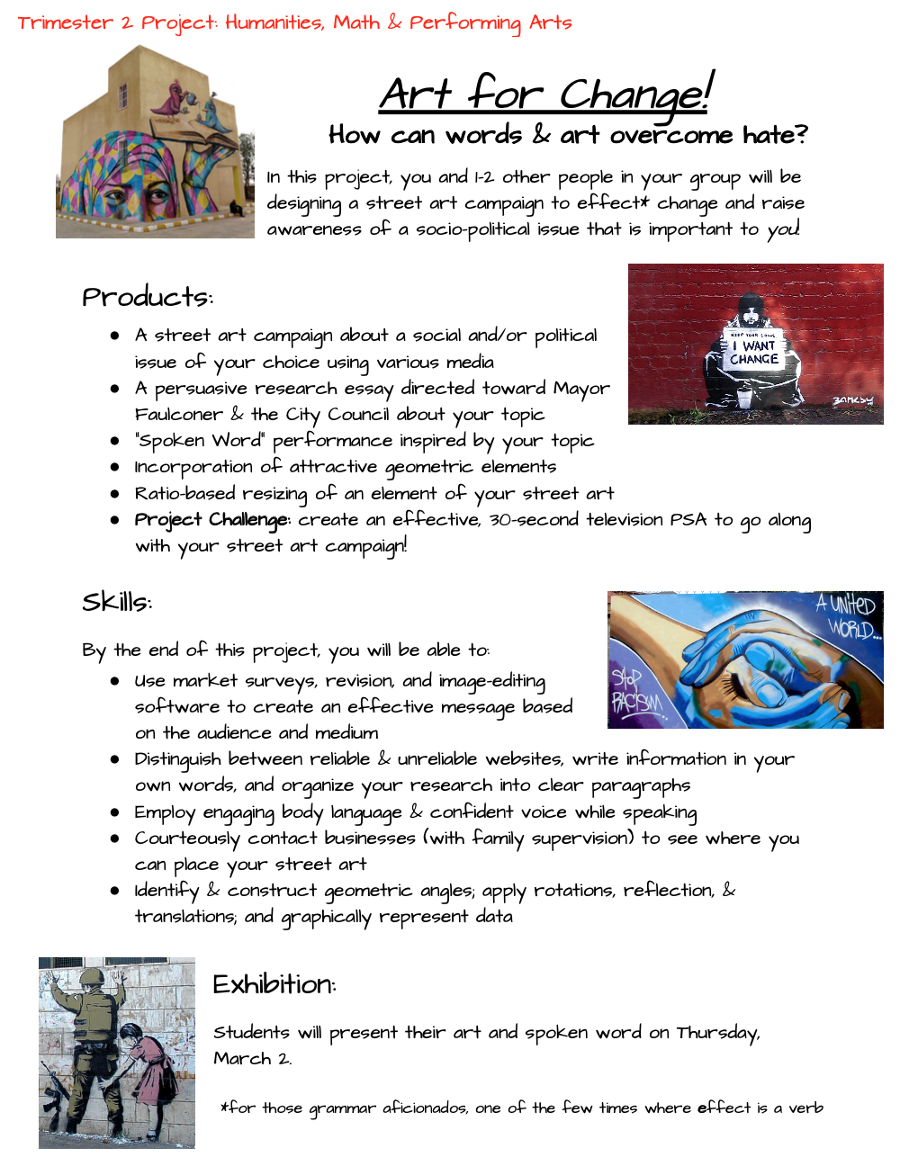
Today’s Goals/Learning Objectives
Understand the reasons behind PBL
Learn what Project-Tuning is
Come up with a (basic) outline of an interdisciplinary project you could do for your subject/grade
Any other things you’d like to address?
Notes:
Any

Slide 3
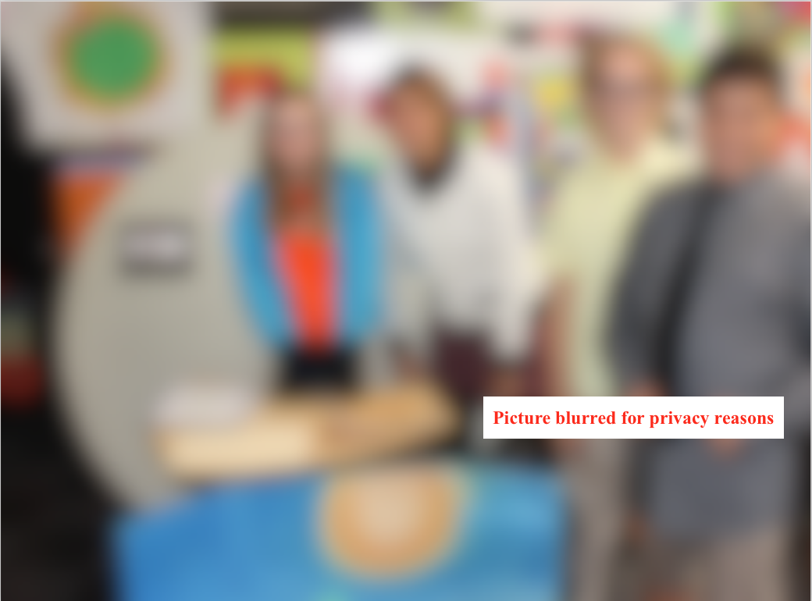
Why PBL?
Meets the standards while engaging students
Exposes students to the 21st Century 4 C’s:
  Creativity, Critical Thinking, Collaboration, Communication
Encourages curiosity and empowers students to be lifelong learners (and, ideally, empathetic world citizens)

Slide 4
Components of an Effective Project
Hits the standards/4 C’s
Students learn by (among other things) discussing, questioning, and investigating, based on the essential question(s) and their own questions
Real-World Authenticity
Public Product – Exhibition
Group *and* Individual assessment
Project-Tuning

Slide 5
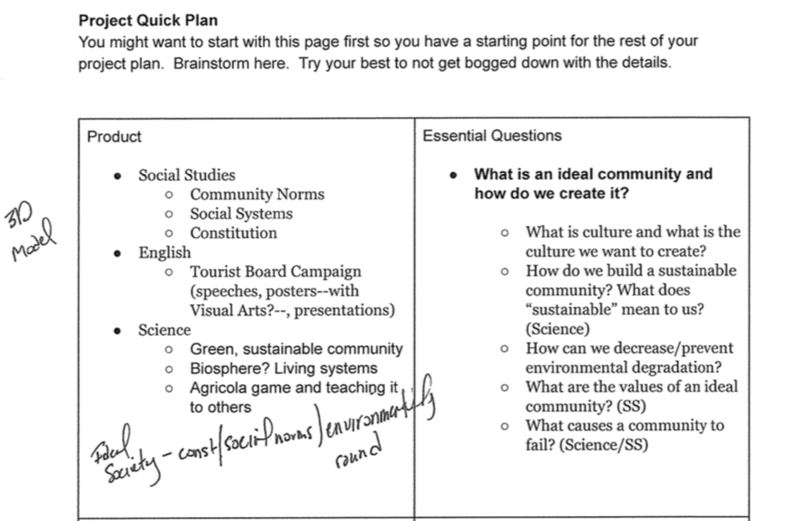
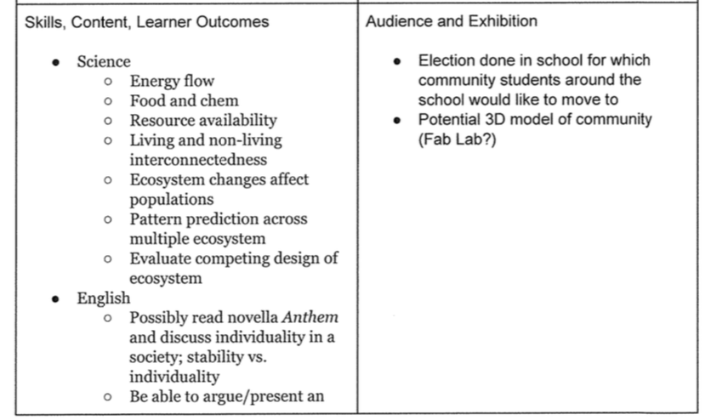
Project Planning/Brainstorming

Slide 6
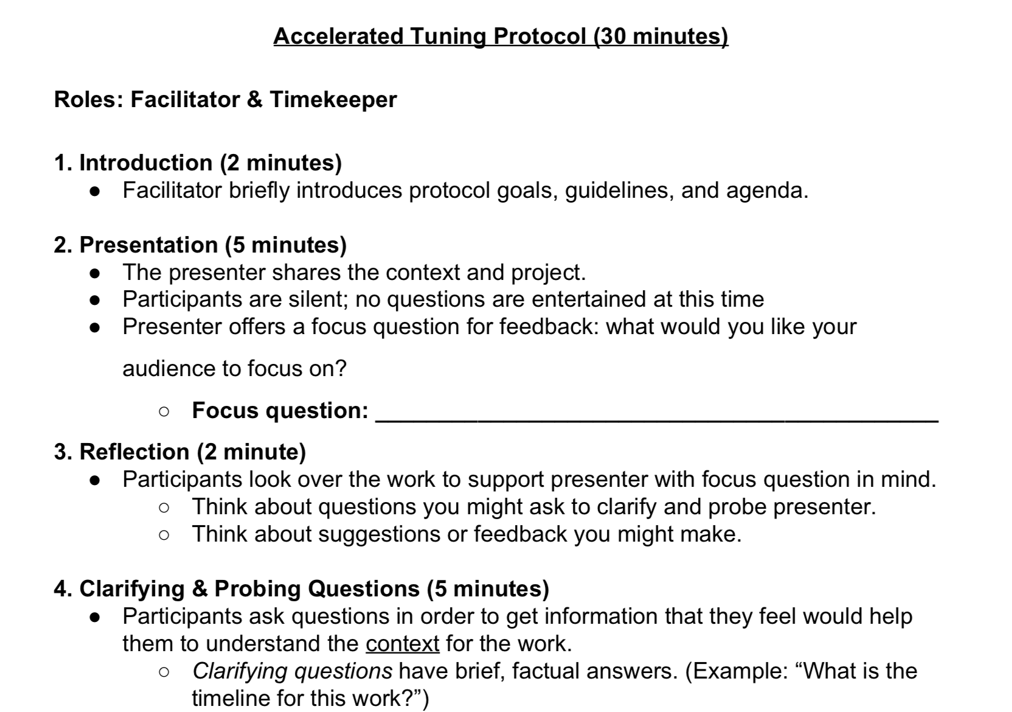
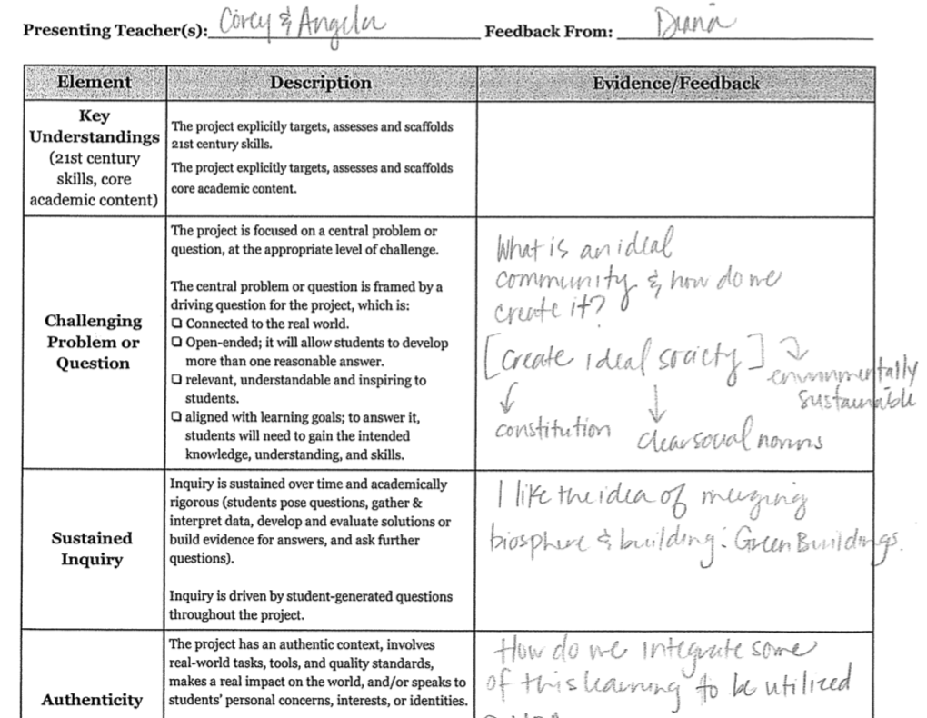
Project-Tuning

Slide 7
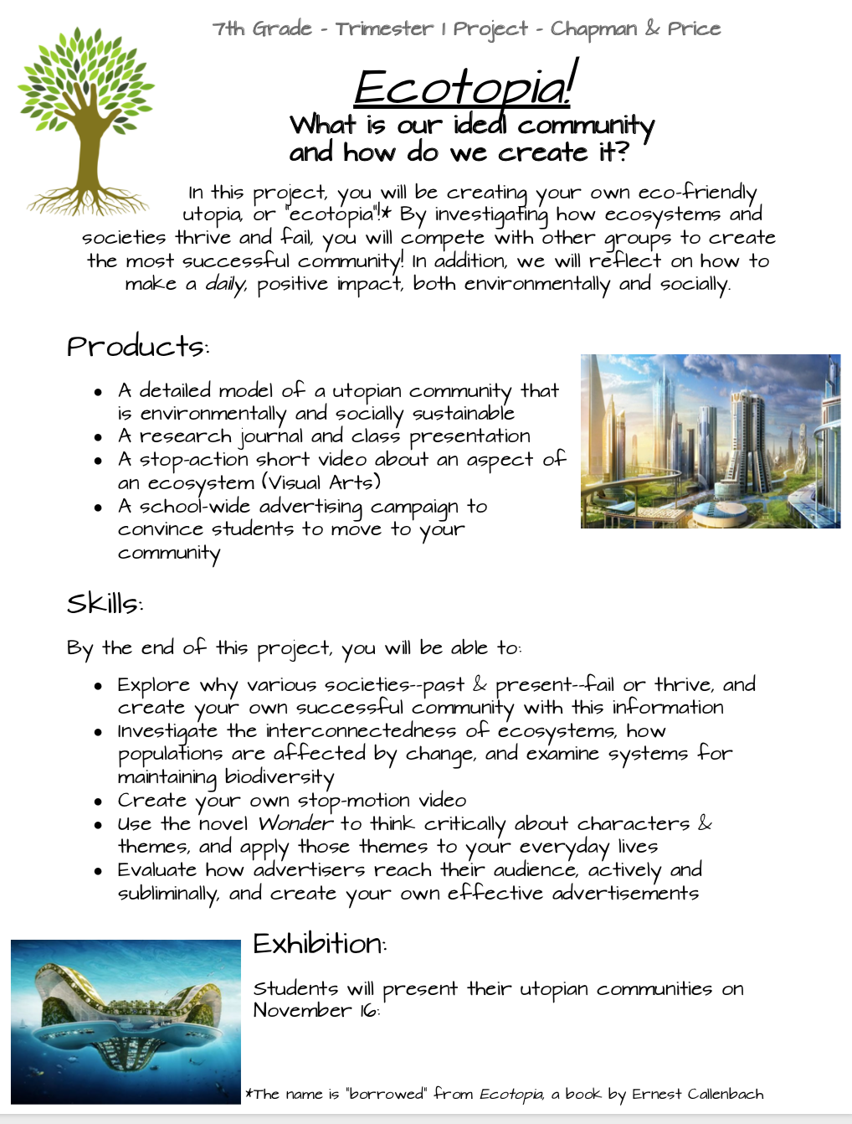
Example
Ecotopia Project
  Research & create socially & environmentally stable community (S.S. & Science)
  Create guidebook to community (Spanish)
  Design own national game for new community (PE)
  Create stop-motion video for ecosystem (Visual Arts)
  Create advertising campaign for utopia, using ethos, pathos, and logos (English)

Slide 8
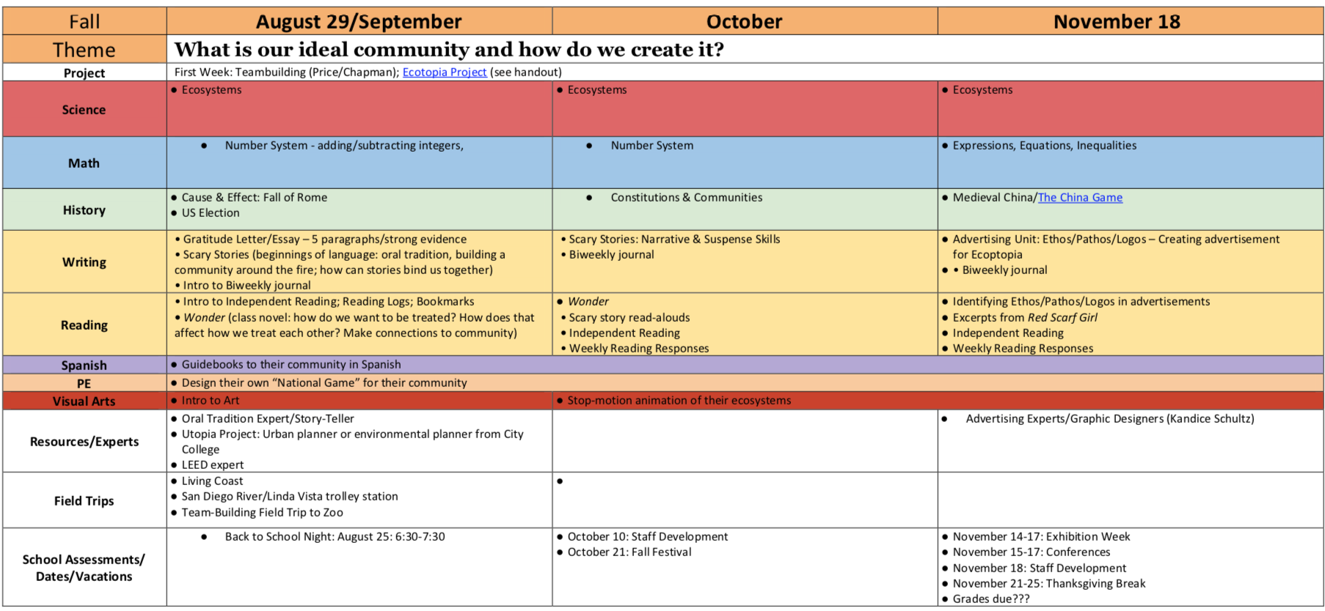
Curriculum Sample

Slide 9




What It Looks Like

Slide 10

Street Art Project

Slide 11
Activity
A science teacher wants to excite students about engineering/NGSS standards through a project. Using those standards and standards from your curriculum, come up with a potential project in your groups.

Slide 12
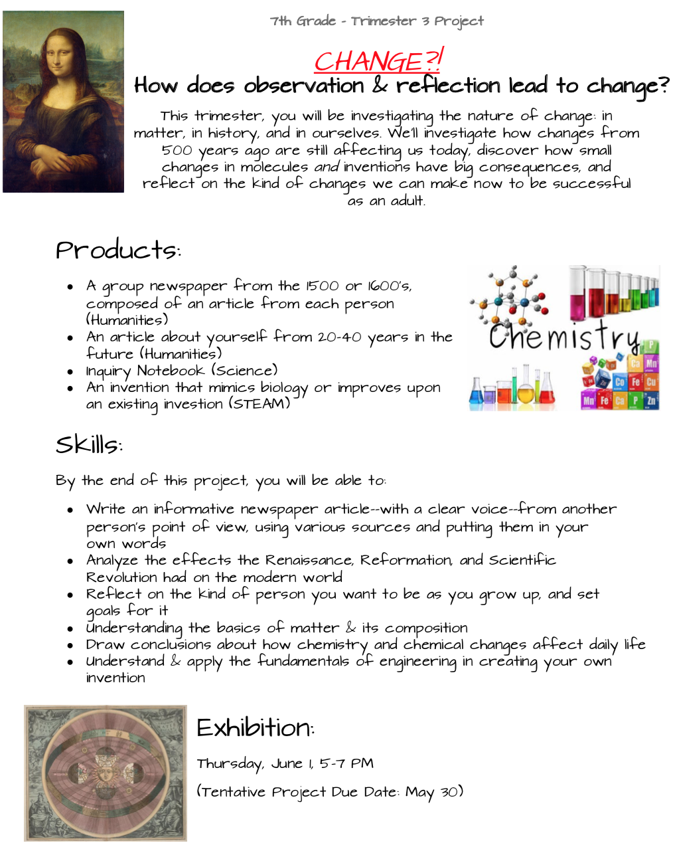
Last Thoughts
Create an engaging flyer & include Exhibition date
Integrate field trips and/or experts
Don’t force interdisciplinary when it isn’t natural
Balance is key – there are a ton of things that you just can’t do with a project

