Slide 1
Parental Involvement
Overview of US Parental Policies & Studies

Slide 2
Overview of Studies
Studies show that “parent engagement matters even more than schools in shaping the achievement of young people” (Desforges 2003)
“The best predictor of student success is the extent to which families encourage learning at home and involve themselves in their child’s education” (PTA 2000)
“Across 50 studies, parental involvement was positively associated with achievement, with the exception of parental help with homework [emphasis added]. Involvement that reflected academic socialization had the strongest positive association with achievement” (Hill 2009)
Notes:
Academic Socialization: "parents' beliefs, aspirations, expectations, knowledge of children's development as well as educationally relevant practices"

Slide 3
Expectations for Parents: Academics
Communicate with teacher directly before emailing administrators
“In general, complaints are best resolved at the level where they arise.” (UNIS)
Depending on grade level (7th & up?), students communicate first
Self-advocacy is one of the strongest concepts we can teach (see Outliers by Malcolm Gladwell)
Personal Experience: These boundaries for parents should be communicated at beginning of the year

Slide 4
Expectations for Parents: Modeling Behavior
Honor & respect for campus rules, teachers, administrators, and their:
Expertise and passion
time/schedules (including weekends/holidays)
class size (the knowledge that they have a large number of students)
Language (on-campus and in emails)
On-Campus Dress (not a problem in our school, but mentioned in many policies)

Slide 5
Expectations for Schools: Communication
Clear, active, two-way communication about:
school/teacher expectations & procedures for their child
parental expectations & procedures (and any changes to these)
school events & activities that they’re invited to
overall issues that affect their child (not just at conferences or when they receive their child’s report cards)
how parents can help their children to improve their academic achievement, such as materials, “literacy training and using technology, as appropriate, to foster parental involvement”
Personal Experience: Expectation—communicated to parents at beginning of the year—that teachers will respond within 24-48 hours, not counting weekends and holidays

Slide 6
Expectations for Schools: Partnerships
Acknowledgment that:
parents “play an integral role in assisting their child’s learning”;
parents should be “encouraged to be actively involved in their child’s education”;
parents are full partners in their child’s education and are included, as appropriate, in decision-making and on advisory committees to assist in the education of their child;
Training for teachers & staff:
“in how to reach out to, communicate with, and work with parents as equal partners” and “in how to implement and coordinate parent programs and build ties between parents and schools”

Slide 7
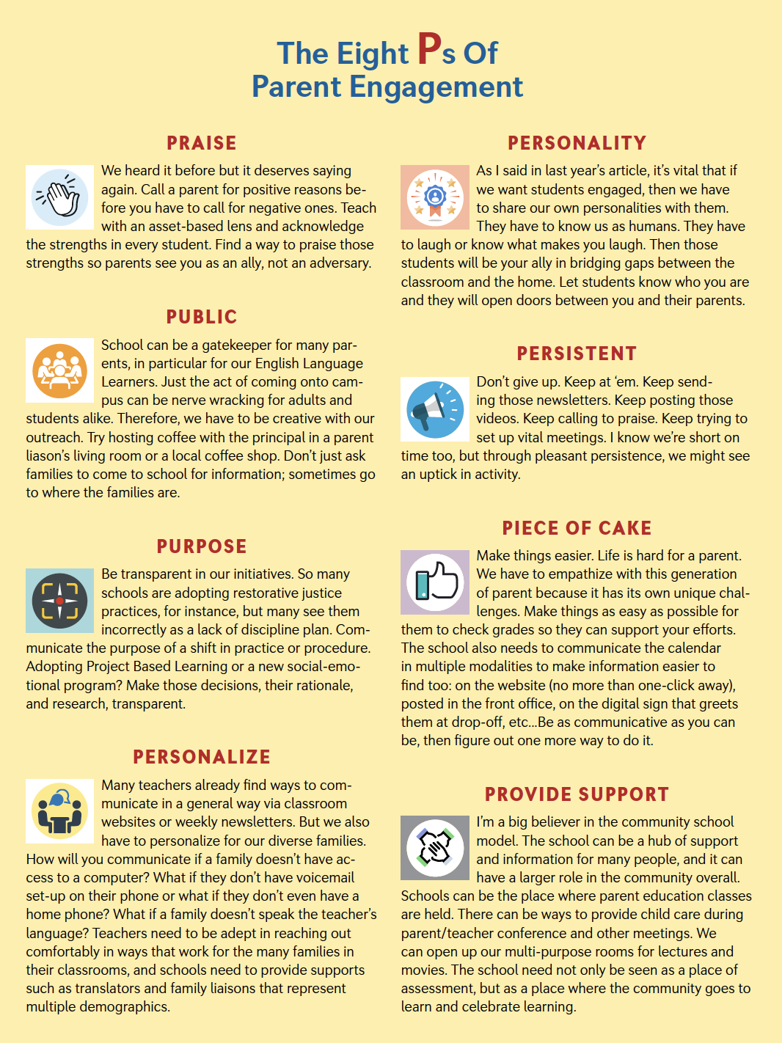
Ways to Get Parents Involved
Coffee mornings/Evening Tea
Curriculum Nights
Project Presentations/Open Houses
Expertise for a unit/project
3-A-Day App
Notes:
8 P’s from: http://neatoday.org/2019/08/07/improving-parent-engagement/

Slide 8
Analysis Based on Readings & Experience
Clarity and communication of expectations are key at the beginning of the year—before students even arrive;
Parental boundaries & expectations—in talking to teachers & staff, and in helping their child—must be clear and enforced
Administration needs to be respectful but firm about this
Teachers & staff must brainstorm, reflect, and be trained on how best to include parents directly or through technology:
Online gradebook
Emails & phone calls for *positive* reasons
Objectives/class syllabus communicated at the beginning of every quarter in a brief but clear way
Ensuring parents feel they’re part of their child’s learning…without letting them think that they direct it
Notes:
I find the fear of parents takes priority over student learning, at least in my department

Slide 9
Resources
Policy Samples (sorted by usefulness):
US Department of Education School Policy Template
GEMS Wellington International School
Sacaton Schools
UNIS
Spring City Elementary (Utah) Parent Policies & Expectations
Region 16 Schools (Texas) Parental Involvement Policy FAQ
American Institutes for Research Guide
School Parental Involvement Policy Sample (Wisconsin)
New Jersey Sample Template
King & Queen County Schools (Virginia) Policy
Clara Byrd Baker Elementary School (Virginia) Policy
Davenport Ridge Elementary School (Connecticut)
South Carolina Guide to Parental Involvement

Slide 10
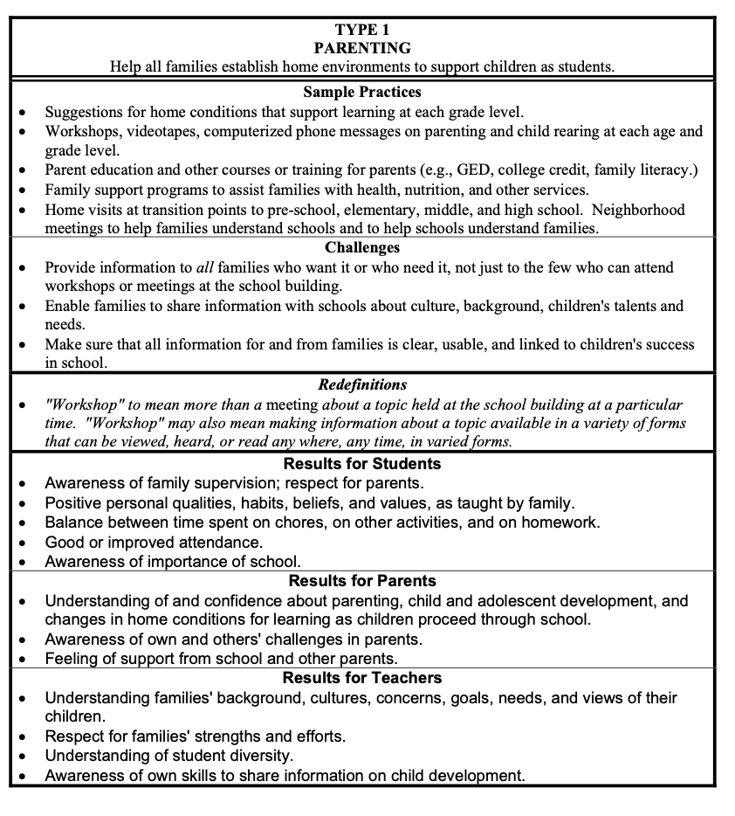
Resources
Studies
Epstein, Joyce: “Framework of Six Types of Involvement”
Hill, Nancy and Tyson, Diana: “Parental Involvement in Middle School: A Meta-Analytic Assessment of the Strategies That Promote Achievement”
FAST: “The Importance of Parent Engagement: A List of Research and Thought Leadership”
NEA: “Building Positive Parent-Teacher Relationships”
NEA: “Improving Parent Engagement”
NEA: “Lawnmower Parents”
NEA: “Parent, Family, Community Involvement in Education”
NEA: “The Eight P’s of Parent Engagement”
New Zealand Education Review Office: “How Is my Child Doing?”
New Zealand Now: “The Role of Parents”
Waterford.org: “How Parental Involvement Leads to Student Success”
From “Framework of Six Types of Involvement”

Slide 11
Partial Template of School-Parent Contract (from US Department of Education)
Clear Policy Implementation — how schools:
will take the following actions to involve parents in the process of school review
will take the following actions to involve parents in the joint development of its school parental involvement plan
will hold an annual meeting to inform parents
will provide parents of...a description and explanation of the school’s curriculum, the forms of academic assessment used to measure children’s progress, and the proficiency levels students are expected to meet by: [date]
will at the request of parents, provide opportunities for regular meetings for parents to formulate suggestions and to participate, as appropriate, in decisions about the education of their children. The school will respond to any such suggestions as soon as practicably possible by [list of actions]
will provide materials and training to help parents work with their children to improve their children’s academic achievement, such as literacy training and using technology, as appropriate, to foster parental involvement, by:
will, with the assistance of its parents, educate its teachers, pupil services personnel, principals and other staff in how to reach out to, communicate with, and work with parents as equal partners in the value and utility of contributions of parents, and in how to implement and coordinate parent programs and build ties between parents and schools, by:

