Slide 1
Persuasive Essay

Slide 2
Introductions

Slide 3
Introductions
Think of your introduction as a movie trailer, giving a quick preview of the text and making us excited about it. An intro has a:
Hook: A question, a “many” statement, or an image.
Background/Summary of Problem: Describe the problem/Issue: What do you think the reader needs to know about this topic?
Thesis: Your argument (your “should” or “need” statement) with your reasons

Slide 4
The Hook
You can often hook in your reader with a question, a “many” statement, or an image. An image is usually the most advanced of hooks.
Have you ever seen anyone get bullied? Bullying is unfortunately a common sight in schools.
Many students every day are forced to live in fear. They fear being bullied.
Kids with black eyes. Kids crying themselves to sleep. Kids afraid to go to school. These are just some of the things that happen when kids are bullied.
For the image, think of the results that would show up if you “Google Imaged” your topic.

Slide 5
Background (Summary of Problem)
You’ll want to describe the problem in a sentence or two, but no more (details go in your body paragraphs). Ask yourself, what extra information does your reader need to know?
What is bullying?
How many smokers are out there?
What kinds of pollution are you talking about?
Ex. Millions of kids are bullied every month. They’re bullied physically and emotionally, and made fun of and intimidated in person, online, over phones, and almost everywhere.

Slide 6
The Thesis
The thesis is what your essay will be about. It usually goes at the end of the introduction (the 1st paragraph).
Potential theses (+ reasons):
People shouldn’t smoke because x, y and z.
People should stop littering because x, y and z.
We need to stop bullying because x, y and z.
We need to stop killing cockroaches because x, y and z.

Slide 7
Introduction
Kids with black eyes. Kids crying themselves to sleep. Kids afraid to go to school. These are just some of the things that happen when kids are bullied. Millions of kids are bullied every month. They’re bullied physically and emotionally, and made fun of and intimidated in person, online, over phones, and almost everywhere. Not enough is being done. Bullying should be punished by a a fine or jail time because it’s too prevalent, it leaves long-lasting emotional and academic scars, and it can lead to suicide. In addition, fines and jail time will prevent further bullying.

Slide 8
Body Paragraphs

Slide 9
Organizing Your Evidence
Your essay is like a building. If you don’t have strong evidence, it will collapse. If it’s not organized well (like a blueprint), it will collapse.
Your thesis is like your Penthouse at the top. Everything below supports it.
Your reasons are like the floors of your building.

Slide 10
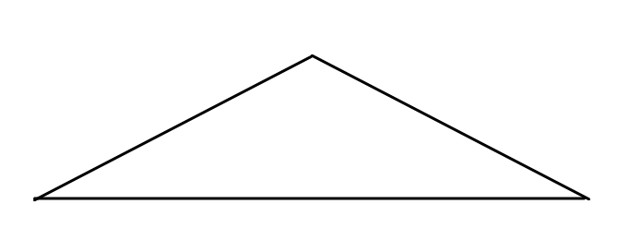
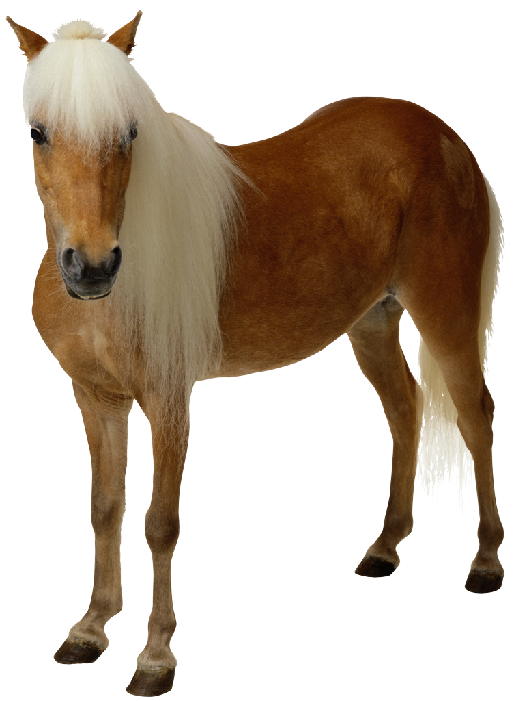
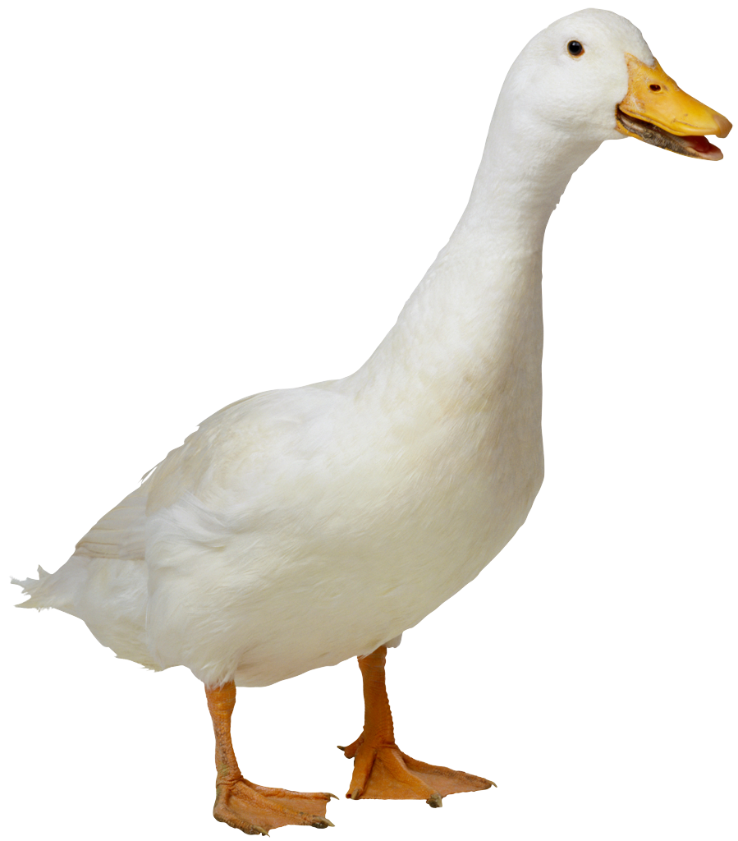
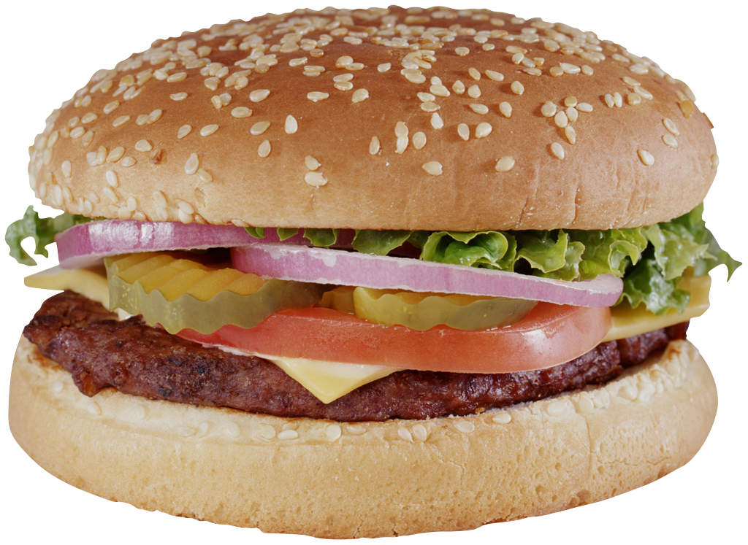
1st Body Paragraph & Topic Sentence
Introduction
Thesis (at end intro): Bullies should receive fines and jail time.
One reason we need to stop bullying is that it happens too often. of
Evidence 1A
Evidence 1B
Evidence 1C
Another reason is that it hurts students emotionally and academically.
2nd Body Paragraph & Topic Sentence
Evidence 2A
Evidence 2B
Evidence 2C
Finally, these punishments will prevent bullying.
3rd Body Paragraph & Topic Sentence
Evidence 3A
Evidence 3B
Evidence 3C

Slide 11
For example, one study shows that “every 7 minutes a child is bullied.”
One reason we need to stop bullying is that it happens too often
According to another study, 282,000 students in middle and high schools are attacked physically every month!
¾ of students will be bullied between kindergarten and 12th grade.

Slide 12
Solid Evidence
Read/listen to the paragraph. How many pieces of solid evidence does it have?
Another reason is that bullying can hurt students academically and emotionally. For example, many students miss school because they’re scared of bullies. Another example is that many kids become depressed because of bullying. Finally, many kids have lower grades because of bullying.
This has no solid pieces of evidence. ZERO!! Solid evidence needs to have specifics and often a number.
(It has elementary evidence; not high school-type evidence)

Slide 13
Solid Evidence
Let’s try this again.
Another reason is that bullying can hurt students academically and emotionally. For example, one study states that “160,000 students miss school everyday because they’re afraid of being bullied” (Felding, 34). Another example is that many kids become depressed because of bullying. One article mentions that 78% of students who are depressed have been bullied (Wright). Finally, according to another website, 39% of students who are bullied report that their grades have lowered because of bullying (Janes, 76). This shows that bullying clearly doesn’t just affect people physically—it leaves lasting emotional and academic scars.
Another reason is that bullying can hurt students academically and emotionally. For example, many students miss school because they’re scared of bullies. Another example is that many kids become depressed because of bullying. Finally, many kids have lower grades because of bullying.

Slide 14
Solid Evidence
Evidence needs to be specific*:
For example, many animals are killed every year from pollution. Another example is…
For example, smoking causes lung cancer. Another example…
For example, many teen mothers drop out of school. Another example…
For example, many people have lost fingers because of smoking. Another example…
Evidence needs to be specific :
For example, according to one article, 284,000 animals are killed every year by choking on trash.
For example, smoking causes lung cancer. One study shows that those who smoke have an 87% greater chance of dying of lung cancer.
For example, three out of every four teen mothers drop out of high school.
For example, many people have lost fingers because of smoking. Studies show that cigarettes shrink blood vessels, making it harder for blood to reach places like fingers and toes.
* These statistics are made up just to demonst-rate. Obviou-sly you’lll need to use real evidence.
If I don’t have a number to use, I can at least show how it can potentially harm people.

Slide 15
Stay on Topic (Sentence)! (What is the title/sign of your paragraph?)
One reason that smoking needs to be banned is that it causes lung cancer.
85% of people who have lung cancer are smokers.
Smoking can also increase your risk of heart attacks.
Smoking can cover up people’s lungs with tar, making it harder to breathe.
lung cancer. health problems.
(This supports the statement “Smoking causes lung cancer.”)
(This doesn’t support the statement “Smoking causes lung cancer.”)
(This doesn’t support the statement “Smoking causes lung cancer,” unless I specifically show that the tar and not being able to breathe cause lung cancer.)
Notes:
If a restaurant is labeled “Chinese Food,” it better have Chinese food! If it’s labeled organic, it better be organic!

Slide 16
Biggest Issues: Evidence
You need specific evidence—at the very least three pieces in each paragraph.
Which of these is solid evidence?
According to a study, drinking causes birth defects in babies.
Drunk drivers have killed many people.
The pollution from car engines causes brain damage.
Teachers say that having a dog increases happiness.
None. None of them are solid pieces of evidence.

Slide 17
Biggest Issues: Evidence
If you quote someone, you better show me why I should believe that person. Ask yourself, “Why would the reader consider this person an expert?”
If you don’t explain that, I have no reason to believe it. Otherwise, it’s like coming into the class and saying, “Mr. Chapman, Mr. Chapman, we can’t have school today—a man on the street said that school was against the law.”
“Well, who said it?”
“A guy on the street.”
Notes:
It’s not enough to say that they said…why is it important, and how does it support your topic sentence?

Slide 18
Questions to Ask Yourself
Who is your audience?
Who are you trying to convince? Your reasons need to convince them.
Does your topic sentence support your thesis? If I write “…because” in front of the topic sentence, does it make sense?
Are the topic sentences different?
Smoking can kill you. Smoking can cause lung cancer.
Are your topic sentences basically in your thesis?
Maybe not the same exact words, but they mean the same thing.

Slide 19
Conclusions

Slide 20
Conclusion
Restate the thesis, usually in slightly different words (with a transition like “In conclusion,”).
Restate your reasons (in slightly different words).
A question or catchy final statement. (Ask yourself, what do you want to leave the reader with? It’s usually a call to action, or a statement showing what might happen if nothing is done, or if something is done.

Slide 21
Restate the Thesis (in a slightly different way)
Bullying should be punished with a fines or jail times.
In conclusion, bullying needs to stop now—and fines and jail time are the way to make it happen!
In conclusion, we need to institute a federal system of punishment and put an end to bullying!
People should save the cockroaches.
In conclusion, cockroaches are needed in this world.
In summary, we need to work to protect cockroaches.
Cats are better than dogs.
In conclusion, cats make better pets than dogs.
In conclusion, cats are hands-down more amazing than dogs.

Slide 22
Restate Your Reasons (in a slightly different way)
…because it happens way too often, it hurts students emotionally and academically, and victims of bullying are more likely to kill themselves. In addition, this punishment will most likely decrease the rate of bullying.
Too many people are bullied,
bullying raises rates of teen suicide,
and it affects students emotionally and academically.
Implementing these penalties would provide an effective deterrent to bullying.

Slide 23
Catchy Final Statement
It’s hard to explain how to do a strong final statement. Much of it is just being able to “hear” the sound. The statement needs to leave a strong “taste” in the reader’s “mouth.” Just like a chef learns to figure out just what a recipe needs by practice, you’ll learn as you mature what will make the best final statement.
Ask yourself, what do you want to leave the reader with? It’s usually a call to action, or a statement showing what might happen if nothing is done, or if something is done.
Imagine, what would the world be like if we continued doing it, or if we stopped doing it? (Try not to be too overdramatic.)

Slide 24
Catchy Final Statement
In conclusion, bullying needs to stop now—and fines and jail time are the way to make it happen! Too many people are bullied, it raises rates of teen suicide, and it affects students emotionally and academically. Implementing these penalties would provide an effective deterrent to bullying. Every day that we allow this savage practice to continue is a day that tens of thousands will become victims; in effect, by ignoring this issue we turn a blind eye to the basic human rights of these people. The time to act is now. Doing nothing is just as bad as the bullying itself.

Slide 25
Catchy Final Statement
In conclusion, we should farm cockroaches. They provide fuel, they make great snacks, and they make great pets. The world is determined to destroy them, but in the end, it’s our responsibility to save them.

Slide 26
Catchy Final Statement
In conclusion, cats are better than dogs for many reasons. They don’t drool, they smell better, and they are much much smaller. Who wouldn’t want to go to sleep snuggled next to a furball?

Slide 27
Catchy Final Statement
In conclusion, we need to fight against Sargon of Akkad. He’s weak, he’s too scared to fight, and we’re too strong for him to beat us. If we let our soldiers just surrender, we face a punishment worse than death.

Slide 28
Blocking An Opponent’s Argument

Slide 29
Blocking An Opponent’s Argument
To make the most impact, persuasive essay writers need to predict what the “opposition” might say and make a counterargument.
In your partnerships, brainstorm some potential arguments opponents might have against my argument. You can’t address every counterargument, but you should address/block at least 2-3.
Notes:
Here, I relate this to boxing or martial arts. You observe your opponent and consider what they might do. Then you block or diffuse the punch before it makes impact. It’s the same with an essay.
After this, I brainstorm the counterarguments on the board—they usually come up with 5-8--and with students go over how to acknowledge and then block the counterarguments before they are used.

Slide 30
Blocking An Opponent’s Argument
Many people argue that bullying is a common practice, a “rite of passage” that is as normal as apple pie.
There are a lot of things that are “normal” too. War, murder, crime, child abuse…all are common and “normal” too…it doesn’t mean it’s right. It clearly can also be deadly.
Many people argue that bullying is reflective of the real world—people will always encounter people who try to pick on them. It’s better that students learn to stick up for themselves at an early age.
As said above, poverty, war, murder and other “plagues” are normal…does that mean we should try to bring them to schools so they’re more reflective?
(Notice that I used a rhetorical question. Too many can be distracting, but a few—without “you”—can be strong)
Many people argue that bullies are too young to be punished—they don’t really know what they’re doing. A large percentage of them (30%) are also bullied or abused at home, so it’s not really their fault for being bullies.
Students are already fined/sentenced to juvenile hall for defacing property and skipping school—crimes that don’t necessarily cause physical or emotional harm to anybody—not to mention many teenagers tried as adults for the more extreme robbery, rape, assault, and murder.
While extenuating circumstances can be considered by judges, it doesn’t excuse bad behavior, no more than an abused person should be excused from robbery.
Notes:
Now in individually—and then in your partnerships--do the same for your own argument.

Slide 31
Blocking An Opponent’s Argument
There are two main ways to block your opponent’s argument:
At the end of your body paragraphs (when appropriate);
In their own paragraph or two.

Slide 32
Blocking An Opponent’s Argument
Finally, we should stop bullying because it can lead to suicide. For example, it is estimated the 500,000 teens try killing themselves every year, and 5,000 succeed. According to a study by Yale University, bully victims are between 2 to 9 times more likely to consider suicide than non-victims. Recently, a thirteen-year-old named Asher Brown killed himself partially because so many students made fun of him. In early October, Tyler Clementi jumped off the George Washington Bridge after his college roommate “outted” and made fun of him on facebook.
Notes:
You can acknowledge and block an opponent’s argument at the end of almost every body paragraph.

Slide 33
Blocking An Opponent’s Argument
Finally, we should stop bullying because it can lead to suicide. For example, it is estimated the 500,000 teens try killing themselves every year, and 5,000 succeed. According to a study by Yale University, bully victims are between 2 to 9 times more likely to consider suicide than non-victims. Recently, a thirteen-year-old named Asher Brown killed himself partially because so many students made fun of him. In early October, Tyler Clementi jumped off the George Washington Bridge after his college roommate “outted” and made fun of him on facebook. While many people argue that bullying is a common practice—a “rite of passage” that is as normal as apple pie—as the above evidence shows, this supposed “right of passage” can easily be deadly.
Notes:
You can acknowledge and block an opponent’s argument at the end of almost every body paragraph.

Slide 34
Blocking An Opponent’s Argument
There are obviously many people who feel fining and jailing kids who participate in bullying is taking it too far. Some would argue that…but… Another argument against it is that it could potentially… Yet everyday… Finally, many people will point out that… However, as the evidence above shows…
Notes:
Or you can put it all in its own body paragraph.

Slide 35
What Might People Say Against These Statements?
People shouldn’t smoke.
This shows that although some people think they’re just hurting themselves by smoking
While some people may think smoking’s cool, having your teeth fall out isn’t.
People should eat cockroaches.
This shows that while most people are disgusted by cockroaches, they’re actually quite healthy for you.
Even though some cockroaches do have diseases, if you roast them this won’t be a problem.
People shouldn’t bully.
While some people may think bullying is a normal part of life, this shows that bullying can be deadly.
Even though some people might not think bullying is a big thing, this shows that it clearly affects most people.
People shouldn’t smoke.
“It’s my body. It’s not hurting anybody else.”
“It’s cool.”
People should eat cockroaches.
“Cockroaches are disgusting.”
“Cockroaches have diseases.”
People shouldn’t bully.
“It’s a normal, everyday thing.”
“It’s not a big deal.”
Notes:
This version is a little more basic. I used it with my 6th graders when they were first learning basic persuasive essays.

Slide 36
Transitions

Slide 37
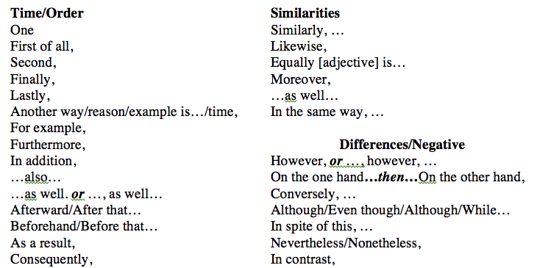
Transitions
A transition is like a bridge between your examples and paragraphs. 95% of examples will have a transition between them.
Notes:
The transitions here are on the transitions attachment along with an activity.

Slide 38
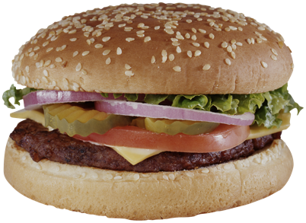
Transitions
I want to cross the river to eat that yummy meat but there’s no bridge! ☹
Yum! Thank you, friend! Aren’t I so cute?
Transitions make the reader happy and prevent them from getting wet!
2nd paragraph!
Finally, …
3nd paragraph!

Slide 39
Transitions
Transitions make the reader happy and prevent them from getting wet!
2nd paragraph!
Finally, …
3nd paragraph!

