Slide 1
Reader’s Workshop
Increasing Fluency and Enthusiasm
© Mr. Chapman Productions. ☺

Slide 2
Why Workshop Model?
Done effectively, the model fosters:
  Independence
    Students learn interchangeable strategies they can use again and again on their own.
  Differentiation
    Students read and write at their own level and there’s a lot more time for individual and group conferencing.
  Excitement about reading and writing
    When students choose what to read and write, they have more ownership, they’re introduced to other genres, and they get their friends excited about reading and writing.
  Increased reading and writing abilities (and scores)
    From my experience, students in the workshop model, especially lower level students, grow exponentially as readers and make major leaps as writers.
Notes:
-one of the things I hated most when I started workshop—and when I start anything, is that no one would explain why we do it. What makes it effective?

Slide 3
Agenda
Goals of Reading Workshop
Setting it up for the first time
Creating a community of readers
Assessment: Conferences, reading logs, and reading responses
What a lesson can look like
Notes:
By the end of the workshop, my goal is for you to know how to begin to implement the workshop model efficiently and effectively; as I was putting this together I was trying to find a balance between general structure, specific ideas, and nuances that have really helped me out. The whole goal of workshop is to get students to enjoy reading while being metacognitive about their reading.

Slide 4
Goals of Reading Workshop
To increase fluency…
  we need to foster a love of reading.
To increase critical thinking…
  we need to teach students how to be metacognitive about reading, to think about how they read.
To instill independence…
  we need to model strategies in a way that they can repeat the process on their own.
Notes:
The more students read, the better they get as readers. It’s as simple as that.
Much of what we do as readers we do unconsciously. We want to get students to be aware of what they already do, add to those abilities, and get them to a point where they can be critical thinkers without having to think about it.

Slide 5
Setting it Up For the First Time
Set up your library & reading resources
  Divide books into genres, levels, and partnership books
  Have a quick, efficient system for signing out books
  Have specific, clear library rules
  If you can make your library slightly closed off, great!
  Make sure reading resources—like reading logs, reading plans, book recommendation sheets, whatever!—are easily and independently accessible
Notes:
2 days spent on setup is a lot better than going three months with them not knowing much about it.
• I feel there’s nothing more important to reading workshop than having a well-stocked library
• I usually prefer to have students do it.
• Never let a student bring a book back to heir seats without checking it out…that’s how books are lost
• Silent communication, mouthing, restrictions on how often they can go…they shouldn’t choose a new book every day
•

Slide 6
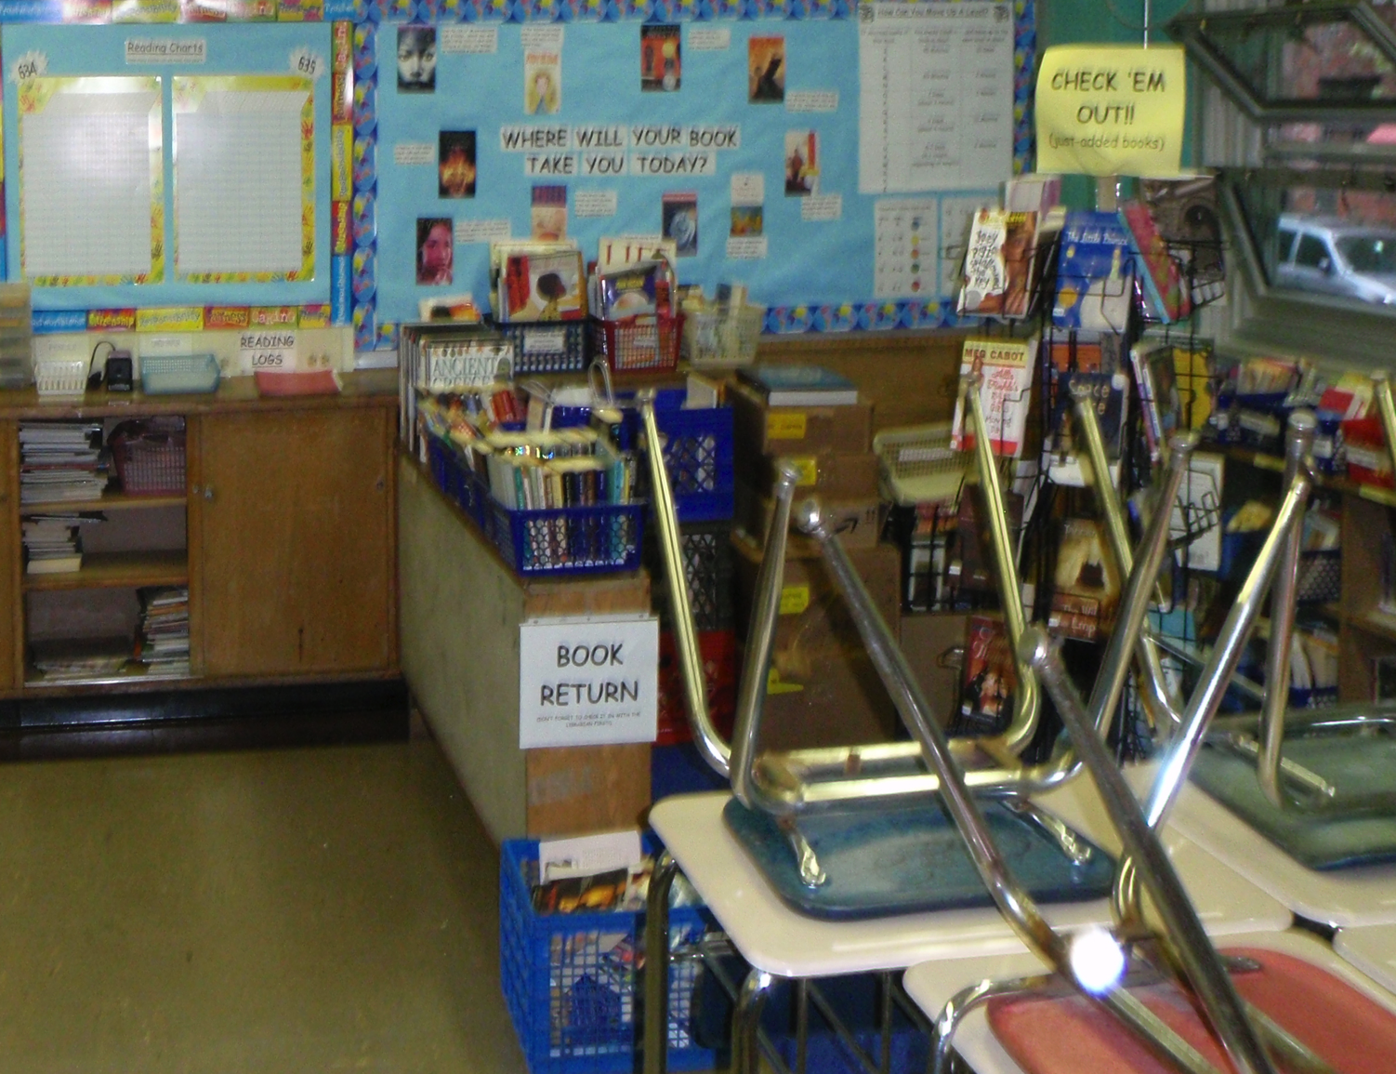
Notes:
Blurry pre-first day photo: Book Return, Books sorted by levels and genres (and even some boxes of unsorted ones), color-coded read “Just In/Check ‘Em Out” books, folder for reading logs, and Reading Chart (for how many books completed)

Slide 7
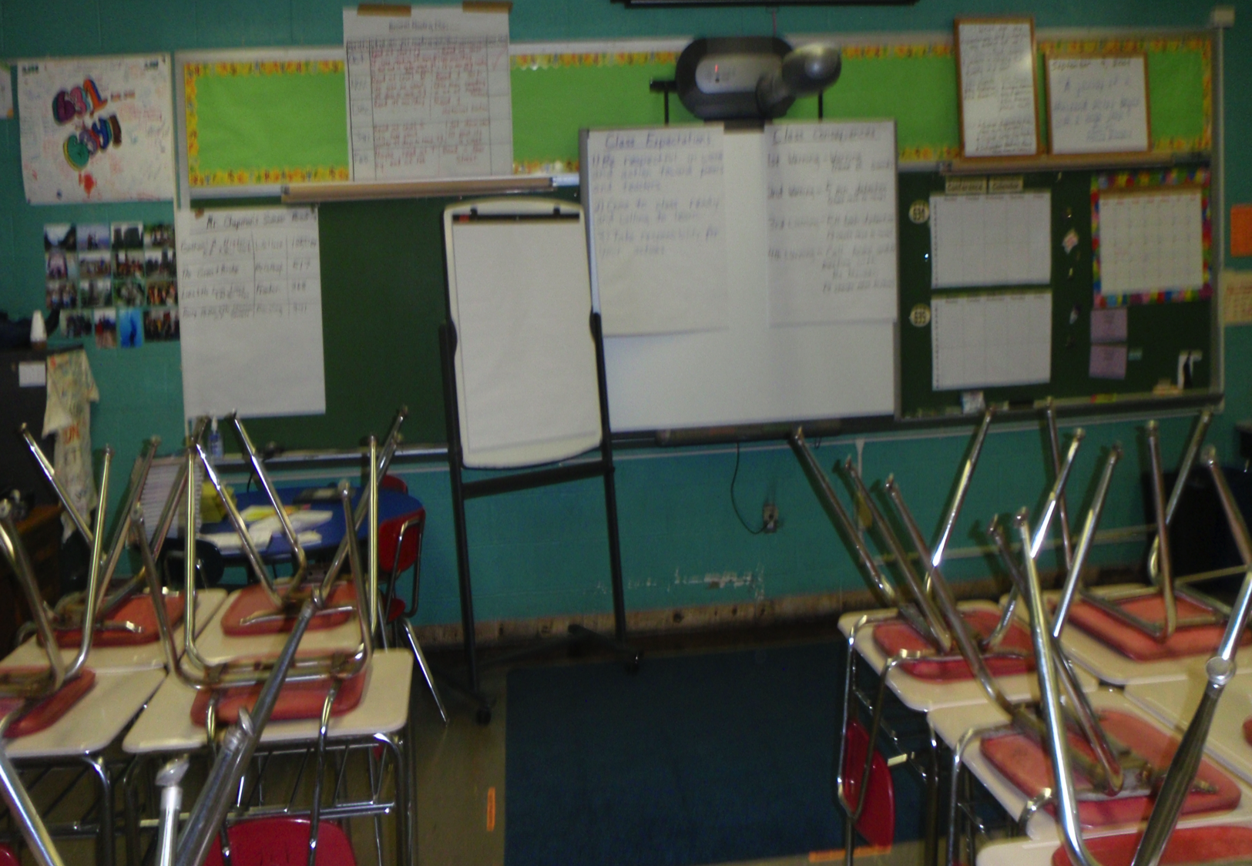
Notes:
“Quote of the Day,” calendar, Personal Reading Plan, Mr. Chapman’s Books Completed List (from the summer) and conferencing calendar

Slide 8
Setting it Up For the First Time
Set up your library & reading resources
  Divide books into genres, levels, and partnership books
  Have a quick, efficient system for signing out books
  Have specific, clear library rules
  If you can make your library slightly closed off and add chairs or bean bags, great!
  Make sure reading resources—like reading logs, reading plans, book recommendation sheets, whatever!—are easily and independently accessible
  Teach students how to choose a “just right” book—and give them the time to do it!
Notes:
2 days spent on setup is a lot better than going three months with them not knowing much about it.
• I feel there’s nothing more important to reading workshop than having a well-stocked library
• I usually prefer to have students be the librarian so that I can conference with students—usually I choose a strong reader, as I’m less worried about them being interrupted in their reading
• Never let a student bring a book back to their seats without checking it out…that’s how books are lost. But they should be able to stay as long as they need to in the library.
• Silent communication, mouthing, restrictions on how often they can go…they shouldn’t choose a new book every day (ask permission to go to library by pointing)
• I usually only let 3-4 students in library at a time
•

Slide 9
Setting it Up For the First Time
Teach students how to find a “just right” book
  BLURB
  READ THE FIRST FEW PAGES
  TITLE
  AUTHOR
  COVER
  5-FINGER RULE
  PICTURES
  SIZE OF THE TEXT
  MOVIES
  GENRE
  RECOMMENDATIONS
Notes:
2 days spent on setup is a lot better than going three months with them not knowing much about it.
• I feel there’s nothing more important to reading workshop than having a well-stocked library
• I usually prefer to have students do it.

Slide 10
Setting it Up For the First Time
Have students practice coming to the front a few times (I usually time them with an online timer) and sitting next to their partners
Have students have a specific reader’s notebook:
  It can be combined with a writer’s notebook if need be, but if the resources are available, I prefer it to be separate; at the very least, there should be a reading and a writing section
Notes:
http://www.online-stopwatch.com/full-screen-stopwatch/
I was tempted to have you all practice coming to the front with the timer, but I think it would be demeaning.

Slide 11
Setting it Up For the First Time
When you first start teaching strategies, explain what a strategy is:
  “A strategy is just a tool you use to become better readers and writers. Everyday I’m going to be teaching you a strategy so you can put it in your toolbox. You don’t have to use that strategy, but you’ll know it’s there. It’s just like putting up a poster—sometimes you’ll use a hammer and nail, sometimes you’ll use a screw and screwdriver, and sometimes you’ll use tape—and all of them are okay.”
  For you, teachers, a “strategy” is a means for them to get to a “skill”; for example, if students are having trouble inferring something about a character (a skill), one strategy might be for them to focus primarily on the dialogue, and think about what they already know about people: “If I heard someone on the street saying those things, what would I think about them?”
Notes:
2 days spent on setup is a lot better than going three months with them not knowing much about it.

Slide 12
Potential Workshop Schedule
Monday | Tuesday | Wednesday | Thursday | Friday
Read-Aloud/Independent Reading | Mini-lesson/ Independent Reading | Read-Aloud/ Independent Reading | Mini-lesson/ Independent Reading | 40 minutes of independent reading
• If you want to keep your mini-lessons short, you might not have time to read a full short story and teach a strategy. I usually do 15 minutes of read-alouds twice a week, pausing a few time as I read to practice strategies we’ve already learned or previewing the strategy I’m going to teach tomorrow.
• Then, the following day, I’ll teach them a strategy based on the piece I’ve already read.
• Modify it to your needs. If you need to do a read-aloud and strategy on the same day, go for it!
Notes:
Sometimes when I’m reading a longer short story (or a novel), my students will beg me to read more. And if you want to wake 40-45 minutes (a whole class period for me) to do a read-aloud, go for it! You know your students!
It’s always fun, though, to watch students get disappointed when you *stop* reading. That’s a good way to increase engagement and excitement about reading.

Slide 13
What A Workshop Lesson Looks Like
Hook/Connection
  Possibly ask a question or make a statement to engage students, and definitely make a connection to what you’ve done recently
Demonstration (“I Do”)
  Model the strategy for the day in front of them (usually takes 5-7 minutes)
Active Engagement (“We Do”)
  Have students work on the strategy on their own or in partnerships for 30 seconds to a minute; have a few share
Independent Work (“You Do”)
  Have students go back to their seats and read independently for 15-20 minutes, while hopefully demonstrating some evidence of using that strategy in their notebook or on post-its
Sharing
  If there’s time, I often have students share a little about their book with someone at the table, a book recommendation they have with the whole class, or the evidence of the strategy (“I inferred this because…”)
Notes:
-modeling is important; students need to know that you’re a writer, that you make mistakes
-I do a lot of my modeling on the computer because it’s so much faster and it makes it that much easier for me to reuse the lesson the next year
-Steps if students need it

Slide 14
What A Workshop Lesson Looks Like
Hook/Connection
  Possibly ask a question or make a statement to engage students, and definitely make a connection to what you’ve done recently. If you’re just doing a read-aloud, you could just introduce the book a little
    “How many of you have overheard a conversation on the street and assumed something about them based on what they were saying?”
    “I was reading the comic strip Calvin & Hobbes the other day, and I was thinking about how well I seem to know them just from a few conversations and actions.”
    “Last week we worked a lot with inferring something about a person from their actions—what they do. A lot of times, though, our first impressions of a person or a character come from what they are saying.”

Slide 15
What A Workshop Lesson Looks Like
Hook/Connection
  Possibly ask a question or make a statement to engage students, and definitely make a connection to what you’ve done recently
Demonstration (“I Do”)
  Model the strategy for the day in front of them (usually takes 5-7 minutes)
Active Engagement (“We Do”)
  Have students work on the strategy on their own or in partnerships for 30 seconds to a minute; have a few share
Independent Work (“You Do”)
  Have students go back to their seats and read independently for 15-20 minutes, while hopefully demonstrating some evidence of using that strategy in their notebook or on post-its
Sharing
  If there’s time, I often have students share a little about their book with someone at the table, a book recommendation they have with the whole class, or the evidence of the strategy (“I inferred this because…”)
Notes:
-modeling is important; students need to know that you’re a writer, that you make mistakes
-I do a lot of my modeling on the computer because it’s so much faster and it makes it that much easier for me to reuse the lesson the next year
-Steps if students need it

Slide 16
What A Workshop Lesson Looks Like
Strategy: Readers can often infer, or guess, a lot about a character from what the say. Read what your character is saying and ask yourself, “If I were listening to this person in real life, what would I think about them?”
Notes:
-modeling is important; students need to know that you’re a writer, that you make mistakes
-I do a lot of my modeling on the computer because it’s so much faster and it makes it that much easier for me to reuse the lesson the next year; it also allows me to watch the classroom while I’m typing

Slide 17
Potential Units
Month | Unit
September | Launching Independent Reading, Workshop; Reading Assessments
October | Mystery/Horror/Suspense
November | Nonfiction Reading/Content Unit
December/January | Fantasy Unit/Book Clubs
February/March | Poetry
March/April | Reading for a Test
May/June | Social Issues Book Clubs
Notes:
I usually make sure my reading and writing units complement each other. So, for example, if they’re reading poetry in March, they’re usually working on creating their own poetry packet. This is primarily taken from Teacher’s College calendars and collaboration at my school.

Slide 18
Skills I Focus on
Throughout the Year
Self-Monitoring (making sure they understand what they’re reading)
Making a movie in their heads (envisioning)
Inferring
Making predictions
Asking questions
Making text to self/text/world connections
Responding personally to the text
Notes:
I introduce them during the first month
• And I’ll show different strategies for each of them. For me, inferring is the one that leads to the most critical thinking, and is extremely important as students start writing literary essays.
• You can use multimedia!

Slide 19
Assessment: Reading Levels
Being able to assess students and, especially, getting them to assess themselves is essential to their growth.
With levels, make clear that one’s reading level is nothing to be ashamed of.
A student at their right level usually should be reading about a page every minute (in fiction)
Notes:
“Everyone has strengths and weaknesses.” I tell my students that you don’t start advanced chemistry before you’ve read “Chemistry.” You wouldn’t read Twilight if Judy Blume is difficult for you.
How is elementary school assessing their readers?
I used to link to an online assessment I put together with Google Forms for students who were above a T level, but for privacy/proprietary reasons, I’ve hidden the links

Slide 20
Assessment: Conferencing
One-on-one conferencing is the best way to assess a student’s level. Even a question as simple as “How’s your book going?” can give you a sense of student comprehension.
  It’s easier said than done: it takes a lot of time, especially as you’re getting used to it
Tips:
  Reading Notebooks/Responses: allows perfect jumping off point for a conversation
  Thumbs Up/Thumbs Down: Ask students at the end of the lesson to show you with their thumbs, “Will you know how to use the strategy when you go back to your seats?” or “How well did you understand the lesson?”
  Computer documentation: easy to copy and paste specific strategies…or having a list of skills you want them to have as a check-off sheet

Slide 21
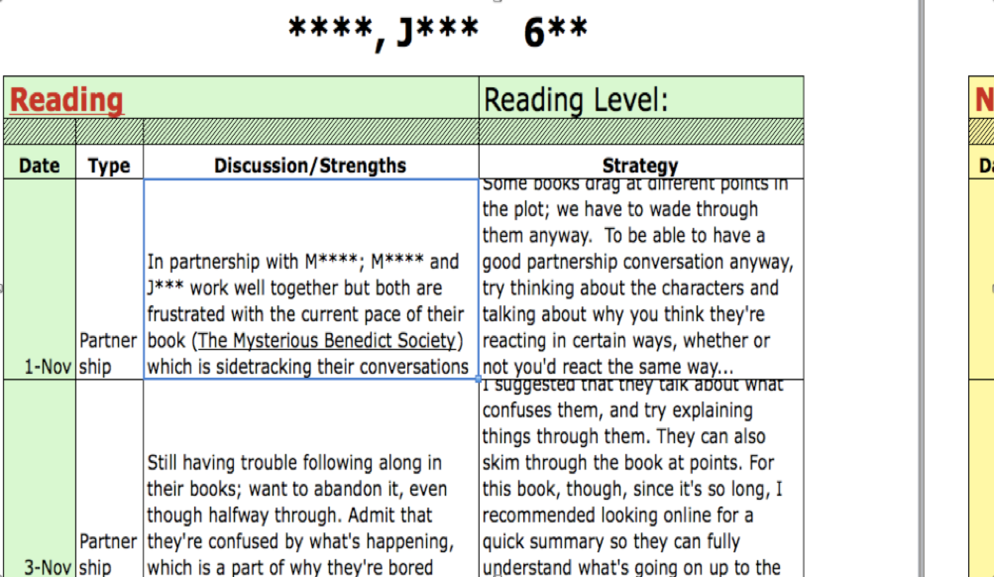
Assessment: Conferencing

Slide 22
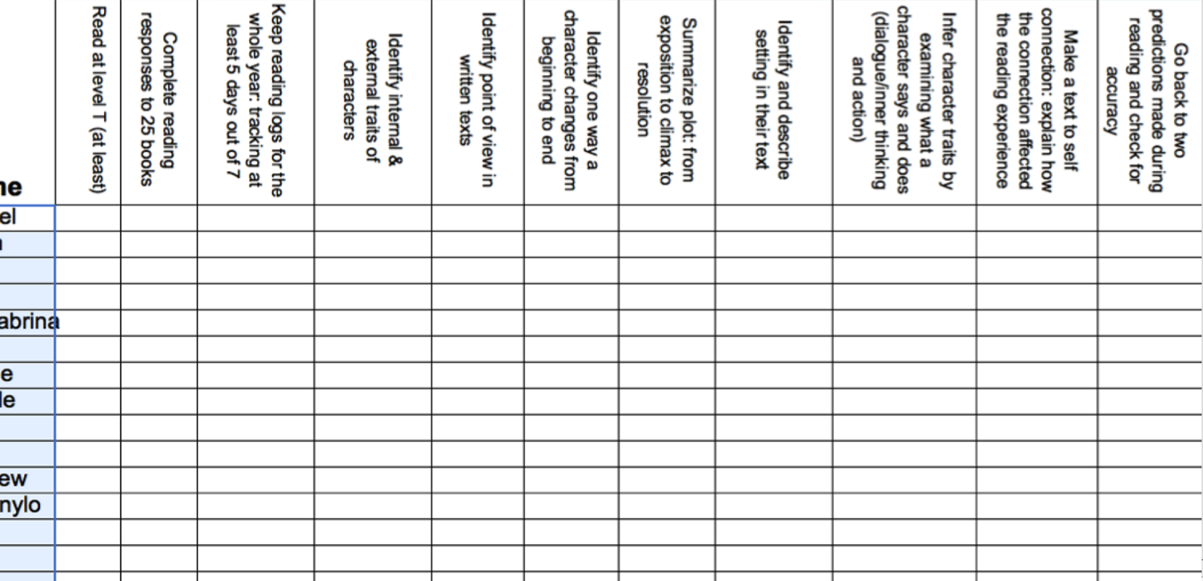
Assessment: Conferencing

Slide 23
Assessment: Conferencing
One-on-one conferencing is the best way to assess a student’s level. Even a question as simple as “How’s your book going?” can give you a sense of student comprehension.
  It’s easier said than done: it takes a lot of time, especially as you’re getting used to it
Tips:
  Reading Notebooks/Responses: allows perfect jumping off point for a conversation
  Thumbs Up/Thumbs Down: Ask students at the end of the lesson to show you with their thumbs, “Will you know how to use the strategy when you go back to your seats?” or “How well did you understand the lesson?”
  Computer documentation: easy to copy and paste specific strategies
Notes:
I’ve heard of other teachers having the students write down the strategy they learned

Slide 24
Assessment: Reading Logs
Students should be reading at home and responding to their reading.
  I assign a certain number of pages each week, adjustable depending on class novel pages and if there are any tests/projects
  Honesty is part of it, but there’s an easy way to check to see if they’re telling the truth.
  Judging by their responses and how many pages they’re reading, you have a jumping off point for conferences.
Notes:
-that way, you also can’t have the students tell their parents, “I don’t have homework this week!” No, you have your pages!

Slide 26
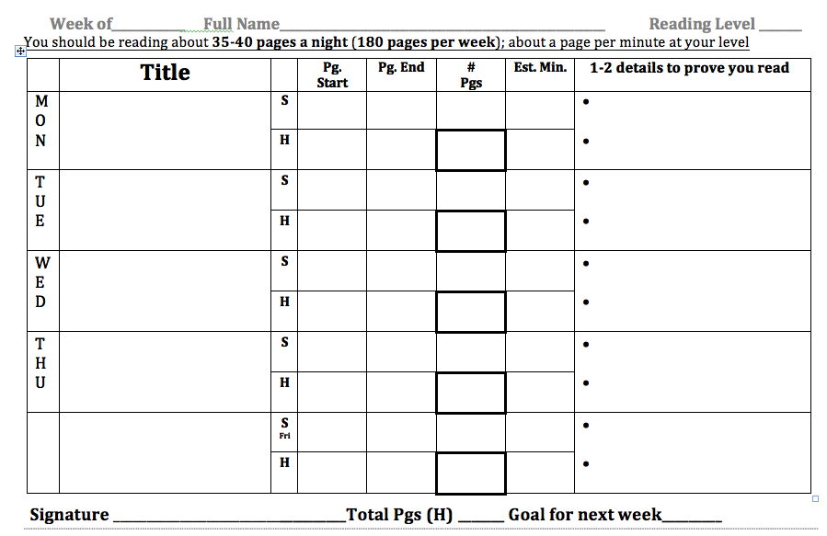

Slide 27
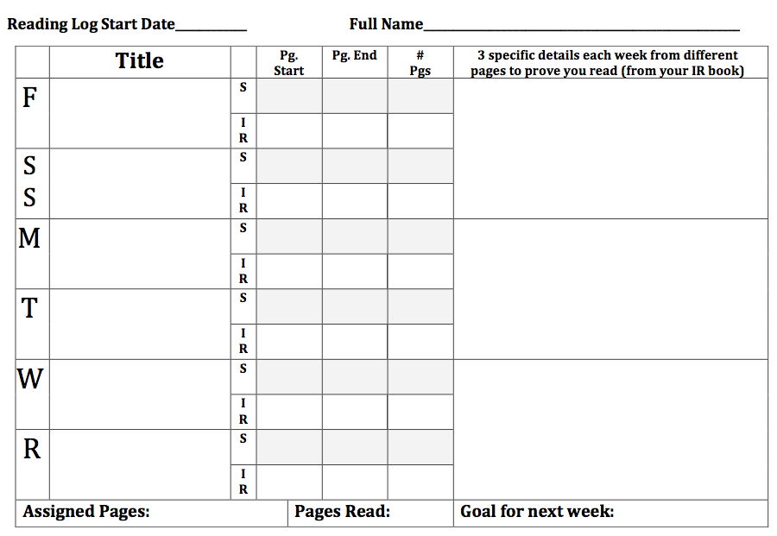

Slide 28
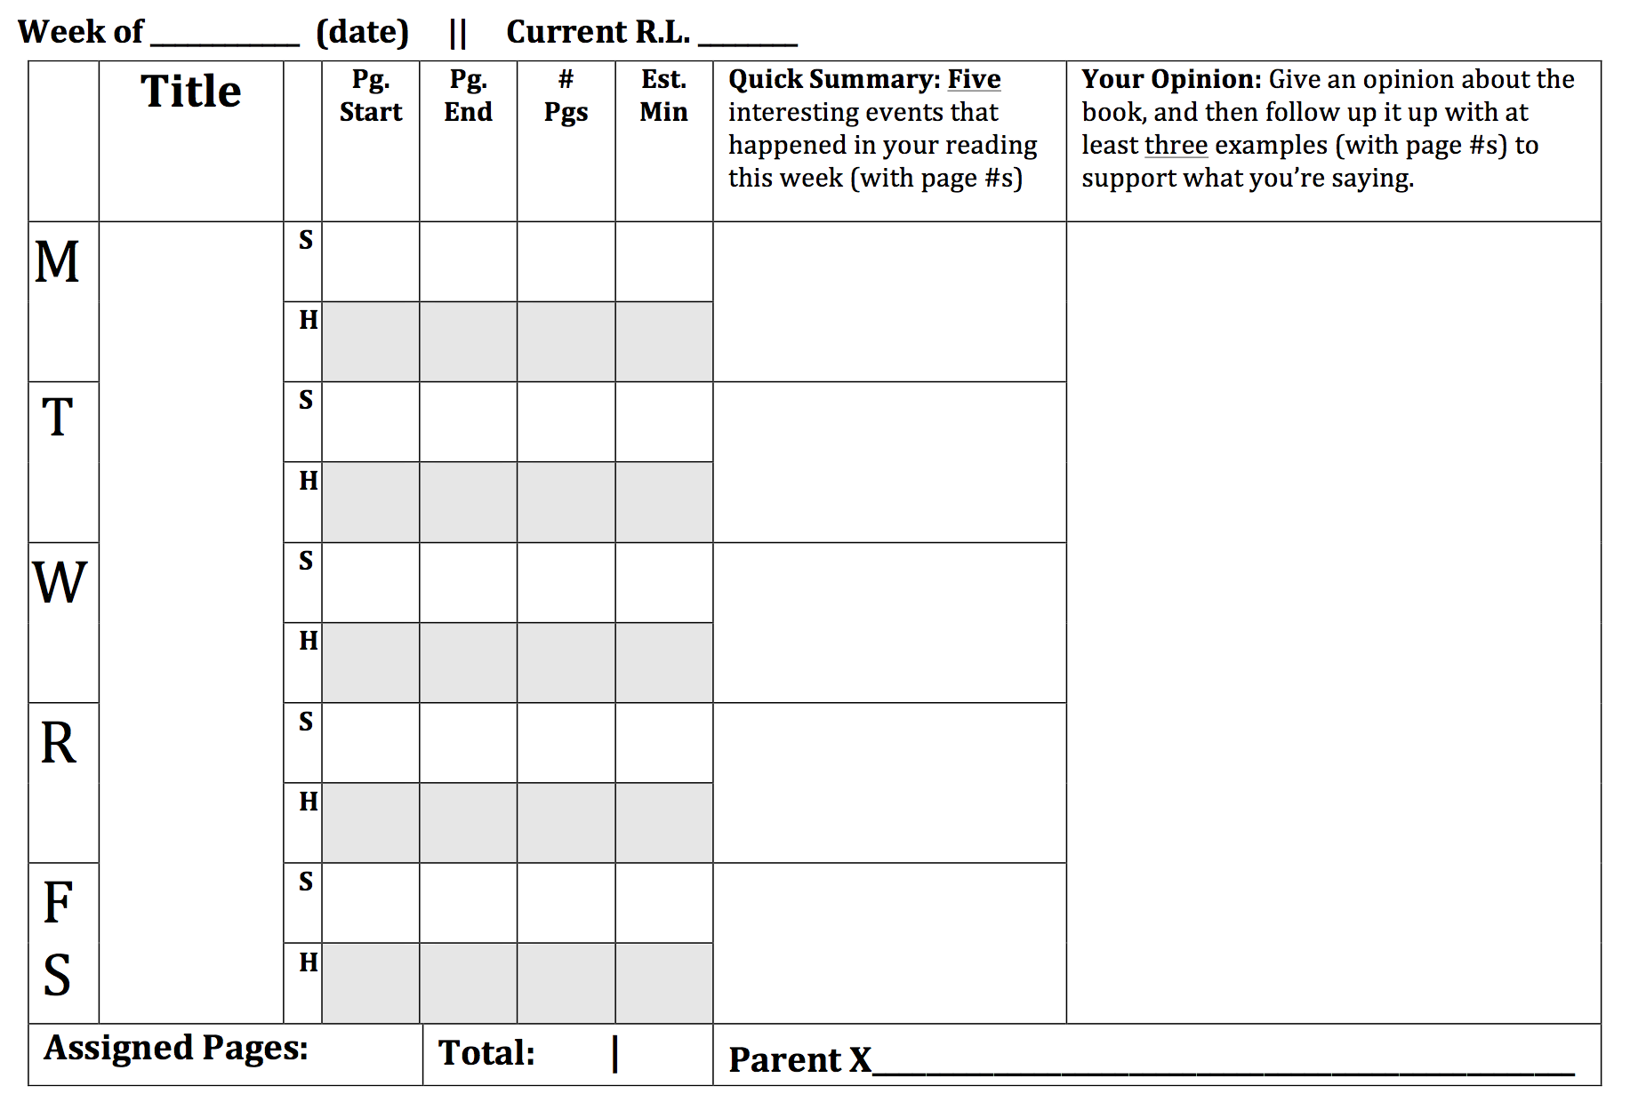

Slide 29
Assessment: Reading Responses
If you’re just starting reading responses, your student’s responses might be simple:
  I can see that Melanie is a lot calmer than Roger.
  I predict that Roger is going to cheat on the test.
  Melanie reminds me of the character Rachel from the movie The Dark Knight.

Slide 30
Assessment: Reading Responses
But push your students to go farther, as these require little thought:
  I can see that Melanie is a lot calmer than Roger.
  I predict that Roger is going to cheat on the test.
  Melanie reminds me of the character Rachel from the movie The Dark Knight.

Slide 31
Assessment: Reading Responses
But push your students to go farther, as these require little thought:
  I can see that Melanie is a lot calmer than Roger.
    Why do you think that?
  I predict that Roger is going to cheat on the test.
  Melanie reminds me of the character Rachel from the movie The Dark Knight.

Slide 32
Assessment: Reading Responses
But push your students to go farther, as these require little thought:
  I can see that Melanie is a lot calmer than Roger.
    Why do you think that?
  I predict that Roger is going to cheat on the test.
    Why do you think that?
  Melanie reminds me of the character Rachel from the movie The Dark Knight.

Slide 33
Assessment: Reading Responses
But push your students to go farther, as these require little thought.
  I can see that Melanie is a lot calmer than Roger.
    Why do you think that?
  I predict that Roger is going to cheat on the test.
    Why do you think that?
  Melanie reminds me of the character Rachel from the movie The Dark Knight.
    Why do you think that?
Notes:
Make sure they answer their own questions.

Slide 34
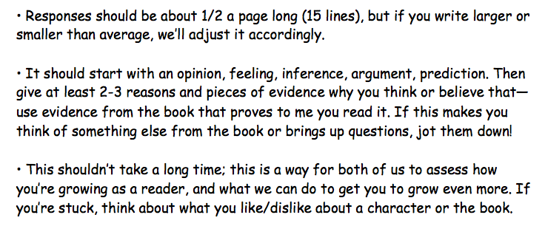
Assessment: Reading Responses
Eventually, when I feel they’re ready, I have them write mini-essays graded solely on effort:
Notes:
Make sure they answer their own questions.

Slide 35
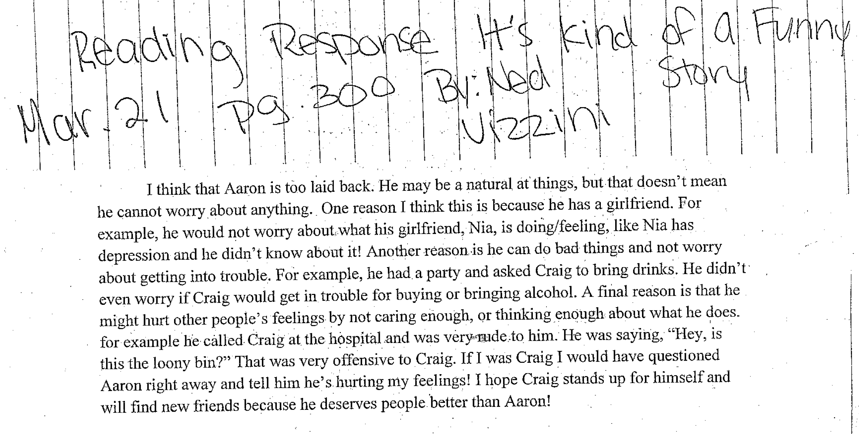
Assessment: Reading Responses
Notes:
6th Grade Sample: This is a strong response, and I’d praise her for her organizing ability when I conference with her. I would ask her, though, next time to work on expanding her examples: giving more than 1 example per reason. Used with student’s/parents’ permission

Slide 36
Assessment: Now What?
If students are very low, it’s often helpful to pull them for guided reading 2-3+ times a week. It’s almost like a quiet read-aloud, but with a lot more scaffolding (you might give a brief summary of the chapter and point out vocabulary ahead of time, for example)
Have students set goals for themselves, both based on levels but also on genres, number of pages per week and number of books. Check in on their personal reading goals when you conference.

Slide 37
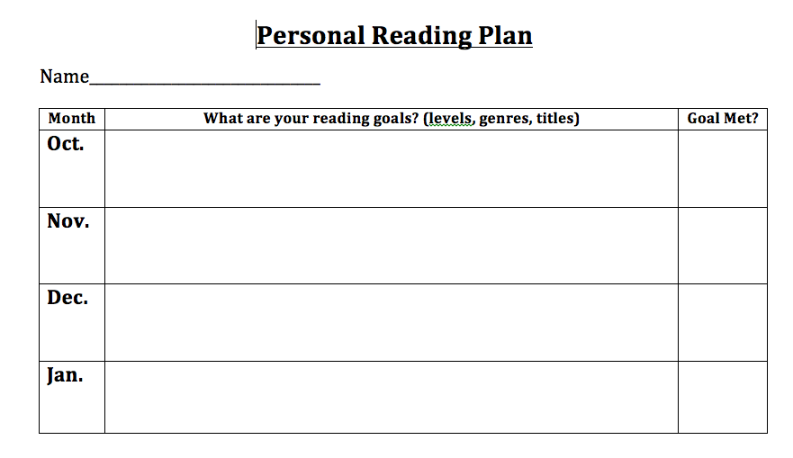

Slide 39
Creating a Community of Readers
The best thing you can do to increase literacy in your class is creating an environment where students want to read, and from my experience the best way to do that is to make reading a social practice. When students walk into your room, they should see that “This is a place where reading happens.”
Notes:
Usually I’d save this part toward the end, but this is actually one of the most important things you can do…and I don’t know how I’ll be on time

Slide 40
Creating a Community of Readers
Make reading a social, fun activity!
  Give students the time to share their books both with each other—orally or through letters—and with the entire class. Post recommendations next to your library!
  Have partnership/group books reserved just for 2+ students to read at the same time
  Have a books completed chart with stickers/stars for when students finish.
  Have your students read to younger or older students
  If you’re doing a read-aloud and students are enjoying it, keep reading!
Notes:
Even something small like opening up a new box of books in front of them is great! I used to open up amazon.com boxes in front of students while they were reading silently—didn’t say anything, just let them turn their heads and get excited.

Slide 41
Creating a Community of Readers
Make clear that you are a reader too!
  When you are reading or finish a really good book, talk about it with your students, even briefly!
  Try to read as many of the books in your library at various levels so you can offer them as recommendations to students.
  Put up a chart that lets students see if they can beat you in pages or number of books: “Can you beat Mr. Chapman?”
  For some of the independent reading, you should read too! Again, you are the model reader.
Notes:
“Can you beat Mr. Chapman?”

Slide 42
A Few Reading Activities
(that have worked really well for me)

Slide 43
A Few Reading Activities
(that have worked really well for me)
Tone/Mood
  Have students listen to love songs, then ask themselves, “What is the speaker’s tone toward the subject? What is the mood?” Then they make a collage of tone & mood.

Slide 44
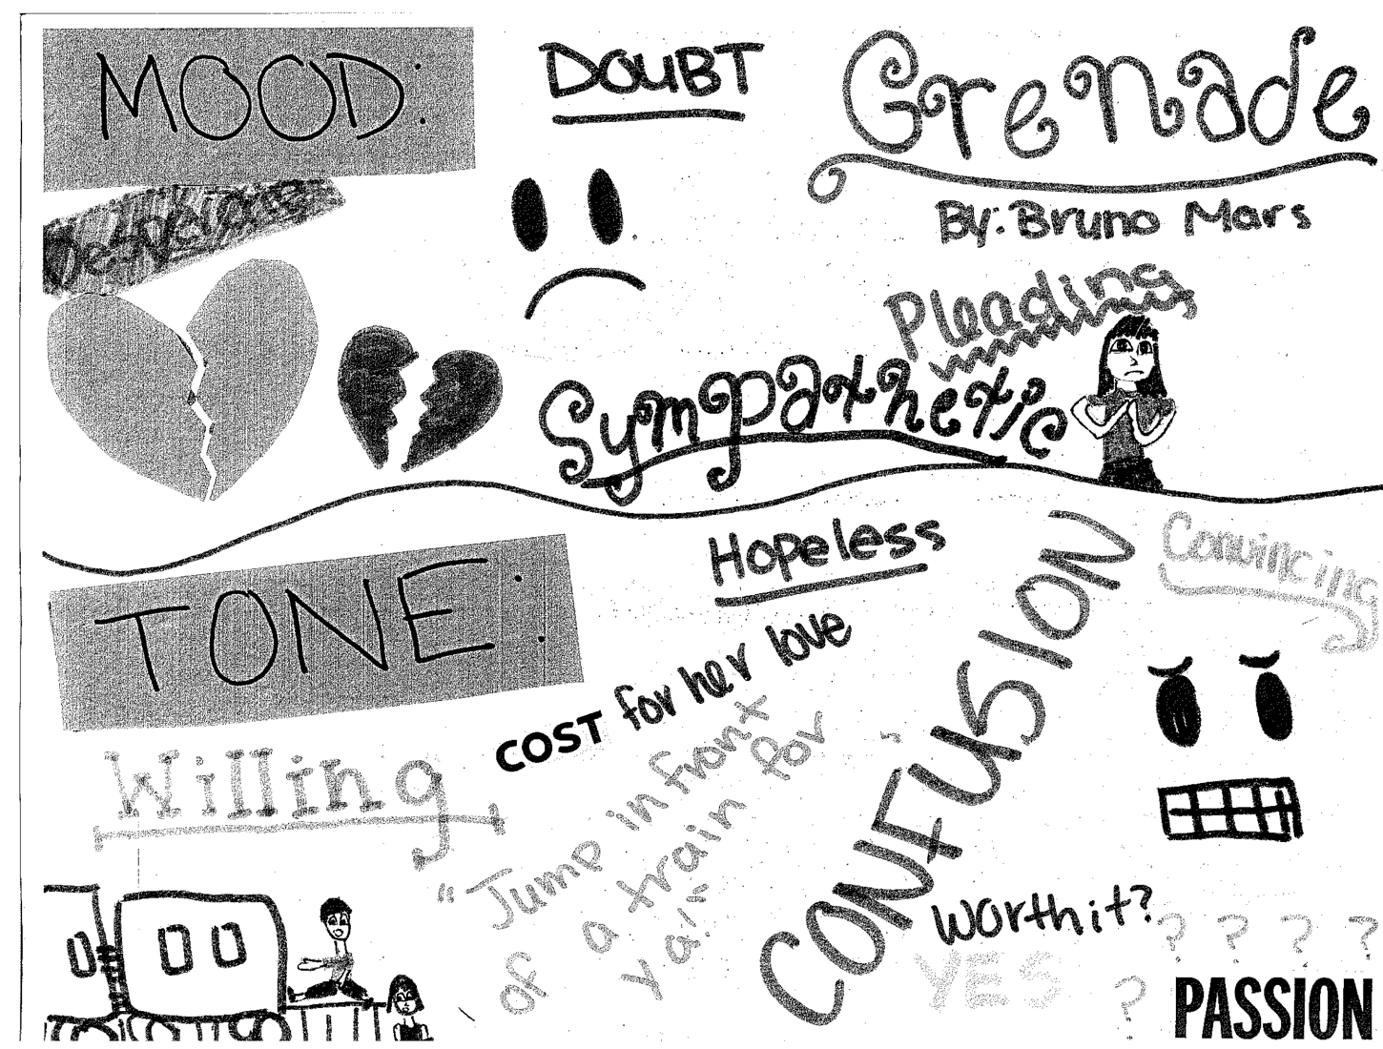
Notes:
6th Grade Sample. Used with student’s/parents’ permission

Slide 45
A Few Reading Activities
(that have worked really well for me)
Tone/Mood
  Have students listen to love songs, then ask themselves, “What is the speaker’s tone toward the subject? What is the mood?” Then they make a collage of tone & mood.
Informational Posters
  Have students in groups read nonfiction books from a specific category, and make their own DK posters

Slide 46
Notes:
This is just a quick sketch I gave students of what I was expecting.

Slide 47
A Few Reading Activities
(that have worked really well for me)
Tone/Mood
  Have students listen to love songs, then ask themselves, “What is the speaker’s tone toward the subject? What is the mood?” Then they make a collage of tone & mood.
Informational Posters
  Have students in groups read nonfiction books from a specific category, and make their own DK posters
“Murder Mystery”/Scavenger Hunt
  Create a scavenger hunt around the school revolving around the genre you’re teaching your students

Slide 48
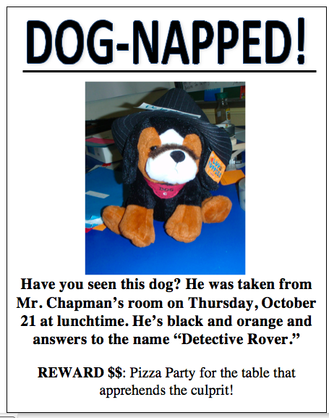

Slide 49
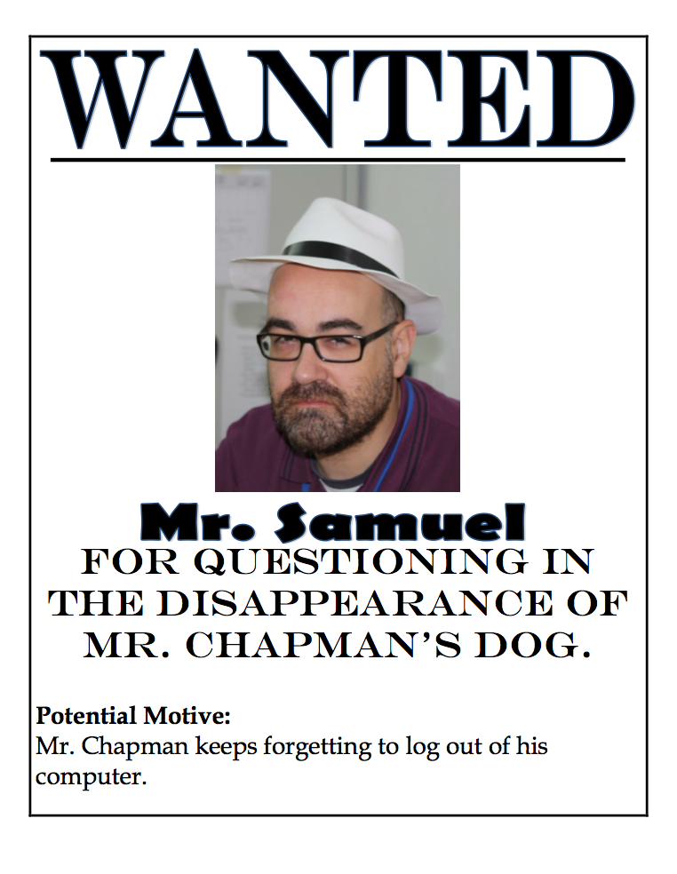

Slide 51
A Few Reading Activities
(that have worked really well for me)
Tone/Mood
  Have students listen to love songs, then ask themselves, “What is the speaker’s tone toward the subject? What is the mood?” Then they make a collage of tone & mood.
Informational Posters
  Have students in groups read nonfiction books from a specific category, and make their own DK posters
“Murder Mystery”/Scavenger Hunt
  Create a scavenger hunt around the school revolving around the genre you’re teaching your students
Poetry Write-Around
  If you’re teaching poetry, have students in groups copy out the poems on posters, then write comments next to specific words or lines. Every few minutes, have them pass it.
Bumper Stickers
  Have students consider the theme of a book in a creative way: “If I were going to turn this book into a bumper sticker, what would it be?” Then have them create a bumper sticker for their IR book.
Notes:
Bottom 2 are *not* my ideas

Slide 52
What a Nonfiction Strategy May Look Like
As we’re reading nonfiction, it’s often easy to be overwhelmed by all the information. Strategy: Sometimes it’s good to just focus on one aspect at a time.
As I’m reading the story, in groups of 3:
  Fact: Jot down bits of information—numbers, details, who, what, when and where
  Story: Who are the characters? What is the conflict?
  Reflection: What is your response to the story?
Notes:
I read a nonfiction narrative (in this case, “Killer,” which I “translated” from The New Yorker)

Slide 53
Final Thoughts
In a lot of ways, the workshop model requires much more work than a “traditional” one
  Not just mini-lesson: conferencing, note-taking, pre-assessments, group work
Let students be real readers:
  Real readers occasionally abandon books. (Most) real readers don’t “stop and jot” in their book. Real readers go back and read a book that’s extremely easy for them.
Be engaging when you read!
  Show your excitement, do voices, make them laugh!
Use multimedia!
  A “text” is a broad term! The more connections students make between books and the multimedia they “read” more often, the better!
Notes:
• That doesn’t mean you should allow students to always abandon their books or not respond to reading. Just acknowledge to them that readers read differently, even if you need evidence that they’re able to comprehend and think critically about their reading.
• A lot of things you might do for your class novels—graphic organizers, Facebook pages for their characters, writing letters to their characters—still apply in their IR books.
One of the greatest problems I’ve seen in people using the workshop model is that it ends up being the end-all/be-all in their classrooms; it shouldn’t be. Trust your instincts. If you think your mini-lesson should go on longer, great! If you think students need some more time on something, great!

Slide 54
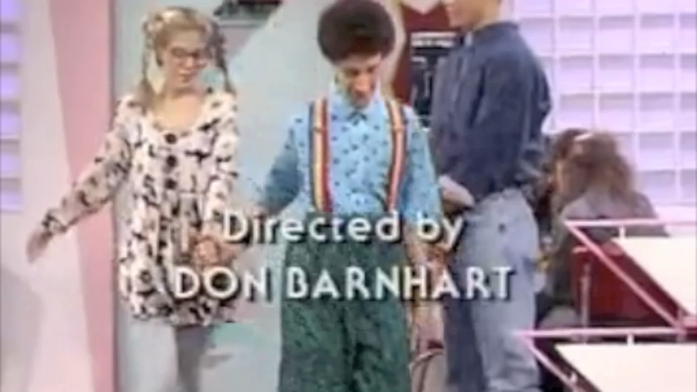
Notes:
I might show a short clip from Saved By The Bell and let students infer something about the characters

Slide 55
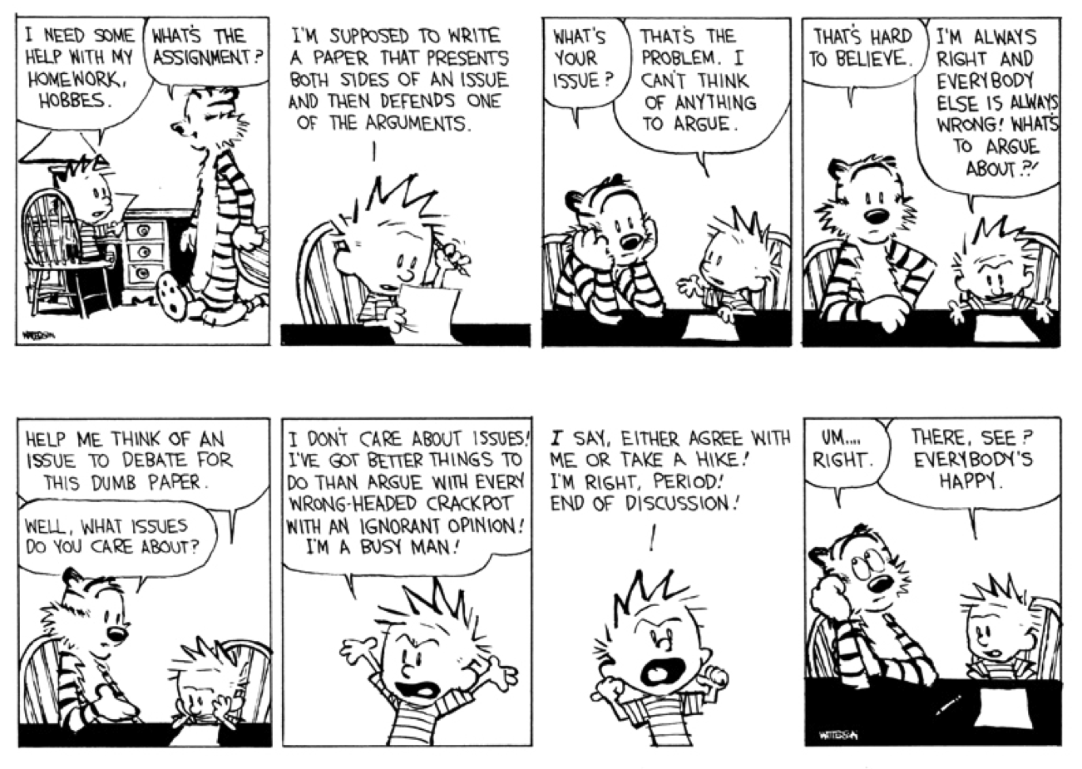
Notes:
Or infer something about Calvin and Hobbes from their dialogue

Slide 56
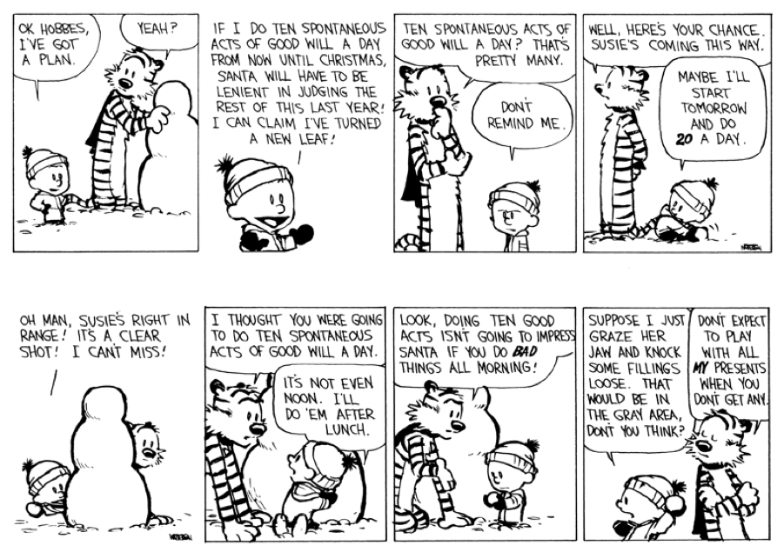
Notes:
Or infer something about Calvin and Hobbes from their dialogue

Slide 57
Final Thoughts
In a lot of ways, the workshop model requires much more work than a “traditional” one
  Not just mini-lesson: conferencing, note-taking, pre-assessments, group work
Let students be real readers:
  Real readers occasionally abandon books. (Most) real readers don’t “stop and jot” in their book. Real readers sometimes go back and read a book that’s extremely easy for them (I read Charlotte’s Web once a year, for example!).
Be engaging when you read!
  Show your excitement, do voices, make them laugh!
Use multimedia!
  A “text” is a broad term! The more connections students make between books and the multimedia they “read” more often, the better!
Be prepared to “break” the model
  It’s not set in stone: use your instincts
Notes:
• That doesn’t mean you should allow students to always abandon their books or not respond to reading. Just acknowledge to them that readers read differently, even if you need evidence that they’re able to comprehend and think critically about their reading.
• A lot of things you might do for your class novels—graphic organizers, Facebook pages for their characters, writing letters to their characters—still apply in their IR books.
One of the greatest problems I’ve seen in people using the workshop model is that it ends up being the end-all/be-all in their classrooms; it shouldn’t be. Trust your instincts. If you think your mini-lesson should go on longer, great! If you think students need some more time on something, great!

