Slide 1
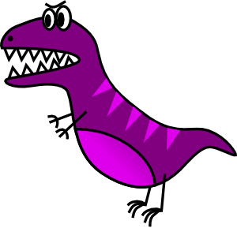
Stretching Out a Scene
Showing vs. Telling

Slide 2
Why the heck?
Stretching out a scene adds suspense and gets us into the story.
If you just tell an important scene, it’s very unsatisfying to the reader. We want to see it!

Slide 3
Telling
The dinosaur chased them through the forest.

Slide 4
Showing
Notes:
http://youtu.be/rxqHVoZ0fzc?t=30s (there’s a bad word in there, so if they’re too young, mute it [:54-1:00] )

Slide 5
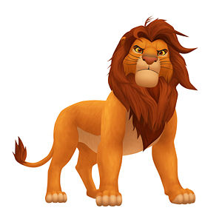
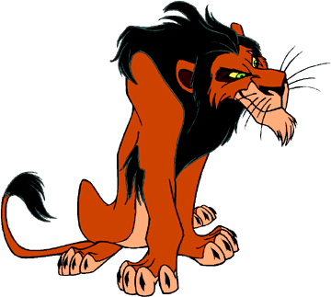
Telling an important scene
Simba fought Scar and became king.
Scar, step down as king or fight.
Okay, let’s fight!
No!
Notes:
I ask my students, “Would you pay $8 for this movie if this were the climax?”

Slide 6
Showing the Scene
Notes:
http://www.youtube.com/watch?v=c8nHCZqgFA8

Slide 7
What differences did you notice? (think things that could be written in a story)
Notes:
Zooming in on the face (very important in stories)
Tone of voice (dialogue--conversation)
Background (fire, embers, other people around)
Action (way they fight, biting on the neck, paws in the face)

Slide 8
Description (Flames, Rocky ledge/mountain, hyenas around, embers)
Dialogue
Action (Individual punches, threw the embers, threw him to the ground, running/jumping)

Slide 9
Zoom in on a scene by adding:
Play-by-Play Action (little bits of action, step-by-step)
The monster attacked Raul. Raul stood frozen in fear as it reached out a claw and grabbed his left shoulder, digging its knife-like claws into his skin. Raul let out a muffled scream as the monster lifted him into the air.
Description
• Rachel walked into the temple. main chamber of the temple. The vines of Dionysus hung on the decrepit walls and wrapped around the four massive marble columns, almost hiding their cracks. The floor was littered with the rotting skins of grapes, causing the pungent stench of vinegar to pervade the room.
Thoughts (internal conflict).
• Will wasn’t sure what to do. If If he ran he might live, but then his friend would be trapped. Would he ever make it out alive either way? He had to make a decision fast!
Dialogue (but don’t make your characters talk if they don’t)
She threatened him from the bottom of the castle. she screamed from the bottom of the castle.
Zoom in on a scene by adding:
Play-by-Play Action (little bits of action, step-by-step)
The monster took a step toward Raul and let out a roar. Raul stood frozen in fear as it reached out a claw and grabbed his left shoulder, digging its knife-like claws into his skin. Raul let out a muffled scream as the monster lifted him into the air.
Description
Rachel walked into the expansive main chamber of the temple. The vines of Dionysus hung on the decrepit walls and wrapped around the four massive marble columns, almost hiding their cracks. The floor was littered with the rotting skins of grapes, causing the pungent stench of vinegar to pervade the room.
Thoughts (internal conflict).
Will wondered what he had to do. If he ran he might live, but then his friend would be trapped. Would he ever make it out alive either way? He had to make a decision fast!
Dialogue (but don’t make your characters talk if they don’t)
“One of us is going to die today!” she screamed from the bottom of the castle. “And it’s going to be you!”
Notes:
This can either be an introduction to all four, or an integration of these four. Either way, you’ll probably want to teach each of these four as their own individual lessons before or after this PowerPoint.

Slide 10
Let’s Expand This
Simba fought Scar and became king.

Slide 11
Let’s Expand This
Scar swept the embers into Simba’s eyes. Simba howled in pain as his enemy pounced on him. Simba wrestled him to the ground, but quickly was thrown off him.
Suddenly, they both charged toward each other. They grappled. Scar smashed his paw into Simba’s face, who then returned the blow.

Slide 12
Let’s Expand This
Scar swept the burning embers into Simba’s eyes. Simba howled in pain as his enemy pounced on him, Scar’s fierce eyes glowing in the firelight. Simba wrestled him to the ground, but quickly was thrown off him. The crackle of burning bushes filled the air while the embers of the fire danced around them.
Suddenly, they both charged toward each other, their faces twisted in anger. They grappled. Scar smashed his paw into Simba’s face, spraying blood from the wound, who then returned the blow.
Notes:
Action & Description

Slide 13
Let’s Expand This
Scar swept the burning embers into Simba’s eyes. Simba owled in pain as his enemy pounced on him, Scar’s fierce eyes glowing in the firelight. Simba felt the adrenaline rush through him as he realized his uncle would never fight fair. He wrestled Scar to the ground, but just as quickly was thrown off him. The crackle of burning bushes filled the air while the embers of the fire danced around them.
Suddenly, they both charged toward each other, their faces twisted in anger. They grappled. Scar smashed his paw into Simba’s face, spraying blood from the wound. It felt like his face was on fire, but he managed to return the blow.

Slide 14
Let’s Expand This
“Run away, Scar,” Simba uttered with disdain, “and never return.”
Scar’s face expressed his disappointment, before regaining its fierce look.
“As you wish…your majesty!”
Scar swept the burning embers into Simba’s eyes. Simba howled in pain as his enemy pounced on him, Scar’s fierce eyes glowing in the firelight. Simba felt the adrenaline rush through him as he realized his uncle would never fight fair. He wrestled Scar to the ground, but just as quickly was thrown off him. The crackle of burning bushes filled the air while the embers of the fire danced around them.
Suddenly, they both charged toward each other, their faces twisted in anger. They grappled. Scar smashed his paw into Simba’s face, spraying blood from the wound. It felt like his face was on fire, but he managed to return the blow.

Slide 15
Expand This “Climax” On Your Own
Rocky/Rachel and I got into a fight yesterday. He/she called me dumb and then I hit him/her.
Notes:
How did they hit? Where did they hit? What was “I” thinking? Where were they? Were there people around? What were they screaming? What did the pain feel like?

