Slide 1
Writer’s Workshop
Increasing Fluency and Engagement
By Corey Chapman
mail@coreybchapman.com

Slide 2
Why Workshop Model?
Done effectively, the model fosters:
  Independence
    Students learn interchangeable strategies they can use again and again on their own.
  Differentiation
    Students read and write at their own level and there’s a lot more time for individual and group conferencing.
  Excitement about reading and writing
    When students choose what to read and write, they have more ownership, they’re introduced to other genres, and they get their friends excited about reading and writing.
  Increased reading and writing abilities (and scores)
    From my experience, students in the workshop model, especially lower level students, grow exponentially as readers and make major leaps as writers.
Notes:
-one of the things I hated most when I started workshop—and when I start anything, is that no one would explain why we do it. What makes it effective? So all this is from my personal experience.

Slide 3
Agenda
Setting it up for the first time
What a lesson can look like
What a unit can look like
Conferencing
Homework/Journaling
Creating a community of writers
Notes:
By the end of the workshop, I hope that will know how to begin implement the workshop model efficiently and effectively; as I was putting this together I was trying to find a balance between general structure, specific ideas, and nuances that have really helped me out.

Slide 4
Setting it Up For the First Time
Have students practice coming to the front a few times (I usually time them with an online timer) and sitting next to their partners
Have students bring in a writer’s notebook and a reader’s notebook (these can be combined if need be, but they should at least be in separate parts of the notebook)
Explain what a strategy is:
  “A strategy is just a tool you use to become better readers and writers. Everyday I’m going to be teaching you a strategy so you can put it in your toolbox. You don’t have to use that strategy, but you’ll know it’s there. It’s just like putting up a poster—sometimes you’ll use a hammer and nail, sometimes you’ll use a screw and screwdriver, and sometimes you’ll use tape—and all of them are okay.”
  For you, teachers, a “strategy” is a means for them to get to a “skill”; for example, if students are having trouble adding description to a story (a skill), one strategy might be for them to draw each scene on a piece of paper first, then write down everything they see.
Notes:
2 days spent on setting up the workshop is a lot better than going three months with them not knowing much about it.

Slide 5
What A Workshop Lesson Looks Like
Hook/Connection
  Possibly ask a question or make a statement to engage students, and definitely make a connection to what you’ve done recently
Demonstration (“I Do”)
  Model the strategy for the day in front of them (usually takes 5-7 minutes)
Active Engagement (“We Do”)
  Have students work on the strategy on their own or in partnerships for 1-2 minutes; have a few share
Independent Work (“You Do”)
  Have students go back to their seats and write independently for 15-20 minutes (I usually make them write their first sentence before they go back)
Sharing
  Have 2-3 students share some of what they wrote for the whole class, or have students share most of what they wrote with their partners
Notes:
-modeling is important; students need to know that you’re a writer, that you make mistakes
-I do a lot of my modeling on the computer because it’s so much faster and it makes it that much easier for me to reuse the lesson the next year
-Steps if students need it

Slide 6
What A Workshop Lesson Looks Like
Hook/Connection
  Possibly ask a question or make a statement to engage students, and definitely make a connection to what you’ve done recently
    “How many of you have gotten in trouble before?”
    “I was watching CSI last night, and there was this scene where a woman had to describe a serial killer to a police sketch artist. The artist had never seen this before, but the woman described him well enough that the artist could create a fairly accurate recreation. As I was watching that I realized that when you’re writing out your fantasy scenes, you want to describe your scenes to the reader so well that they get a fairly accurate idea of what you’re seeing in your head.”
    “Yesterday we worked on adding dialogue to our stories, because we know that characters talk. What we didn’t mention yesterday, though, is something just as important: the dialogue that goes on inside a character’s head. We call this a monologue, thoughts, or internal conflict.”

Slide 7
What A Workshop Lesson Looks Like
Hook/Connection
  Possibly ask a question or make a statement to engage students, and definitely make a connection to what you’ve done recently
Demonstration (“I Do”)
  Model the strategy for the day in front of them (usually takes 5-7 minutes)
Active Engagement (“We Do”)
  Have students work on the strategy on their own or in partnerships for 1-2 minutes; have a few share
Independent Work (“You Do”)
  Have students go back to their seats and write independently for 15-20 minutes (I usually make them write their first sentence before they go back)
Sharing
  Have 2-3 students share some of what they wrote for the whole class, or have students share most of what they wrote with their partners
Notes:
Show a demonstration—scary stories

Slide 8
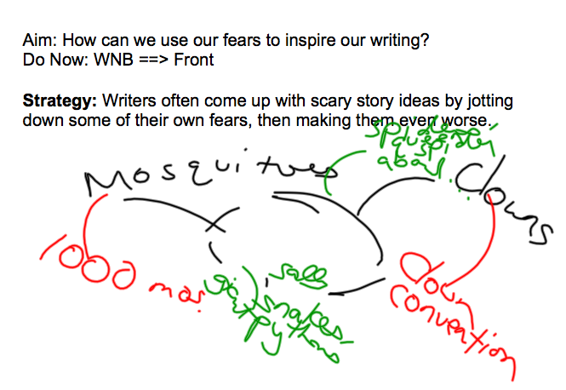
Notes:
Messy brainstorming/seed ideas…this is from my short story ideas. In workshop, I wrote down a few of my fears (mosquitoes, clowns) and made them every scarier. Then had students do it.

Slide 9
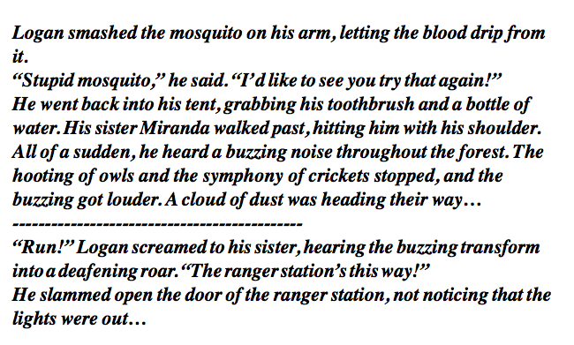
Notes:
Free-writing based on one of my seed ideas—the one on mosquitoes; I do it on the computer because it’s faster than having to write it out, and I can look at students while I’m writing. I switch between Notebook and Microsoft Word, although formatting/indenting is harder with the former (as you can see). I explain to students that they don’t need to write about the whole topic; free-writing is just that, so grammar/spelling is not that important. If they get tired of one idea or get tired of writing that part of the story, draw a line, and start with something else!
Students need to finish their first sentence before they go back to their seats.

Slide 10
What My Writing Workshop Units Look Like
On-Demand Pre-Assessment
Seed ideas
Outlining
1st Draft (skipping lines)
Revision
2nd Draft (typed, double-spaced)
Peer-Editing
Publishing Party/Reflection/Gallery Walk

Slide 11
On-Demand Assessment
Narrative On-Demand:
Write a narrative using what you know about narratives. Make sure you demonstrate what you know about:
• Dialogue
• Thoughts
• Rising conflict
• Description
• Spelling/Grammar
• Starting a story
• Ending a story
Potential start: Rachel heard a noise. She saw the doorknob turn and suddenly realized she wasn’t alone.

Slide 12
On-Demand Assessment
Essay On Demand
Write an essay in which you answer one of these questions.
• Should we have lockers in school? Why or why not?
• Should we have Fridays off? Why or why not?
• Should we have less (or more) homework? Why or why not?
• Why is ------------ better than ---------------?
Use what you know about paragraphs, introductions, conclusions, a thesis, examples/evidence, and reasons to write this essay.
Notes:
Published pieces and/or post-assessments become your pre-assessment for the next related unit.

Slide 13
Potential Seed Ideas
Fantasy Story
  Jot down some problems that teens face. Now put a magical twist on them.
  Draw a map of a potential fantasy place. Now write down a story from it.
Persuasive Essay
  Jot down some things you would change about school, and then write about why it’s important to change them.
  Jot down some of the issues that affect people your age. Write why it’s important and what should be done about it.
Scary Stories
  Jot down some of your fears; now take some of them and make them worse.
  Jot down some places you go to a lot. Write down what scary things could happen there.
Memoir:
  Jot down people who have been influential in your life (in a good or bad way); free-write about them.
  Jot down some lessons you know about life (e.g. “Don’t steal”). Write down where/how you learned them.
Notes:
For most teachers, someone tells us to write a scary story, we can think of thirty ideas right away. Most students, though, are not like us: so we teach them how to do seed ideas, like the one shown about the scary stories. These are just paraphrased…I didn’t go through each of my lessons to find the exact wording.

Slide 14
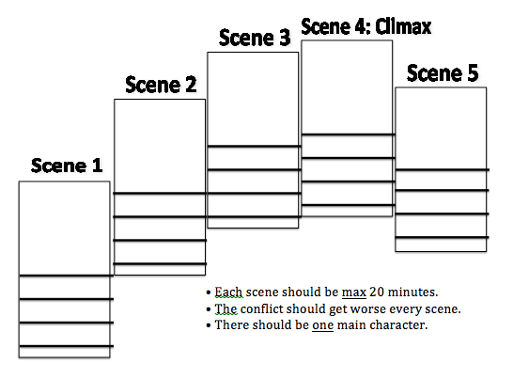
Outlining
Notes:
Outlining is essential for a story or an essay. A day’s worth of outlining saves you form having to read and re-read multiple drafts.
This is from an activity I do on outlining a longer fantasy narrative: Zoom in zoom out; telling vs showing; brushing your teeth is probably a telling moment (if even need be), while a fight scene is showing. This is a story-mountain I combined with storyboards. I limit my students to 4-5 scenes; otherwise they just summarize a story instead of zooming in on important moments, and with 120 students, it’s hard to read long stories that have ten scenes in them. I tell them I’d rather spend the time to focus on five of the most important scenes than have to rush through much longer stories.

Slide 15
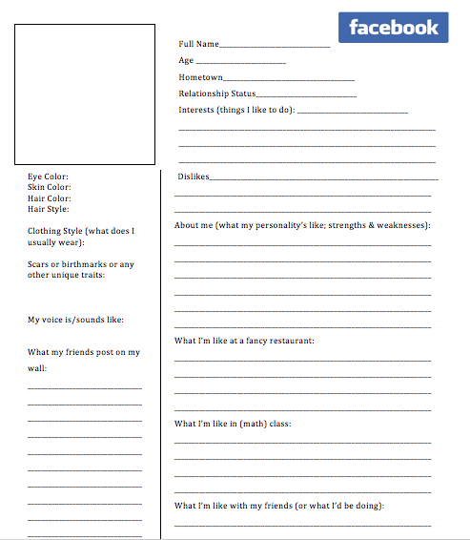
Outlining
Notes:
It’s not just plot! It’s characters too! Students can outline their main characters (or even minor ones) by creating a Facebook profile for them (I made this one, but I’ve seen many other examples online)

Slide 16
Outlining
Activity:
  In your groups, sort the strips into a five-paragraph essay.
Notes:
Hands-On is okay! In this activity, students look at cut-out sentences in a five-paragraph essay and try to organize them by paragraph/topic sentence/thesis/evidence.

Slide 17
Outlining
Students crying. Mountains of homework. Heaps of unfairness. This is what happens in Mr. Chapman’s class. Mr. Chapman is the worst teacher in the world for many reasons.
One reason Mr. Chapman’s the worst teacher is that he locks kids in the closet. For example, one time Justin sneezed without covering his mouth and Mr. Chapman locked him in the closet with no food or water. Another time Antonio dropped his pencil and he was sentenced to three hours in the closet. Finally, when Katie mentioned Justin Bieber she got locked in the closet all day.
Another reason Mr. Chapman’s the worst teacher is that he gives too much homework. One time, for example, he gave twelve hours of reading in one night. Another time he gave us so many books to read that Vasilios collapsed from all the weight in his backpack. Finally, he makes us write four hundred pages a week in our writer’s notebooks!
Lastly, Mr. Chapman’s the worst teacher because he plays favorites with his students. For example, one time he gave Ryan twenty gold cards because he said “bless you,” but he took away all of Daniel’s when he didn’t say “bless you” loud enough. Another time he made Isadora stand on one foot the whole class because she read only 44 minutes, but when Paloma read only 30 minutes he gave her a homework coupon.
In conclusion, Mr. Chapman is the worst teacher in the world because he throws kids in the closet, he gives way too much homework, and he’s unfair to students. He needs to be fired right away.
Notes:
I personally am big on self-disparagement and making fun of myself—it lightens the atmosphere (I still am able to maintain respect though) and lets students feel it’s okay to make mistakes: “We all have ‘dumb’ days.”

Slide 18
I hate Monopoly.
It’s boring. | Everyone always steals from the bank. | I cry every time I lose.
• | • | •
• | • | •
• | • | •
Notes:
Have students sort evidence/statistics into each reason. I might have 14 pieces of evidence/examples, and have students do an activity where they put it under the write reason (with some not being completely extraneous)

Slide 19
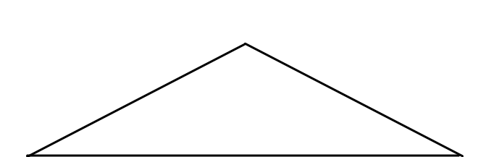





1st Body Paragraph & Topic Sentence
Introduction
Thesis (at end of intro): We need to stop bullying
One reason we need to stop bullying is that it happens too often.
Evidence 1A
Evidence 1B
Evidence 1C
Another reason is that it hurts students emotionally and academically.
2nd Body Paragraph & Topic Sentence
Evidence 2A
Evidence 2B
Evidence 2C
Finally, kids who are bullied are more likely to try to commit suicide.
3rd Body Paragraph & Topic Sentence
Evidence 3A
Evidence 3B
Evidence 3C
Notes:
PowerPoint is your friend! It makes your minilessons stay “mini”! (the things are on the top because they’re in your “penthouse” at the top)

Slide 20


For example, one study shows that “every 7 minutes a child is bullied.”
One reason we need to stop bullying is that it happens too often
According to another study, 282,000 students in middle and high schools are attacked physically every month!
¾ of students will be bullied between kindergarten and 12th grade.
Notes:
If you’re missing evidence, your whole essay collapses! (There should be the sound of a duck quacking here)

Slide 21



A Story Without a Conflict
Two days later, they were still happy. In fact, they were even more happy because they now had a new friend, so they started jumping up and down in happiness.
Notes:
I did this PowerPoint to illustrate how important it was to add a conflict

Slide 22
Zoom in on a scene by adding:
  Play-by-Play Action (little bits of action, step-by-step)
    The monster attacked Raul. Raul stood frozen in fear as it reached out a claw and grabbed his left shoulder, digging its knife-like claws into his skin. Raul let out a muffled scream as the monster lifted him into the air.
  Description
    • Rachel walked into the temple. main chamber of the temple. The vines of Dionysus hung on the decrepit walls and wrapped around the four massive marble columns, almost hiding their cracks. The floor was littered with the rotting skins of grapes, causing the pungent stench of vinegar to pervade the room.
  Thoughts (internal conflict).
    • Will wasn’t sure what to do. If If he ran he might live, but then his friend would be trapped. Would he ever make it out alive either way? He had to make a decision fast!
  Dialogue (but don’t make your characters talk if they don’t)
    She threatened him from the bottom of the castle. she screamed from the bottom of the castle.
Zoom in on a scene by adding:
  Play-by-Play Action (little bits of action, step-by-step)
    The monster took a step toward Raul and let out a roar. Raul stood frozen in fear as it reached out a claw and grabbed his left shoulder, digging its knife-like claws into his skin. Raul let out a muffled scream as the monster lifted him into the air.
  Description
    Rachel walked into the expansive main chamber of the temple. The vines of Dionysus hung on the decrepit walls and wrapped around the four massive marble columns, almost hiding their cracks. The floor was littered with the rotting skins of grapes, causing the pungent stench of vinegar to pervade the room.
  Thoughts (internal conflict).
    Will wondered what he had to do. If he ran he might live, but then his friend would be trapped. Would he ever make it out alive either way? He had to make a decision fast!
  Dialogue (but don’t make your characters talk if they don’t)
    “One of us is going to die today!” she screamed from the bottom of the castle. “And it’s going to be you!”
Notes:
This is a sample from my “Stretching Out a Scene” PowerPoint

Slide 23
Let’s Expand This
Simba fought Scar and became king.
Notes:
Same as previous

Slide 24
Let’s Expand This
Scar swept the embers into Simba’s eyes. Simba howled in pain as his enemy pounced on him. Simba wrestled him to the ground, but quickly was thrown off him.
Suddenly, they both charged toward each other. They grappled. Scar smashed his paw into Simba’s face, who then returned the blow.
Notes:
Actions

Slide 25
Let’s Expand This
Scar swept the burning embers into Simba’s eyes. Simba howled in pain as his enemy pounced on him, Scar’s fierce eyes glowing in the firelight. Simba wrestled him to the ground, but quickly was thrown off him. The crackle of burning bushes filled the air while the embers of the fire danced around them.
Suddenly, they both charged toward each other, their faces twisted in anger. They grappled. Scar smashed his paw into Simba’s face, spraying blood from the wound, who then returned the blow.
Notes:
Description

Slide 26
Let’s Expand This
Scar swept the burning embers into Simba’s eyes. Simba owled in pain as his enemy pounced on him, Scar’s fierce eyes glowing in the firelight. Simba felt the adrenaline rush through him as he realized his uncle would never fight fair. He wrestled Scar to the ground, but just as quickly was thrown off him. The crackle of burning bushes filled the air while the embers of the fire danced around them.
Suddenly, they both charged toward each other, their faces twisted in anger. They grappled. Scar smashed his paw into Simba’s face, spraying blood from the wound. It felt like his face was on fire, but he managed to return the blow.
Notes:
Thoughts/internal monologue/feelings

Slide 27
Let’s Expand This
“Run away, Scar,” Simba uttered with disdain, “and never return.”
Scar’s face expressed his disappointment, before regaining its fierce look.
“As you wish…your majesty!”
Scar swept the burning embers into Simba’s eyes. Simba howled in pain as his enemy pounced on him, Scar’s fierce eyes glowing in the firelight. Simba felt the adrenaline rush through him as he realized his uncle would never fight fair. He wrestled Scar to the ground, but just as quickly was thrown off him. The crackle of burning bushes filled the air while the embers of the fire danced around them.
Suddenly, they both charged toward each other, their faces twisted in anger. They grappled. Scar smashed his paw into Simba’s face, spraying blood from the wound. It felt like his face was on fire, but he managed to return the blow.
Notes:
Dialogue

Slide 28
Expand This On Your Own
Rocky and I got into a fight yesterday. He called me dumb and then I punched him.
Notes:
Again, relatively short PowerPoint, then students spend rest of independent time expanding a scene. Because it’s a difficult concept, I do this for two days, and during the second day’s independent time, students expand their own stories.

Slide 29
Revision
Revision is when I remind students of strategies from before, while also introducing a few new ones:
  Adding scene/character description, dialogue, internal conflict, suspense; expanding important scenes
  Adding an effective hook/intro
  Word choice
  Adding transitions (especially for essays) and topic sentences
  Double-checking that evidence is in the right spot
I often have students do their editing on “spider strips”
Notes:
Spider strips! Model lesson. Spider strips are where you cut out strips of paper and let students add description/action/etc. to it and then tape it where they need it to go. Their drafts should look like spiders after a while! (Credit for this idea comes from Cia—can’t remember her name—from Teacher’s College)

Slide 30
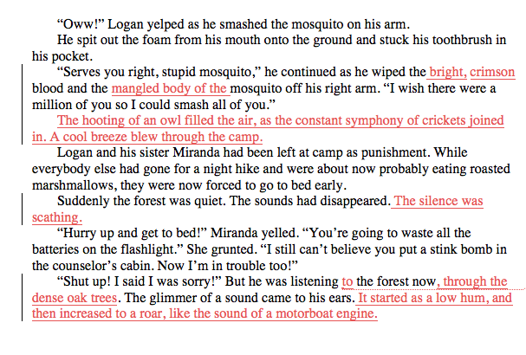
Revision
Notes:
The pink is what I modeled adding in front of them using “tracked changes” (another reason modeling on a computer is great, since it’s easier to see changes and you can email this to students as a model). Here, I was modeling how to add dark sensory description to a scene: what do you hear? See? Smell?

Slide 31
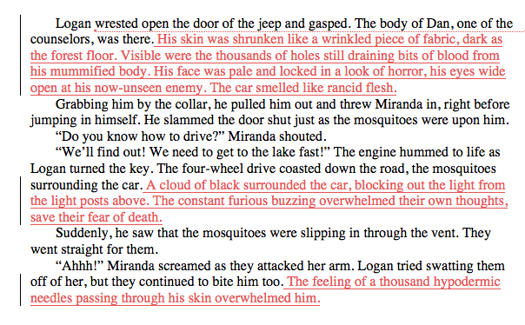
Revision
Notes:
This is what they helped me add.

Slide 32
Peer-Editing
Partnerships are important throughout the writing process, especially to bounce ideas off of each other. This phase, though, is when students know their grades are at stake. 2-3 people should read their 2nd drafts.
  I remind my students that this is the time to be completely honest with their partners, to “tell them when they have spinach in their teeth,” because if they’re not honest, I’m definitely going to be.
  I also remind them to read their stories out loud, even if they’re just moving their lips, to find errors.
Notes:
Hands-On is okay!

Slide 33
Notes:
I give students clear rubrics beforehand, and assess based on the lessons I’ve taught that unit. Each category could be more or less at least one mini-lesson.

Slide 34
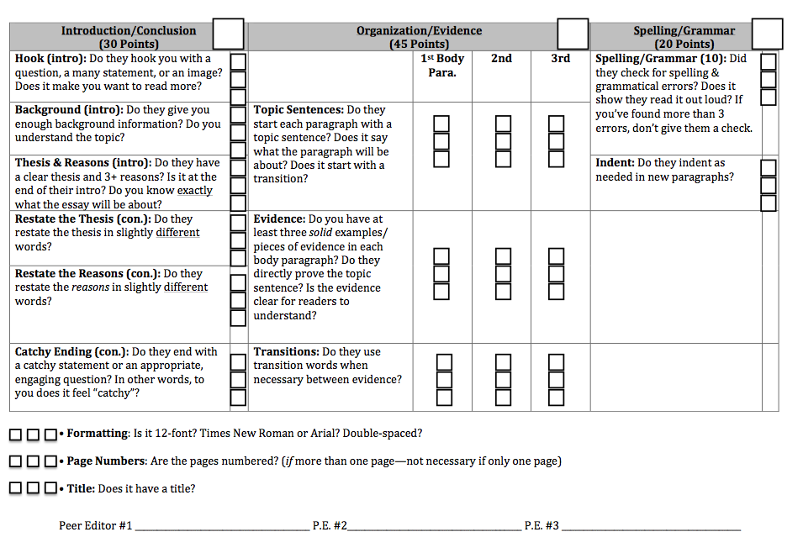
Notes:
This is a peer-editing sheet based on a newer version of the previous rubric. It’s a simpler “yes or no” peer-editing sheet, but still follows the same basic format.

Slide 35
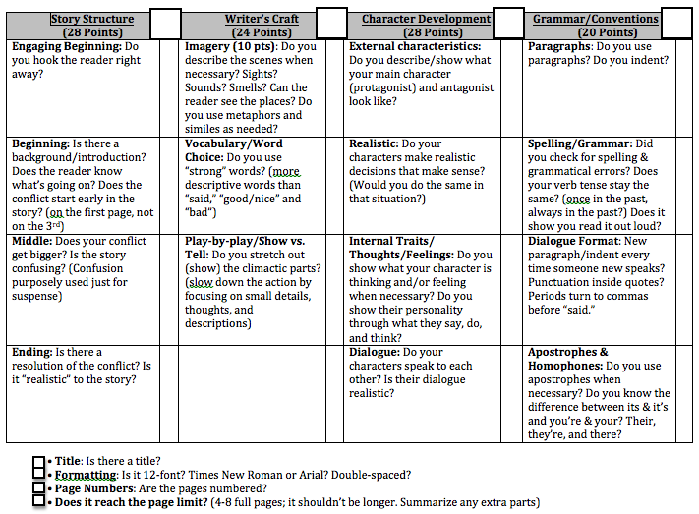
Notes:
Rubric for realistic fiction, although I adapt most categories for all types of narratives

Slide 36
Publishing
When students’ final drafts (or “published pieces”) are ready, I usually hold a “publishing party”
  I spend about ten minutes having them reflect on their pieces next to their earlier On-Demand pieces, then attaching the reflection (and the rubric) so it can go in their portfolio
  Then I have a “Gallery Walk,” where students go around silently reading, then writing positive comments on post-its or on a sheet of paper
  The final 10 minutes, I give students (iced) tea and (bundt) cake.
Notes:
I feel it’s doing a disservice if they have to listen to every person read their story.
-Some teachers turn it into a huge potluck; I prefer to keep the food/drink as a small part of it
-I usually read their published piece, then give them a chance to revise after for an averaged grade. I need to start doing that after 2nd drafts, just time-wise it’s difficult to get it back in time. If they don’t revise after you look at it though, it’s hard for them to remember what you talked about

Slide 37
Themes That Have Worked Well For Me
Translation
  It’s all in your head until you translate it onto the page. Our goal this year is to get you to translate what’s in your head as accurately as possible onto the page.
Writers are jerks!
  We take a perfectly happy character and give them a problem. And not only that, we make that problem get worse!
We’re all writers
  “I’ve been writing for most of my life and I still make mistakes, I still have so much I can improve on.”
Empathy
  Writers should always consider the reader’s point of view. What does the reader need to make this story come to life or this essay be convincing? (Pretend the reader knows little about pollution, or Lord of the Rings)
Notes:
Leads into expanding a scene with action and description (the reader doesn’t know if you don’t show them); I show them PowerPoints of stories without a conflict

Slide 38

What It Really Looks Like
Notes:
For my presentation, I showed them a video of me teaching that I did for my National Board Certification. For privacy reasons, I can’t show the video—has my students’ faces in it.

Slide 39
Conferencing
It’s easier said than done: it takes a lot of time, especially as you’re getting used to it
Tips:
  Computer documentation: easy to copy and paste specific strategies

Slide 40
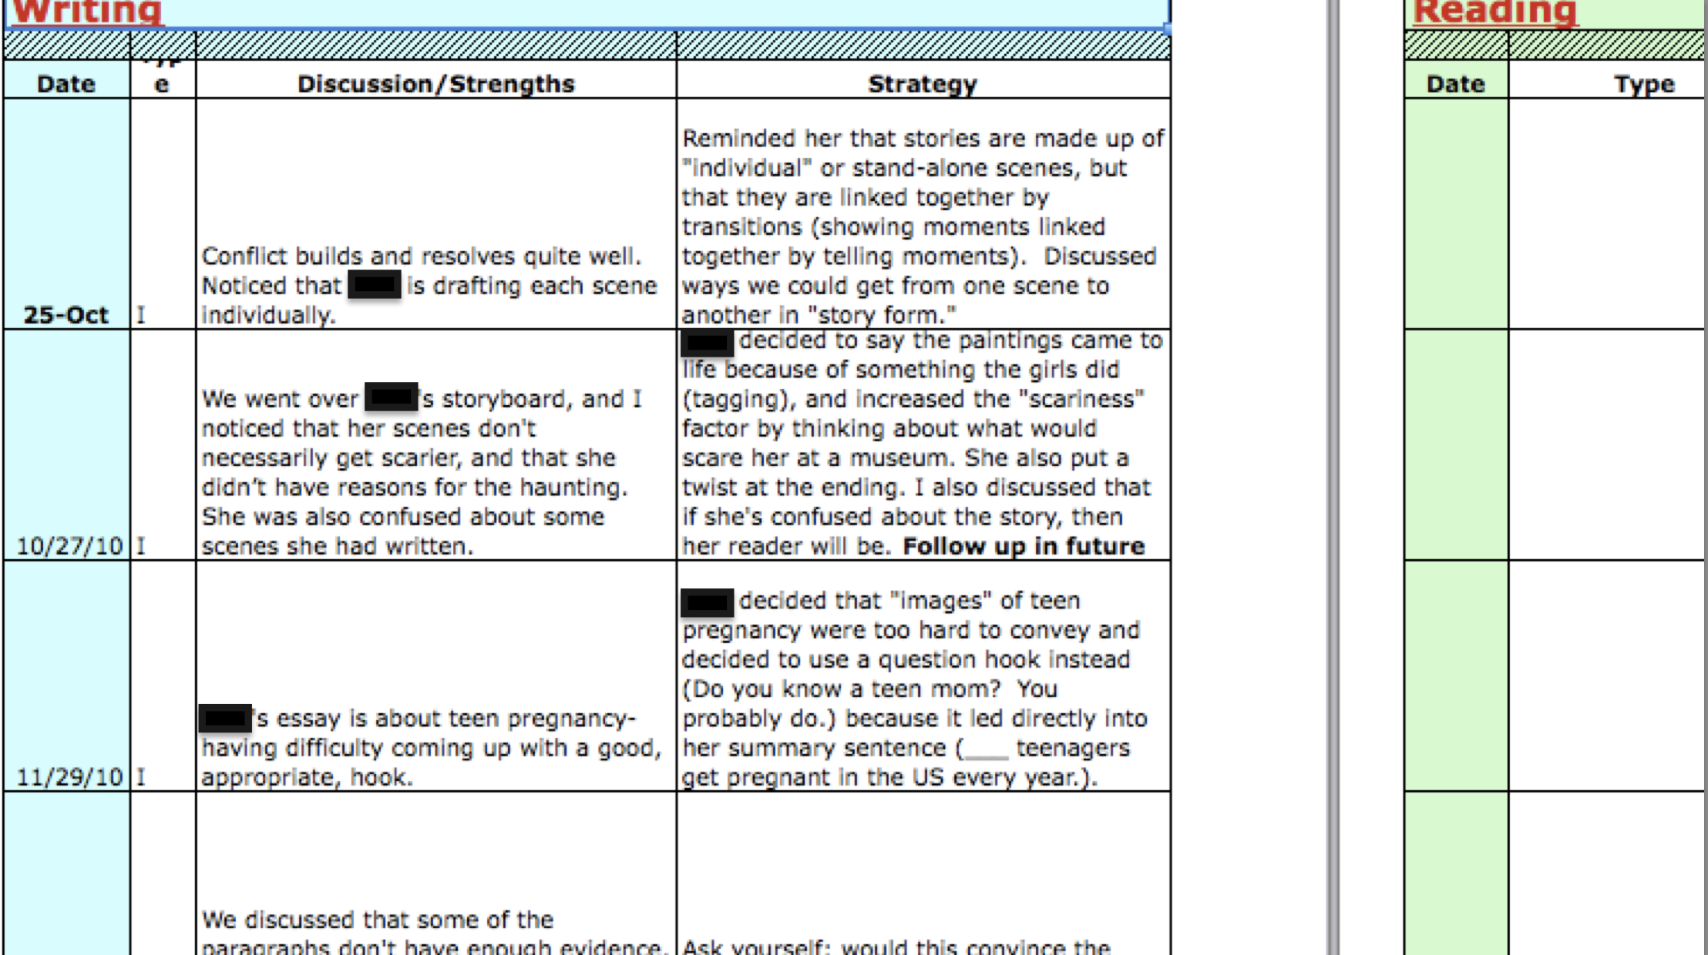
Excel and Google Docs are your best friends

Slide 41
Conferencing
It’s easier said than done: it takes a lot of time, especially as you’re getting used to it
Tips:
  Computer documentation: easy to copy and paste specific strategies
  Writer’s Notebooks/Journals: Offer a perfect, non-stress opportunity to assess as groups
  Thumbs Up/Thumbs Down: Ask students at the end of the lesson to show you with their thumbs, “Do you know what you’re going to write about when you get back to your seat?” or “How well did you understand the lesson?”
  When you read on-demands or published pieces, have a sheet of paper to write down what students need help with what: you’ll have instant conference/pull-out groups
  Be okay with refusing to answer student questions: otherwise you’ll have no time for planned conferencing because you’ll always be putting out “small fires,” and students won’t learn independence.
Notes:
I usually have students turn in 5-10 pages of free-writing every 2-3 weeks by class and table, and then write comments on it with post-its. For the most part, I don’t do corrective comments

Slide 42
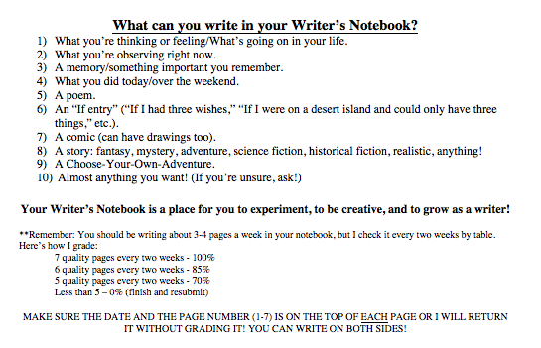
Homework/Journaling
Notes:
I usually have students do most of their published pieces in class. Their homework is usually independent reading and free-writing. I have students keep a journal in their writer’s notebook and turn it in every two weeks by class and table (10th grade one week, Table 1 on Monday, Table 2 on Tuesday, etc.). I adjust the pages depending on student handwriting size, holidays, and other exams/projects they might have on their plates.

Slide 43
Homework/Journaling
Rationale:
  Students practice their writing—practicing alone increases their fluency and writing skills (and they can reflect on their growth at certain points).
  Because it’s not being graded on grammar/punctuation, students feel more free to experiment (I write my comments on post-its, too, to emphasize that this is solely their writing).
  It allows me to regularly assess their writing, which inform my individual conferences, groups to pull, or entire class lessons, as well as my DOL.
  You build subtle rapport with your students with your comments, and find individualized ways to connect with your students.
  For students who write about emotional/family issues, it gives you an opportunity to offer help and/or refer them to the guidance counselor.
Notes:
-D.O.L. = Daily Oral Language (2-3 times a week, students for their “Do Now” spend 3 minutes correcting a certain number of errors in 2 sentences, then we spend 2 minutes going over it; traditional, yes, but I’ve found it helps immensely when I design them based on my students’ errors

Slide 44
Environment
More than anything else, to make writing workshop successful you need to create an atmosphere of “reading and writing happen here on a daily basis.”
Ways to do that:
  Put up posters of lessons/strategies
  Copy a page from each student’s writer’s notebooks and put it on the bulletin board
  Have a poster that you change every two weeks with something you’ve written in your “notebook”
  Refer to students as “writers” when you can
Notes:
-Make sure the page you put up from their writer’s notebooks isn’t personal; make sure that *every* student gets their page up there
-It sounds corny—”writers”--but it actually works

Slide 45
Final Thoughts
In a lot of ways, the workshop model requires much more work than a “traditional” one
  Not just mini-lesson: conferencing, note-taking, pre-assessments, group work
Students don’t need to use the strategy when they go back to their seats
  The goal is for students to have a large “toolbox” of options so they can work independently; encourage students to experiment: “If you have another way to hook the reader/add description/etc., great!”
Having students write for younger grades is an amazing way to inspire and motivate
  When they know they have other people looking up to them, it makes a huge difference!
Be prepared to “break” the model
  It’s not set in stone: use your instincts
Notes:
One of the greatest problems I’ve seen in people using the workshop model is that it ends up being the end-all/be-all in their classrooms; it shouldn’t be. Trust your instincts. If you think your mini-lesson should go on longer, great! If you think students need some more time on something, great! You are intelligent enough to be a teacher—you know deep down what works for you and your students.

